Slide 1
Unit 8 Have A Good Habit
第二课时
WWW.PPT818.COM

Slide 2
1
Be able to read!
Objectives:
2
Be able to listen!
3
Be able to understand!
4
Be able to communicate!

Slide 3
Warm-up 1
Do you have a good habit? What are good habits?
Discuss with your partner!

Slide 4
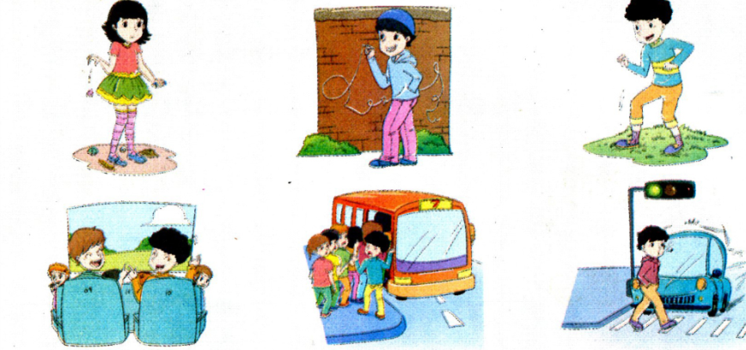
Warm-up 2
Think and Tick or Cross
Do you often do that?

Slide 5
Warm-up 3
Talk in pairs and group the pictures
Good habit | Bad habit

Slide 6
Warm-up 3
Talk in pairs and group the pictures
Good habit | Bad habit

Slide 7
Let's Learn!

Slide 8
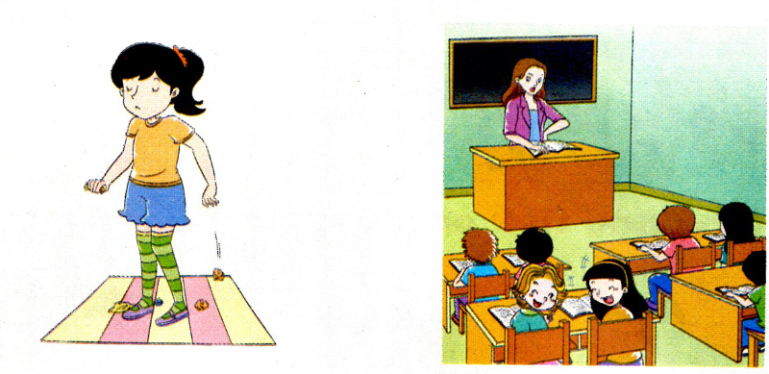
Let's Learn！
litter on the floor
talk loudly in class

Slide 9
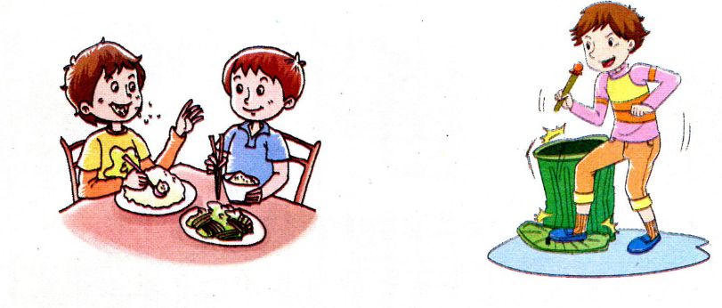
Let's Learn！
speak with mouth full
make a noise

Slide 10
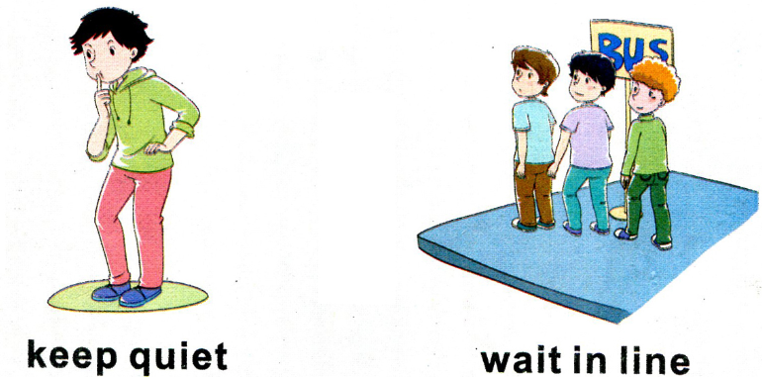
Let's Learn！
wait in line
keep quiet

Slide 11
Let's Talk!

Slide 12
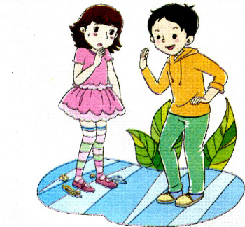
Let's Talk!
Su Nan: Don't litter on the floor. It's a bad habit.
Girl: I'm sorry.

Slide 13
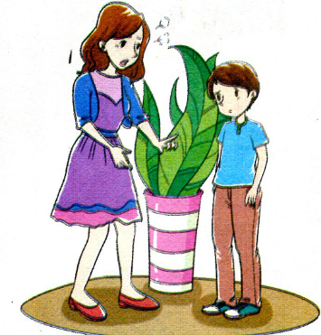
Let's Talk!
Mom: You shouldn't tel lies. It's a bad habit.
Boy: I'm sorry. I won't.

Slide 14
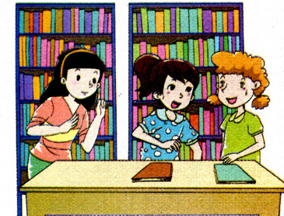
Let's Talk!
Li Shan: We shouldn't make a noise in the library. We'd better keep quiet and we should have a good habit.
Girls: All right.

Slide 15
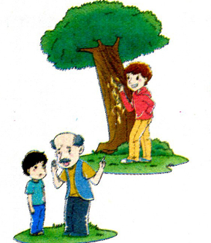
Let's Talk!
Grandpa: The boy shouldn't write on the tree. We should take care of trees and have a good habit.
Boy: I see.

Slide 16
Let's Practice!

Slide 17
Let's Talk!
Talk with your partner using the sentences above!

Slide 18
请课后认真朗读单词课文，在记忆的基础上运用词句进行对话！

