Slide 1
Unit 12
Christmas is coming
WWW.PPT818.COM

Slide 2
本课时目标：
1. 学生能听说读以下新词：
December, already, soon, lot, lots of, dress up,
as, Christmas
2.学生能听懂及使用询问 圣诞节做什么事情的句型及回答：
What do you like doing for Christmas?
I / We like .... He / She likes ....
3. 学生能理解课文意思，能用正确的语音语调流利地朗读课文，
并能扮演课文对话。

Slide 3
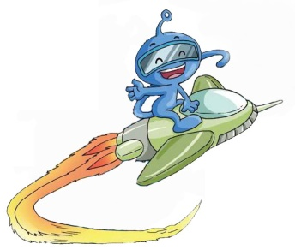
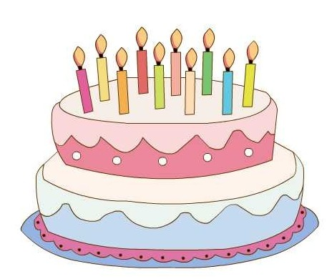
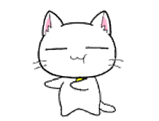
Let’s sing
（播放金太阳或者录音带）
Happy birthday
Happy birthday to you!
Happy birthday to you!
Happy birthday, dear Amy!
Happy birthday to you!

Slide 4
Let’s talk
A: When is your birthday ?
Is it in Janurary ?
B: Yes , it is .
/ No , it isn’t .

Slide 5
Let’s talk
My birthday is in December.
De
cem
ber
December
十二 月
December

Slide 6
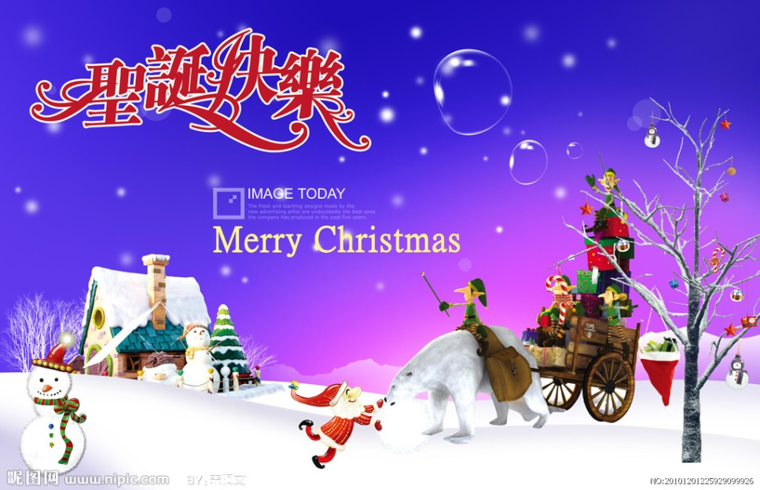
Let’s learn
It's December already.
Which holiday is coming soon?
Christmas

Slide 7
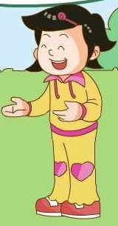
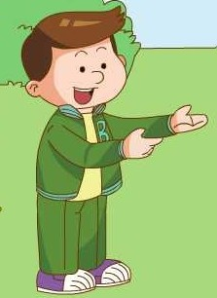
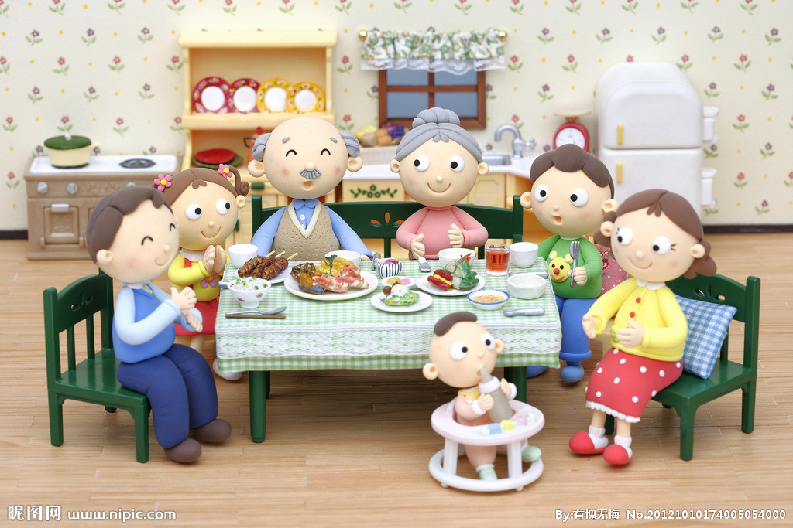
Let’s talk
A: What can you do at Chritsmas?
B: I can
have a big family dinner.

Slide 8
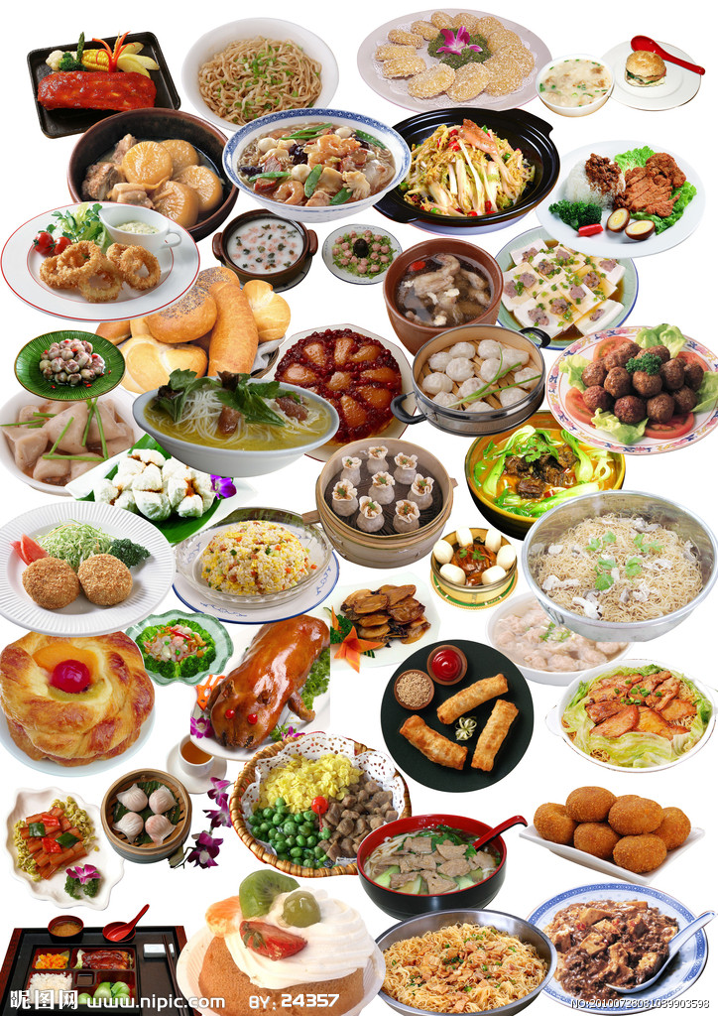
Let’s talk
A: What can you do at Chritsmas?
B: I can
eat lots of great food.

Slide 9
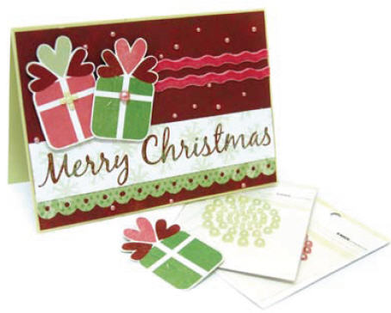
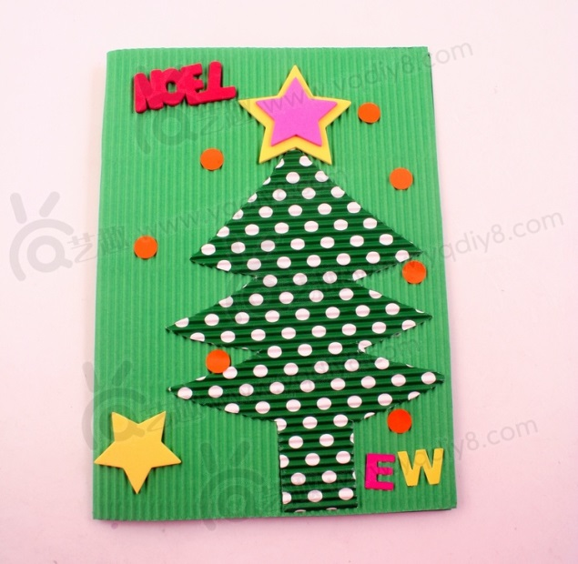
Let’s talk
A: What can you do at Chritsmas?
B: I can
make Christmas cards.
Christmas cards

Slide 10
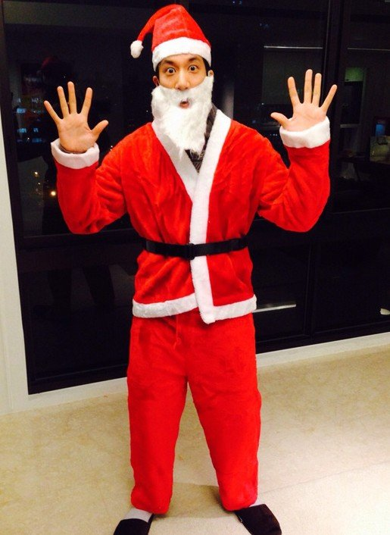
Let’s talk
A: What can you do at Chritsmas?
B: I can
dress up as Father Christmas.
Father Christmas

Slide 11
Practice the phrases.
have a big family dinner
eat lots of great food
make Christmas cards
dress up as Father Christmas

Slide 12
Christmas is coming.
What do you like doing for Christmas?

Slide 13
Let’s learn.
A: What do you like doing for Christmas?
B: I like
having a big family dinner.
We like having a big family dinner with lots of great food.

Slide 14
A: What do you like doing at Chritsmas?
B: I like
dressing up like Father Christmas.
My father likes dressing up as Father Christmas.

Slide 15
A: What do you like doing for Christmas?
B: I like
making Christmas cards for my friends.
B: Here's one for you!

Slide 16
Practice the dialogue.
A: What do you like doing for Christmas?
B: I like …ing …….
having a big family dinner
eating lots of great food
making Christmas cards
dressing up as Father Christmas

Slide 17
Let's learn the dialogue

Slide 18
Listen for the first time,
tick or cross.
(1) It's November already. ( F )
(2) Christmas is in December. ( T )
(3) Ben likes making Christmas cards. ( F )
(4) Janet's father likes dressing up as Father Christmas. ( T )
(5) Ben likes having a big family dinner at Chritstmas. ( T )

Slide 19
Listen for the second time, fill the blanks.
A: It's December soon.
What do you like doing for Christmas?
B: I like having a big family dinner with lots of food.
A: My dad likes dressing up as Father Christmas.
B: I like making Christmas cards for my friends.
Here's one for you.
A: Thank you!

Slide 20
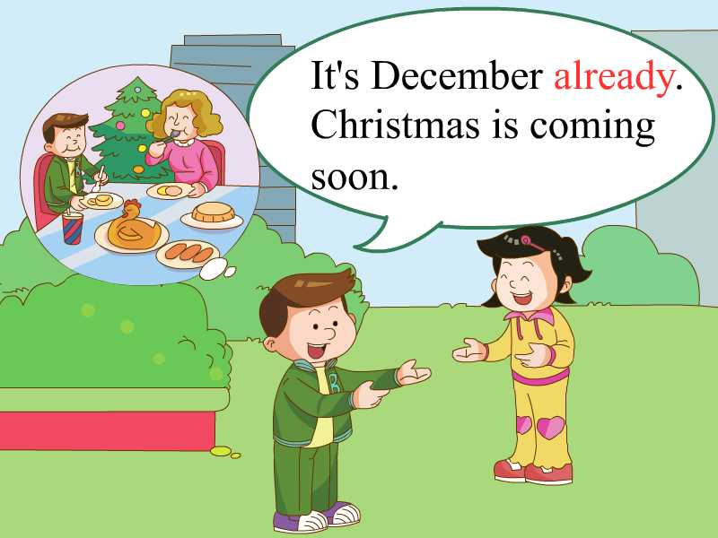
Listen for the third time,
read after the tape.

Slide 21
What do you like doing
for Christmas,Ben?

Slide 22
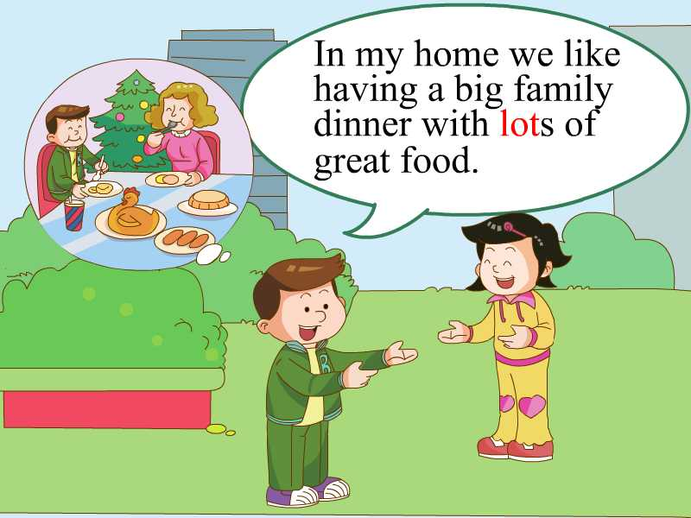

Slide 23
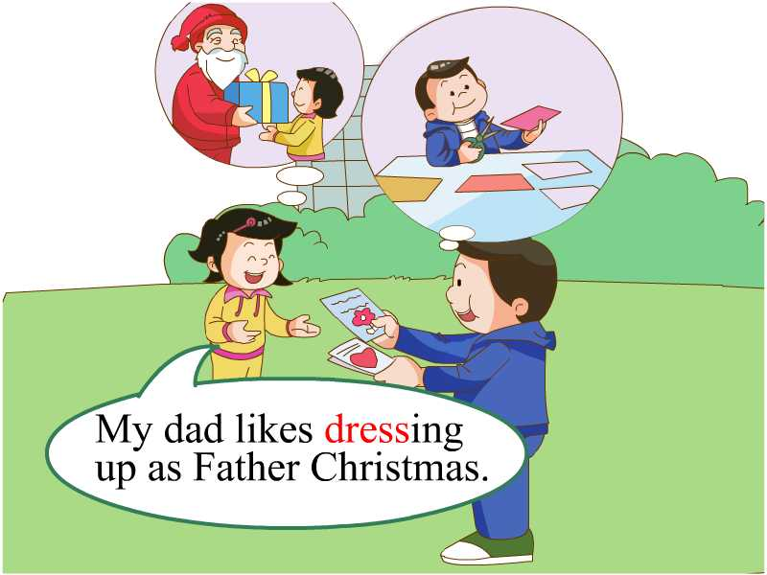
What about you, Jiamin?

Slide 24
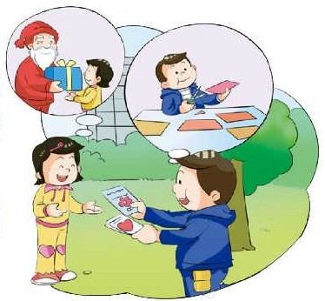
I like making Christmas
cards for my friends.
Here is one for you.

Slide 25
Thanks, Jiamin.

Slide 26
(发展部分：四人小组分角色扮演课文对话。）
Act the dialogue!

Slide 27
Let’s guess
在引入部分，老师先提问学生When is your birthday?
然后让学生猜老师的生日是在几月份，如：Is it in ...?
老师：Yes. / No.
老师最后自述：My birthday is in December.
And it's December already. (引入本课学习）

Slide 28
Let’s guess
(引入句型学习前，先设置一个情景，如：Christmas is coming, some children are going to have a Christmas party. Do you know what they like doing for Christmas? 老师提问，学生回答，如不会用like句型回答，可直接猜短语，如答对，则给予适当鼓励。
T：Who is he?
What does he like?
dress up like Father Christmas
have a big family dinner
make Christmas cards

Slide 29
Let’s interview
本环节，设小玲为小记者，采访小朋友们喜欢在圣诞节做什么事情，为学习新句型做铺垫。

Slide 30
Homework:
1. A本抄U12新词，每词3遍。
2. 听、读、背U12课文。

