Slide 1
Module 10 Unit 1
We’re going to different schools.
WWW.PPT818.COM

Slide 2
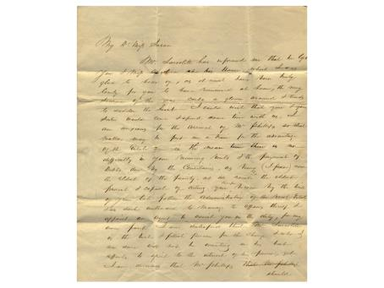
复习
This is a letter. Please describe the structure of letters.

Slide 3
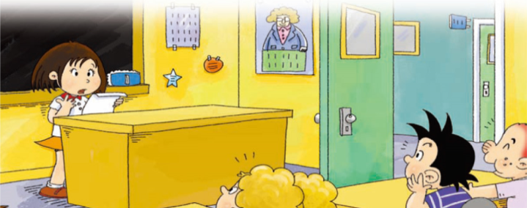
呈现
Lingling is going to leave her primary school. What is she doing? Let’s see.

Slide 4
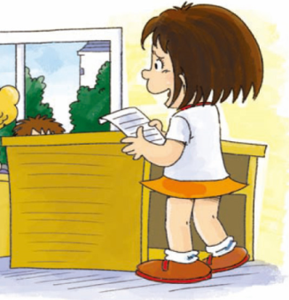
Why is Linging excited?
Because they are going to study Chinese, English, Maths, History, Geography, and learn lots of new things in middle school.

Slide 5
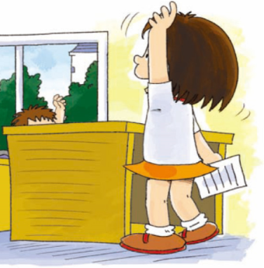
Why is Lingling sad?
Because she has to say goodbye to her classmates and they are going to different schools.
Can Sam and Amy say a lot Chinese now?
Yes, they can.

Slide 6
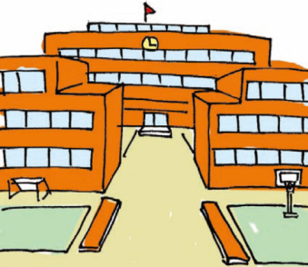
Listen and say
We’re going to leave our primary school soon and start middle school this September.

Slide 7
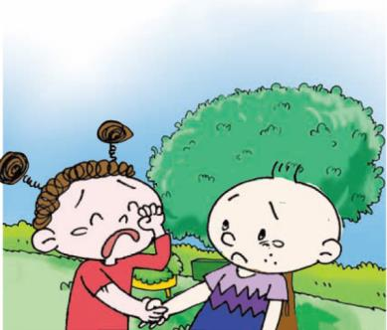
I’m very sad to say goodbye to you. We’re going to different schools.

Slide 8
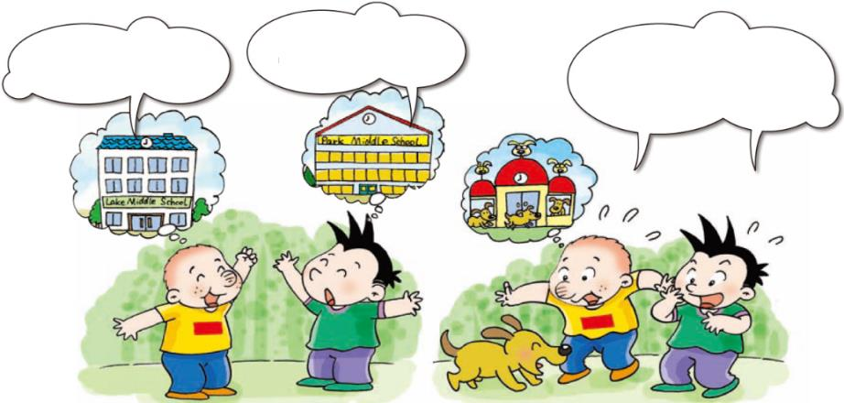
操练
I’m going to Park Middle School.
Are you going to
Dog Middle School?
Ha ha...
I’m going to Lake Middle School.

Slide 9
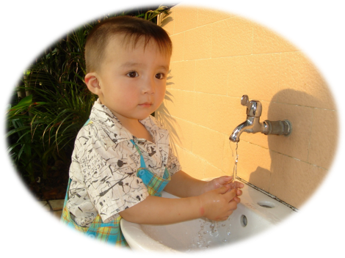
I’m going to wash my hands before dinner.
实际运用
I’m going to sing songs.

Slide 10
What are you going to do?
I’m going to do my homework.

Slide 11
What are you going to do?
I’m going to brush my teeth after dinner.

Slide 12
I’m going to play the guitar after school.
What are you going to do?

Slide 13
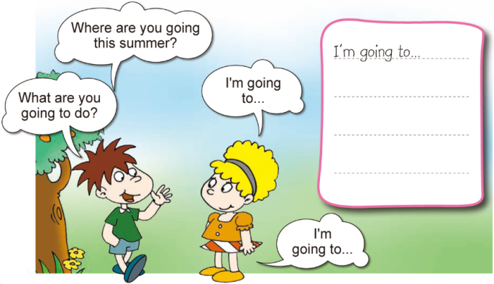
游戏
Talk and write.

Slide 14
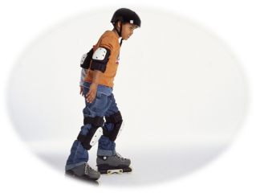
巩固评价
Let’s practice!

Slide 15
Homework
1.完成 配套练习。
2.记诵本课出现的生词和句型。

