Slide 1
Lesson 28 The Study of Living Things
WWW.PPT818.COM

Slide 2
Think About It!
1. Would you like to be a biologist when you grow up? Why or why not?
2. What mysteries of nature do you know about?

Slide 3
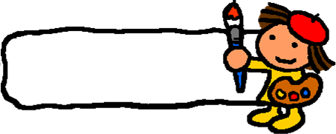
New words
Chip Taylor 奇普﹒泰勒
biology n. 生物
butterfly n.蝴蝶
migrate v. 迁徙
completely adv. 完全地
grandchild （外）孙子；（外）孙女
female n. 女子
milkweed n. 马利筋
chemical n. 化学物质
puzzling adj. 令人费解的

Slide 4
Listening Task: true or false
( ) 1. Dr. Chip Taylor studies a kind of Canadian butterfly.
( ) 2. The butterflies travel south in fall.
( ) 3. About 230 million butterflies spend the winter in in Mexico.
( ) 4.Scientists don’t know how the butterflies know when to fly south.
F
T
T
T

Slide 5
Reading Task: Read and finish Exercise 1 on Page 73.
Then try to retell it.

Slide 6
Language Points
1. Fantastic facts about the butterfly have been drawing Dr. Taylor’s attention. 这些关于蝴蝶的神奇的事实一直吸引着泰勒博士的注意。
draw one’s attention意为“吸引某人的注意”，attention是名词，意为“注意”，为不可数名词，one’s需根据主语做适当变化。
The music drew the girl’s attention. 这首音乐吸引了小女孩的注意。

Slide 7
2. Here, as many as 230 million butterflies spend the winter. 在这里，多达两亿三千万只蝴蝶过冬。
as many as意为“多达”，修饰复数名词。as…as意为“和……一样”，为同级比较，中间要用形容词或副词的原级。其否定形式为not as/so+形容词/副词+as。
The film is as interesting as that one. 这部电影和那部电影一样有趣。
I can’t sing so well as you. 我不能和你一样唱得好。

Slide 8
3. The butterflies that return to the south are the great-great grandchildren of the butterflies that left for the north. 这些飞回南方的蝴蝶是春天飞往北方蝴蝶的曾曾子孙。
1）that return to the south和that left for the north均为定语从句。
2）leave for意为“前往”，“leave+地点”则表示离开某地。
They left for Shanghai yesterday. 他们昨天去上海了。

Slide 9
Practice
根据句意及提示补全单词
1. We spent a _______ (奇异的) weekend in Paris.
2. There are many _________ (mystery) to be discovered by us.
3. I trust my friend __________ (complete).
4. Winter is a season for many birds __________ (migrate) south.
fantastic
mysteries
completely
to migrate

Slide 10
THANK YOU

