Slide 1
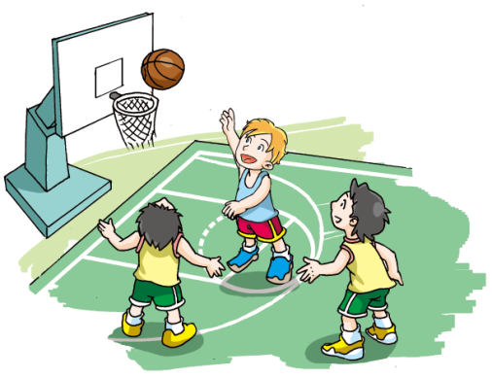
Sport
5
第三课时
WWW.PPT818.COM

Slide 2
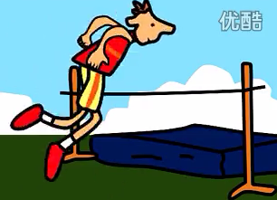
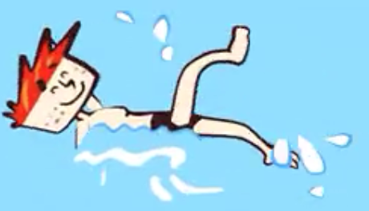
He is good at________.
She is good at _________.
jumping
running
swimming

Slide 3
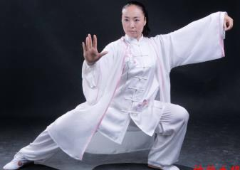
He is good at_______.
She is good at _______.
playing
Taichi
weight lifting

Slide 4
Homework
Read your story to your parents.
Read the story :
A slow and sticky crazy sports day.

