Slide 1
Unit 4 Topic 1
Which do you like better, plants or animals? Section A
WWW.PPT818.COM

Slide 2
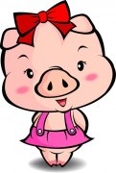
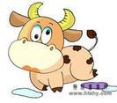
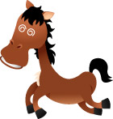

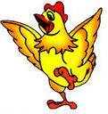



Animals on the farm
a pig
a cow
a horse
a rabbit
a hen
a cat
a dog
a duck

Slide 3
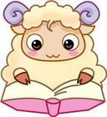


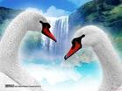

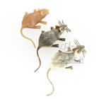
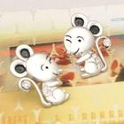
Attention
a sheep
four sheep
a goose
two geese
a mouse
five mice

Slide 4
Compare
smallest
small
smaller

Slide 5
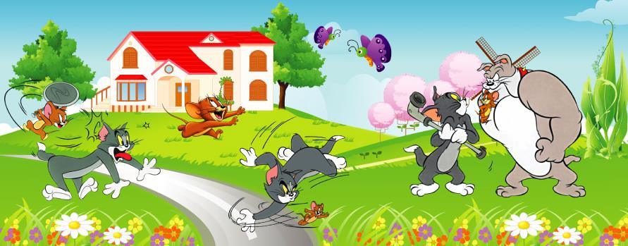
Learn Together
The dogs are small.
The cats are smaller.
The mice are the smallest.

Slide 6
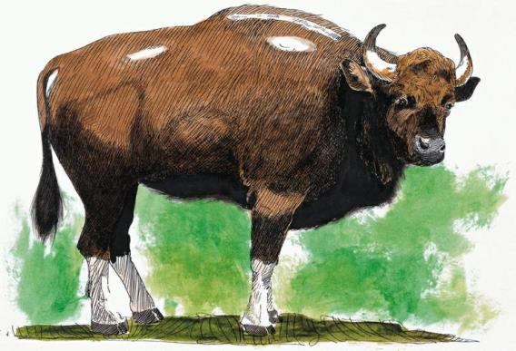

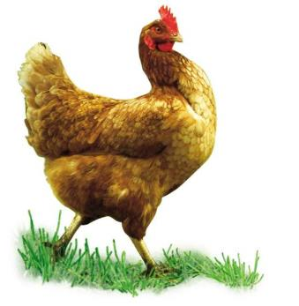
What can we see in the countryside?
countryside n. 农村，乡下
horse
hen
cow

Slide 7
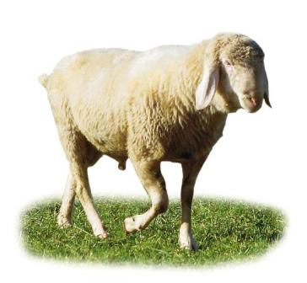


sheep
What can we see in the countryside?
some sheep

Slide 8
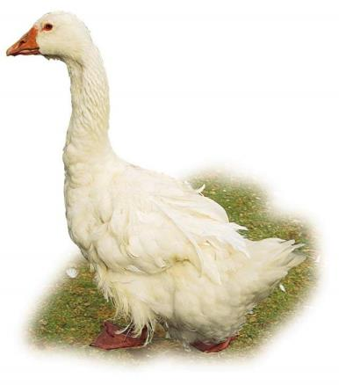

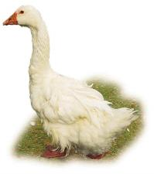
goose
What can we see in the countryside?
some geese

Slide 9
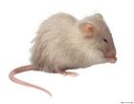
mouse
What can we see in the countryside?
some mice

Slide 10
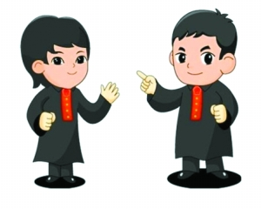
Do you like these animals ?
Yes, I do.
Where do you want to live ?
Can you see them in the cities ?
No, I can’t.
I want to live in …

Slide 11

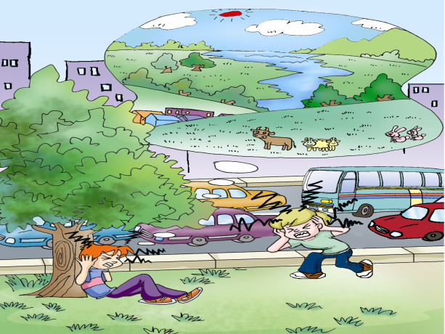
Does Wang Wei like the countryside or the city? Now, watch the flash of 1a, and find out the answer.
1a

Slide 12


1b
Listen to 1a and check the words you hear.
_____ fresher _____ busier _____ bluer
_____ taller _____ bigger _____ clearer
_____ nicer _____ quieter _____ noisier
Now, look at the pictures and say something about the countryside and the city.

Slide 13
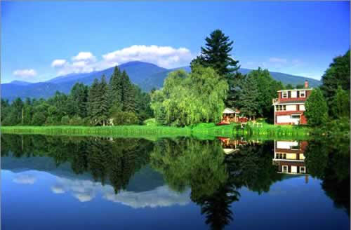
countryside
The air is fresh.
The sky is blue.
The trees are green.
It’s quiet in the countryside.
The river is clear.

Slide 14
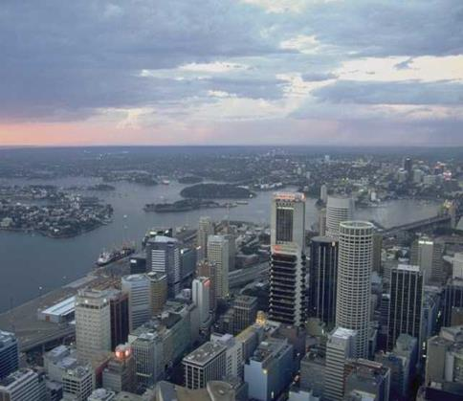
The air is dirty.
city
It’s noisy in the city.
The river is dirty.
The roads are wide.
The traffic is busy.
The buildings are tall.

Slide 15
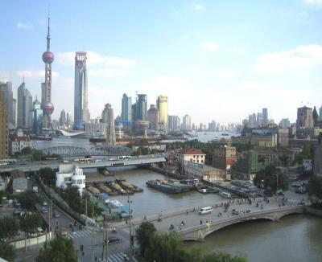
clearer
The air in the countryside is ______
The sky in the countryside is ______
The river in the countryside is ______
The trees in the countryside are _______ than those
in the city.
It’s ________ in the countryside than in the city.
fresher
bluer
than that in the city.
greener
quieter

Slide 16


1c Listen again and fill in the blanks. Then read it aloud.
Wang Wei likes the countryside very much because he thinks the air is _________, the sky is _______ and the rivers are ________ there. Michael thinks the countryside is much ________ than the city, too, so people can enjoy the beauties of nature. Wang Wei goes to the countryside every year for his summer holiday.
fresher
bluer
clearer
quieter
所填单词有什么特点？

Slide 17
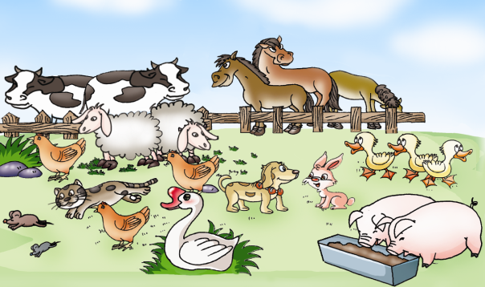
2a
Listen to the conversation and fill in the blanks.
One day, the children were visiting a farm.

Slide 18
Answers to 2a:
taller stronger
shorter nicer
cuter better
Let’s talk about the other animals on the farm.

Slide 19

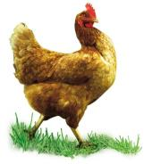
small big
？
？
The hens are smaller than the geese.
The mice are smaller than the hens.
The mice are the smallest of all.
<
<

Slide 20


>
small big
？
？
The hens are bigger than the mice.
The geese are bigger than the hens.
The geese are the biggest of all.
>

Slide 21


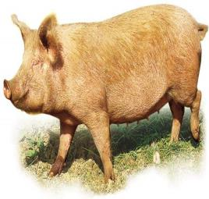

thin
？
The ducks are a little thinner than the geese.
<
The ducks are much thinner than the pigs.
<
thin adj. 瘦的；薄的；稀的

Slide 22

单音节及部分双音节形容词比较级（- er）和最高级
（- est）的规则变化。
2b
下列形容词比较级和最高级变化有什么规律？
Adjective | strong | tall | nice | brave
Comparative | stronger |  | nicer
Superlative | strongest |  | nicest
Adjective | big | fat | thin | lazy | ugly
Comparative | bigger |  |  | lazier
Superlative | biggest |  |  | laziest

Slide 23
单音节及部分双音节形容词比较级（- er）和最高级（- est）的规则变化。
1. 一般在词尾直接加er/est: tall—taller—tallest
2. 以e 结尾的单词去e加er/est: wide—wider—widest
3. 以辅音字母加y结尾的单词，把y改成i, 再加 er/est : busy—busier—busiest
以重读闭音节结尾，且末尾只有一个辅音字母的单
词，双写末尾的辅音字母，再加er/est :
big—bigger—biggest , (fat, thin, red, hot)

Slide 24
单音节及部分双音节形容词比较级（- er）和最高级（- est）的规则变化。
2b
下列形容词比较级和最高级变化有什么规律？
Adjective | strong | tall | nice | brave
Comparative | stronger |  | nicer
Superlative | strongest |  | nicest
taller
braver
tallest
bravest
Adjective | big | fat | thin | lazy | ugly
Comparative | bigger |  |  | lazier
Superlative | biggest |  |  | laziest
fatter
thinner
uglier
fattest
thinnest
ugliest

Slide 25
写出下列形容词的比较级和最高级。
short _______ _______ small ______ _______
large _______ ________ late _______ _______
happy ______ ________ easy ________ _______
hot _______ ________ hard ________ _______
cute ________ ________ dirty ________ ______

Slide 26
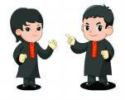

Pair work
3
Look at the picture and choose the correct word for each animal. Then make conversations with the adjectives in 2b.
horse pig
cow cat
sheep mouse
hen goose
duck dog
rabbit

Slide 27
Example :
( One day, the animals on the farm were talking.)
Dog : I’m the strongest on this farm.
Rabbit : I don’t think so. The pig is stronger than you .
Dog : Ha! Ha ! He is lazier than me .
…

Slide 28
summary
1. The comparative and
superlative degrees of adjective.
形容词比较级、最高级的规则变化
及用法。（-er/est）
2. Talking about animals and
describing nature.

Slide 29
Homework
Draw a picture of your hometown and write a passage about it, using adjectives and their comparative and superlative degrees.

