Slide 1
Unit 1 Topic 2
We should learn teamwork.
Section A
WWW.PPT818.COM

Slide 2
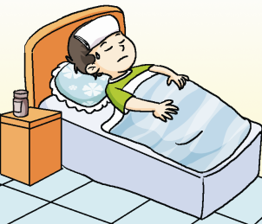


Look and say
Xiao Ming doesn’t go to school because he _________.
falls ill
生病

Slide 3

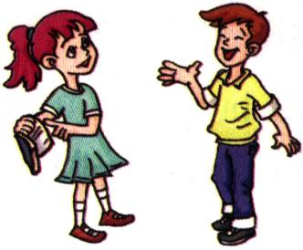
Look and say
Could you give him a hand?
Sure! What is it?
give sb. a hand 帮助某人

Slide 4
Look and say
Would you mind doing sth？ 你介意做某事吗？
Would you mind teaching him English?
Not at all.

Slide 5
— Could you please help me?
= do me a favor
= give me a hand
— Sure /Of course.
What is it?
★ — Could you please + do sth.?
— Sure. / Of course.

Slide 6

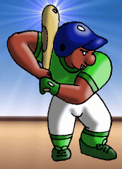
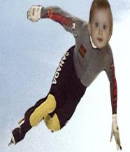

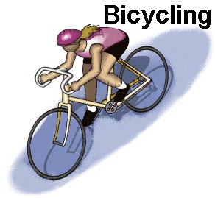
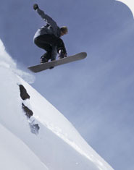

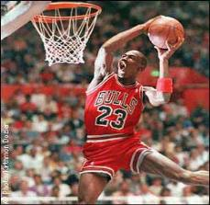
— Could you please tell me this sport’s name?
— Sure. It is …

Slide 7
— Will you play basketball with us?
— I’ll be glad to.
★ — Will you + do sth.?
— I’ll be glad to.

Slide 8
opening the windows
— Would you mind teaching me to play basketball?
closing the windows
你介意做… … ？
— Not at all. /
Of course not.
★ — Would you mind + doing sth.?
— Not at all. / Of course not.

Slide 9
Key structures
★ — Could you please + do sth.?
— Sure. / Of course.
★ — Will you + do sth.?
— I’ll be glad to.
★ — Would you mind + doing sth.?
— Not at all. / Of course not.

Slide 10

1a. Listen, read and say
Kangkang : Michael, could you help me
Michael : sure. What’s it?
Kangkang : we are going to have a soccer game against class five on Saturday. But one of my teammates fell ill. Will you join us?
Michael : I’d be glad to. But I am not very good at it. Would you mind teaching me?
Kangkang: not at all. You can do it! Let’s go
and practice.

Slide 11
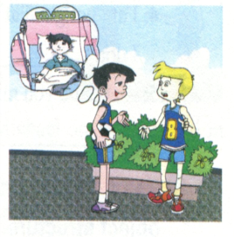
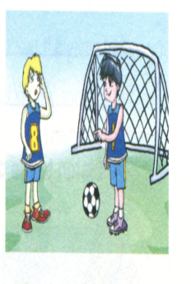
(Kangkang and Michael are practicing
in the playground.
Kangkang : Michael, I kick the
ball to you. and you pass me the
ball like this.
Michael : sorry, I missed it.
Kangkang: never mind. Keep trying.
I’ll kick you the ball again.
Michael : ok.

Slide 12
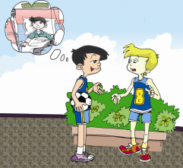
Answer the following questions.
Which class are they going to play against?
What’s wrong with Kangkang’s teammate?
3. Would Kangkang mind teaching him?
They are going to play against Class Five.
He fell ill.
Not at all.

Slide 13
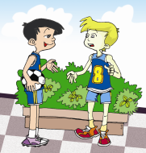
1b
Listen to 1a and complete the sentences.
Kangkang and his team are going to have a soccer game against __________ on Saturday.
Kangkang asks Michael to join them because a teammate _________.
Michael is not good at ______________,but he likes to have a try.
Michael and Kangkang are going to _________ for the game.
Class Five
fell ill
(playing) soccer
practice

Slide 14
Read and understand the first sentence. Then complete the second one with the correct form of each word or phrase in the box.
1c
be ill give … a hand do well in
Could you please football Class Five
1. --- Could you help me, please? ---Sure.
--- Could you please ______________? ---Sure.
2.We are going to have a soccer game against the
fifth class on Saturday.
We are going to have ________ game against
____________ on Saturday.
give me a hand
football
Class Five

Slide 15
3. One of my teammates fell ill.
One of my teammates ________.
4. I am not good at football.
I don’t __________ football.
5. ---Would you mind teaching me?
-----Not at all.
---______________________ teach me?
-----Certainly.
was ill
do well in
Could you please

Slide 16
1c
Read 1a and underline the sentences with
the direct and indirect object structure. Then follow the example to rewrite them.
Example :
I kick the ball to you. I kick the ball.

Slide 17
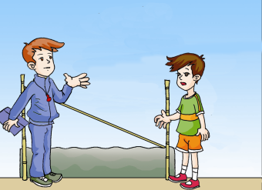
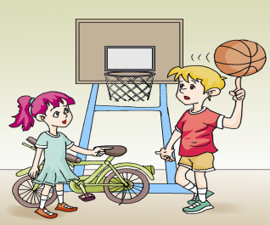

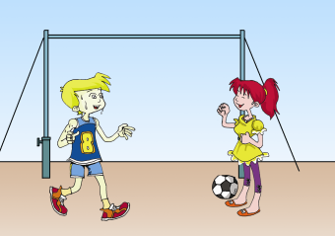
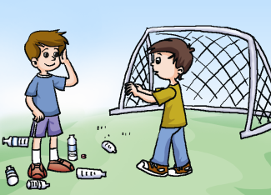
2
A Listen to the conversations and number the pictures.
2
3
1
4

Slide 18
B. Listen again and fill in the blanks.
A: Would you mind ___________________?
B: Of course not. I’ll do it right away.
passing me the ball
A: Would you mind if I try it again?
B: _______________. Please do.
Certainly not
A: _______________ putting your bike here?
B: Sorry. I’ll put it somewhere else.
Do you mind not
A: Would you mind not throwing bottles around?
B: ___________________. I won’t do it again.
I’m sorry about that

Slide 19
Practice
Make a similar conversation with your partner. The following phrases and sentences are useful.
1. — Would you mind …?
— Of course not. / Certainly not.
2. — Would you mind not …?
— Sorry. / I’m sorry about that.

Slide 20
Key points
But one of my teammates fell ill.
fall ill 得病
be ill 生病了，强调状态
Eg: 上星期天我妹妹生病了。
My sister fell ill last Sunday.
别太累了，否则你会生病的。
Don’t be too tired, or you will be ill.

Slide 21
Key points
Would you mind teaching me?
Would you mind doing sth.？ 你介意做某事吗？
Would you mind not doing sth.?你介意不要做某事吗？
Eg: 你介意不要在这里吸烟吗？
Would you mind not smoking here?
你介意把窗户打开吗？
Would you mind opening the window?

Slide 22
Key points
I will kick you the ball again.
这是含有双宾语的句子。
kick sb. sth.=kick sth. to sb.
类似用法的动词有：pass, give, bring, take…
在1a中找出相似结构的句子：
I kick the ball to you.
= I kick you the ball.
You pass me the ball like this.
= You pass the ball to me like this.

Slide 23
Practice
Eg: 请把书包拿给我。
Please bring me the schoolbag.
=Please bring the schoolbag to me.
不要把钱给他。
Don’t give the money to him.
=Don’t give him the money.

Slide 24
Task
Retell the dialog with the useful expressions:
Could you help me?
have a soccer game against …
One of my teammates fell ill
Will you …?
be glad to
Would you mind …?
Let’s go and practice.

Slide 25
Key structures
★ — Could you please + do sth.?
— Sure. / Of course.
★ — Will you + do sth.?
— I’ll be glad to.
★ — Would you mind + doing sth.?
— Not at all. / Of course not.

Slide 26
Key phrases
★ — Could/Would you please + do sth.?
请你做某事好吗？
— Sure. / Of course. 好的。
★ — Will you + do sth? 你愿意做某事吗？
— I’ll be glad to. 我很乐意。
★ — Would you mind + doing sth.?
你介意做某事吗？
— Not at all. / Of course not. 当然不。

Slide 27
★ do sb. a favor 帮某人的忙
★ fall ill 病倒
★ mind doing sth. 介意做某事
★ practice doing sth. 练习做某事

Slide 28
Key structures
★ — Would you mind + doing sth.?
— Not at all. / Of course not.
★ — Would you mind not + doing sth.?
你介意不做某事吗？
— Sorry. 对不起。

Slide 29
Key phrases in 3
★ right away 立刻，马上
★ put it somewhere else
去其他一些地方
★ throw about 乱扔
★ I’m sorry about that.
因那件事而感到抱歉。

Slide 30
Key phrases in 4
★ make one’s bed
整理床铺
★ manage sth.
设法对付；管理
★ manage to do sth.
设法做成某事

Slide 31
Key phrases of Section A
★ do sb. a favor = help sb. = give sb. a hand
帮助某人
★ fall ill 病倒
★ mind doing sth. 介意做某事
★ practice doing sth. 练习做某事
★ right away 立刻，马上
★put it somewhere else 把它放到其他一些地方
★ throw about 乱扔
★ I’m sorry about that. 因此而感到抱歉。
★ make one’s bed 整理床铺
★ manage sth. 设法对付；管理
★ manage to do sth. 设法做成某事

Slide 32
Key sentence patterns of Section A
★ — Could/Would you please do sth.?
请你做某事好吗？
— Sure. / Of course. 好的。
★ — Will you do sth.? 你愿意做某事吗？
— I’d be glad to. 我很乐意。

Slide 33
★ — Would you mind doing sth.?
你介意做某事吗？
— Not at all. / Of course not. 当然不。
Sorry, you’d better not. 对不起，最好不
要。
★ — Would you mind not doing sth.?
你介意不做某事吗？
— Sorry, I won’t. 对不起，我不会再这
样。

Slide 34
Translate the following sentences.
1. -- 你介意不乱扔垃圾吗？
-- 我为此感到抱歉。
2. 你马上去整理床铺好吗？
— Would you mind not throwing rubbish about?
— I’m sorry about that.
Would you please make your bed right away?

Slide 35
3. 我会设法弹钢琴弹得更安静点。
4. 你介意不要说得这么大声吗？
I’ll manage to play the piano more quietly.
Would you mind not speaking so loudly?

Slide 36
Translate the following sentences.
1. 我们将给他们以帮助。
2. 我的一个朋友喜欢在星期天玩电脑游戏。
3. 你和我们一起练习打排球好吗？
We’ll do them a favor.
One of my friends likes playing computer
games on Sunday.
Will you practice playing volleyball with us?

Slide 37
4. 不要太劳累了，否则你会生病的。
5. — 你介意把窗户打开吗？ — 抱歉，外面太冷了。
Don’t be too tired, or you will fall ill.
— Would you mind opening the window?
— I’m sorry. (You’d better not.) It’s too cold outside.

Slide 38
单项选择
1. – Would you mind helping me with my English?
– _____ Let’s go and practice.
A. Not at all. B. Don’t mind.
C. I’m sorry. D. Sure.
2. When the children saw the _____ film, they became _____.
A. exciting; excited B. excited; excited
C. exciting; excited D. excited; exciting
A
C

Slide 39
3. – Would you mind my smoking here?
– _______
A. No, thanks. B. Go out.
C. Of course not. D. Yes, I’d love to.
4. He ______ yesterday. I hope he’ll be well soon.
A. fall ill B. falls ill
C. fell ill D. fell illness
C
C

Slide 40
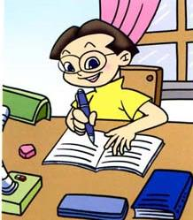
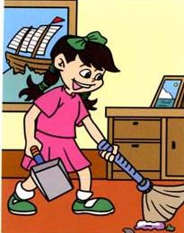
Homework
看图写对话, 运用句型: 1) Where is he/she?
2) What is he/she doing?
3) --Is he/she…? --Yes, he/she is.
--No, he/she isn’t.

