Slide 1
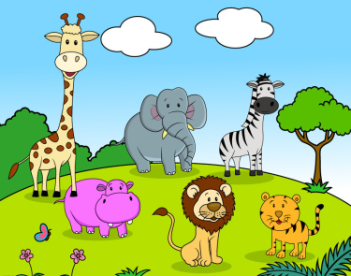
Animals in the zoo
第一课时
WWW.PPT818.COM

Slide 2
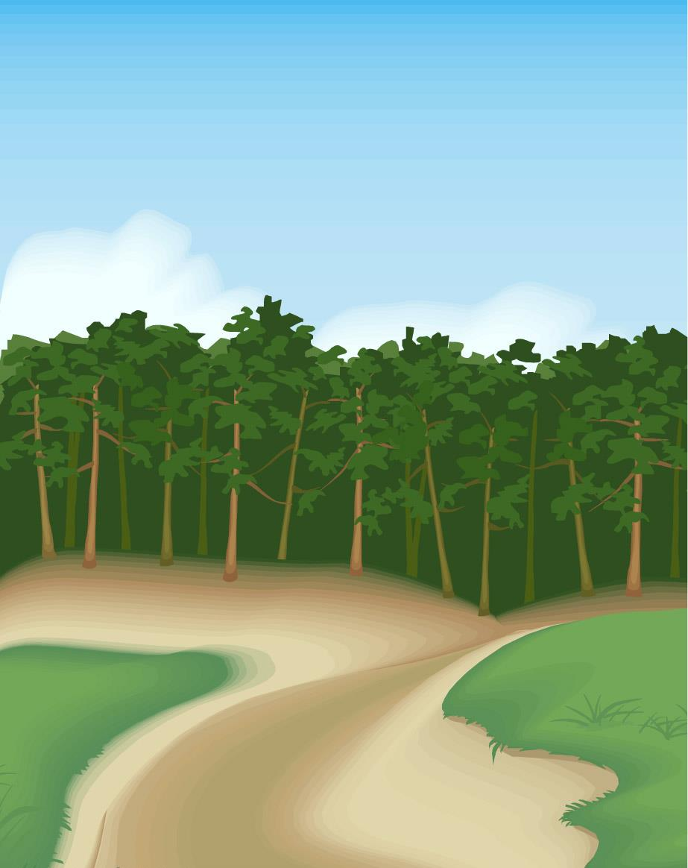
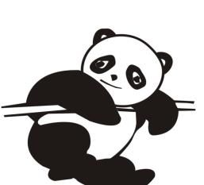

Slide 3
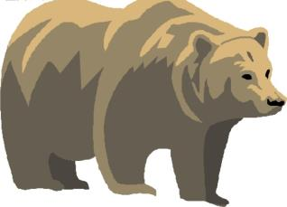
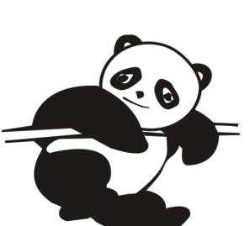
Say and read
bear
tiger
panda

Slide 4
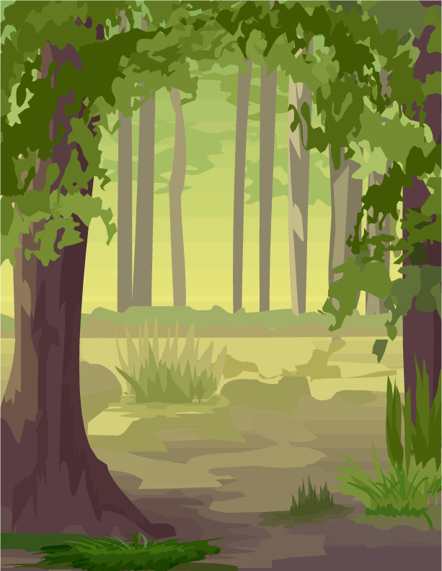
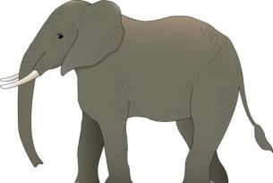
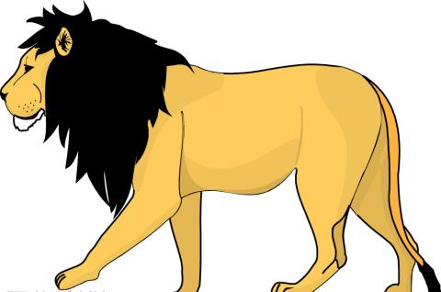
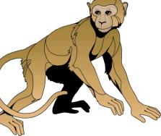
Listen and guess

Slide 5
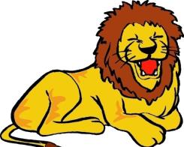
Read and chant
A big, big lion.
A strong, strong lion.

Slide 6
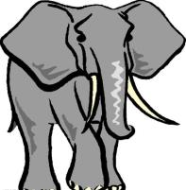
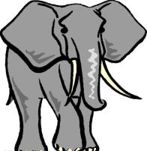
Read and chant
A grey, grey elephant.
A _____, _____ elephant.

Slide 7
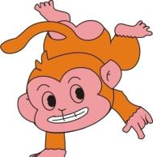
Read and chant
A/An _____, _____ monkey.
A/An _____, _____ monkey.

Slide 8
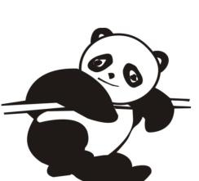
Look and say

Slide 9
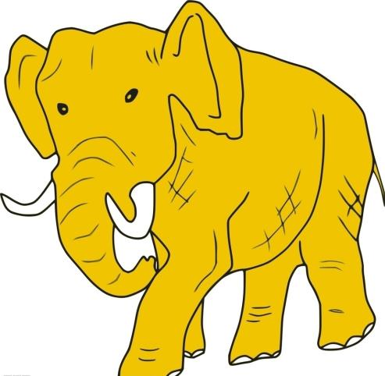
Look and guess

Slide 10
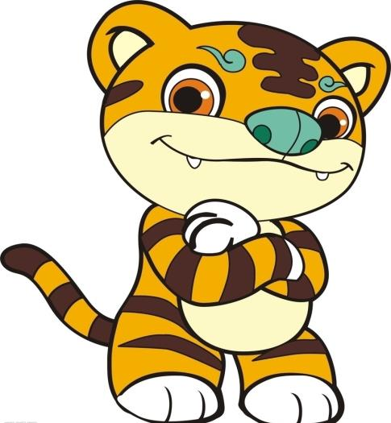
Look and guess

Slide 11
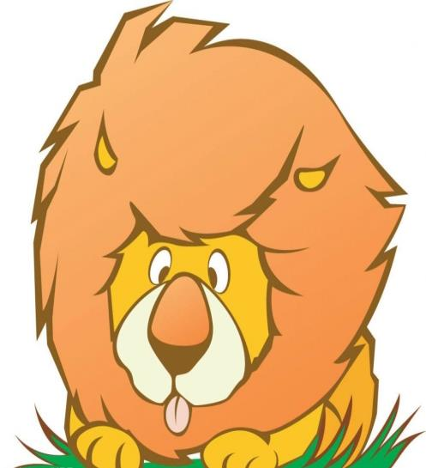
Look and guess

Slide 12
Look and guess

Slide 13
Say and spell

Slide 14
Say and spell
bear
tiger
elephant
lion
panda
monkey

Slide 15
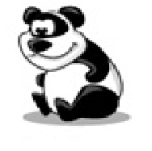
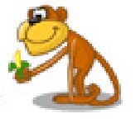
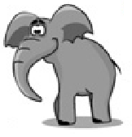
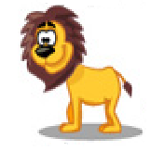
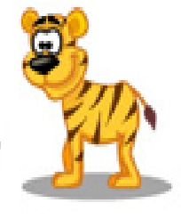
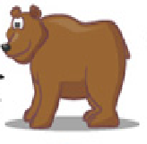
Read and match
panda
bear
tiger
lion
monkey
elephant

Slide 16
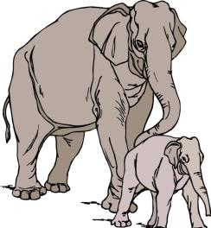
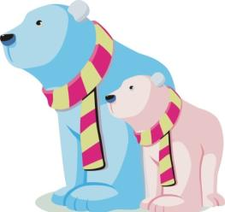
Say and read
elephant
s
bear
s

Slide 17
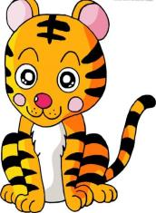
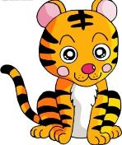
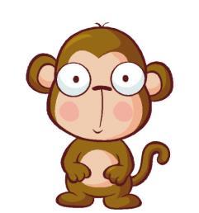
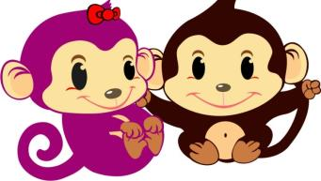
Say and read
tiger
s
monkey
s

Slide 18
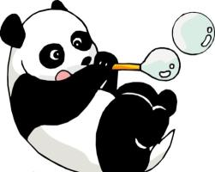
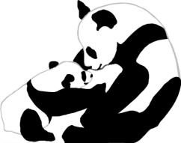
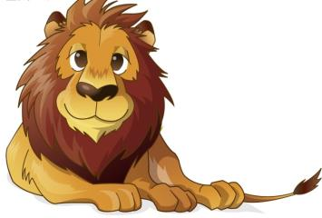
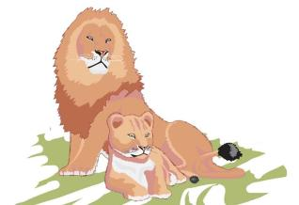
Say and read
panda
s
lion
s

Slide 19
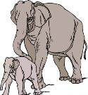
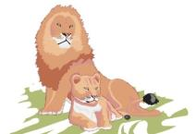
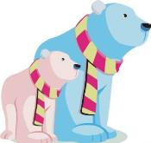
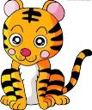
Say a chant
Do you like elephants?
Do you like …?
Yes, I do. Yes, I do. I like .

Slide 20
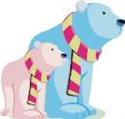
Say a chant
Do you like bears?
Do you like …?
No, I don’t. No, I don’t. I like .

Slide 21
Ask and answer
Do you like pandas?
Yes, I do.
Do you like bears?
No, I don’t.
I like …

Slide 22
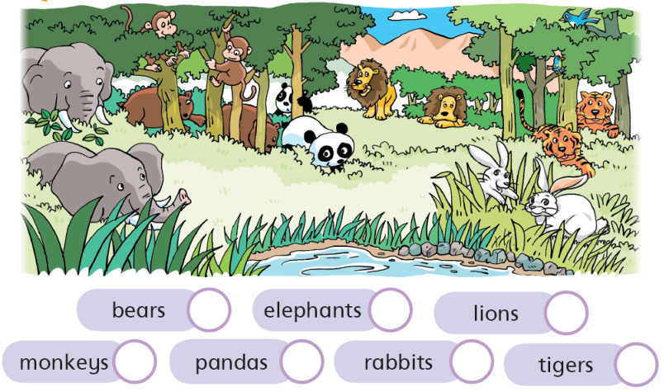
Do a survey
Yes, I do.
Do you like …?
No, I don’t.

Slide 23
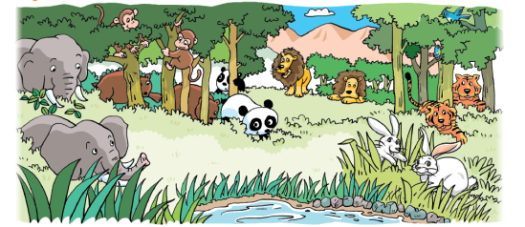
Survey
How many students like …?
 | Like | Not like
bears
elephants
lions
tigers
monkeys
pandas
rabbits

Slide 24
Find your friend
Dialogue 1
S1: Hello, … How are you?
S2: Fine, thank you. And you?
S1: I’m fine too.
Let’s go to the zoo.
S2: OK.
S1: Do you like lions?
S2: No, I don’t. I like tigers.
Do you like tigers?
S1: No, I like lions.
S2: Bye.
S1: Bye.
Dialogue 2
S1: Hello, … How are you?
S2: Fine, thank you. And you?
S1: I’m fine too.
Let’s go to the zoo.
S2: OK.
S1: Do you like lions?
S2: Yes, I do. Do you like lions?
S1: Yes, I do. I like lions too.
S2: Let’s go to see the lions.
S1: Great! Let’s go!

Slide 25
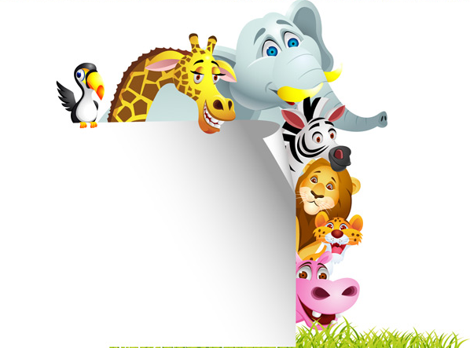
Homework
1 Spell and copy these words.
lion tiger monkey elephant
panda bear
2 Make sentences.
— Do you like …? — Yes, I do.
— Do you like …? — No, I don’t. I like …

