Slide 1
Unit 1 Lesson 3
We sing here.
WWW.PPT818.COM

Slide 2
Let’s learn!
often
basketball
there
thing
make
经常，常常
篮球
那里，那儿
物，东西
制造，做

Slide 3
“here” and“there”
here意思是：这里、在这里
there意思是：那里、在那边

Slide 4
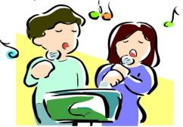
music room
We sing here.

Slide 5
art room
We make things there.

Slide 6
draw
We often draw here.

Slide 7
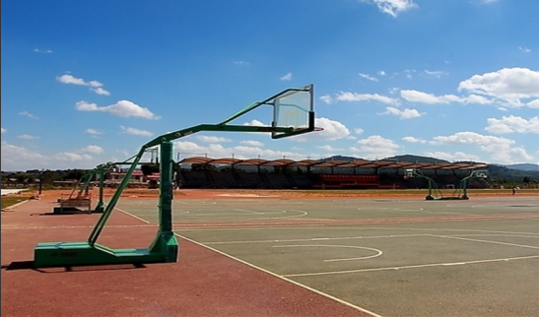
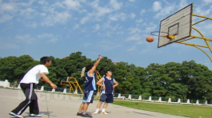
We often play basketball here.
playground

Slide 8
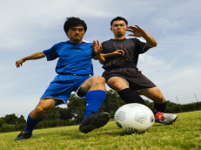
football field
We often play football there.

Slide 9
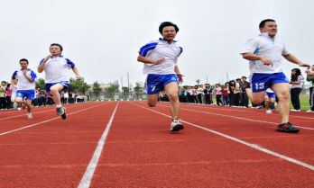
athletic tracks
We often run here.

Slide 10
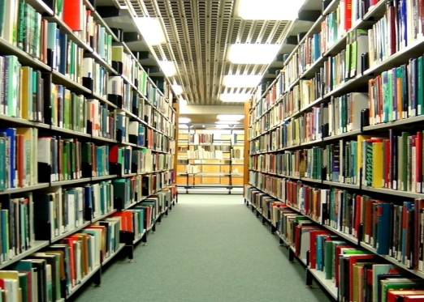
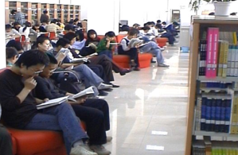
library
We often read books there.

Slide 11
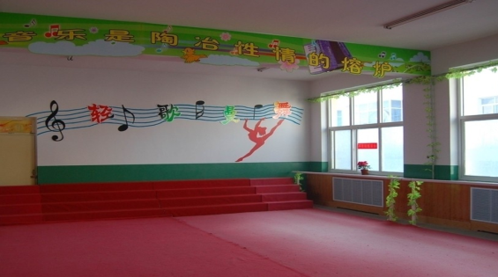
This is the music room.
We sing here.

Slide 12
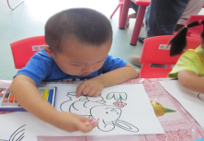
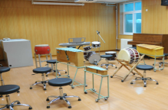
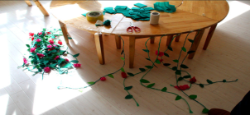
We draw here.
我们在这儿画画。
We sing there.
我们在那儿唱歌。
We make things here.
我们在这儿制作东西。

Slide 13
Practice
Eg: 1) We draw here.
2) We sing there.
3) We make things here.
4) I play basketball in the playground.

Slide 14
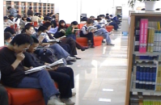
Practice
1) We read in the library.
2) We sing in music room.
3) We make things in art room.
4) I play basketball in the playground.

Slide 15
Homework
1. Listen and read the dialogue as fluently as you can.
2. Copy the four words three times.
PE, science, computer, maths.

