Slide 1
Unit4 When do you have class?
WWW.PPT818.COM

Slide 2
几点钟了？该怎么问呢？
1、What time is it ?几点了？
2、What’s the time ,please?请问，是什么时候了呢？
时间的读法：先读小时，再读分钟，碰上整点得加o’clock,如是半小时
还可以用half past 加小时！！！
eg.What time is it now ?
It’s…

Slide 3
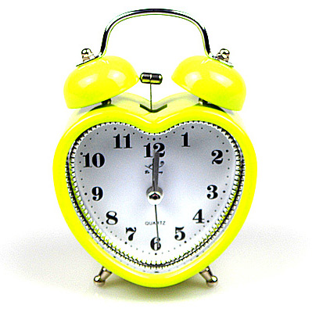
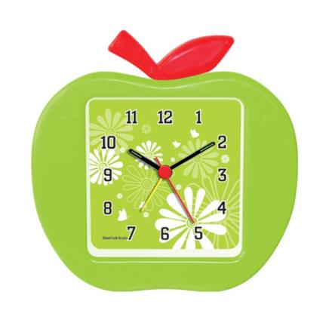
It's ten ten
It's twelve o'clock

Slide 4
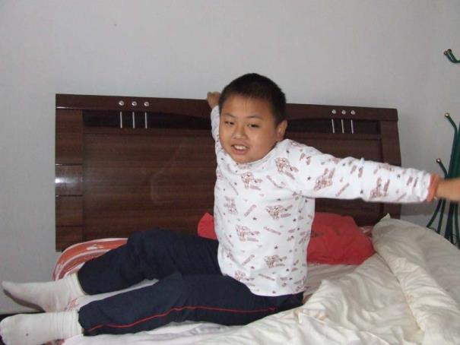
What time do you usually get up?
At six fifteen.
6:15
get up
six fifteen

Slide 5
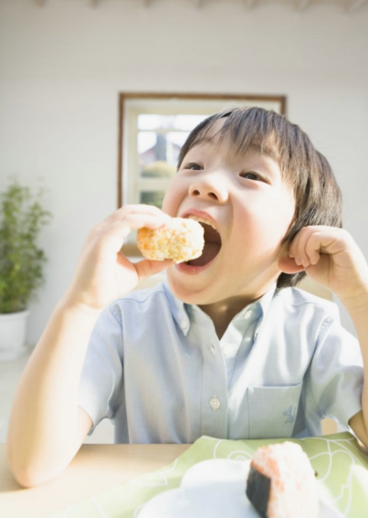
What time do you usually
have breakfast?
At seven o'clock.
7:00
seven o'clock
have breakfast

Slide 6
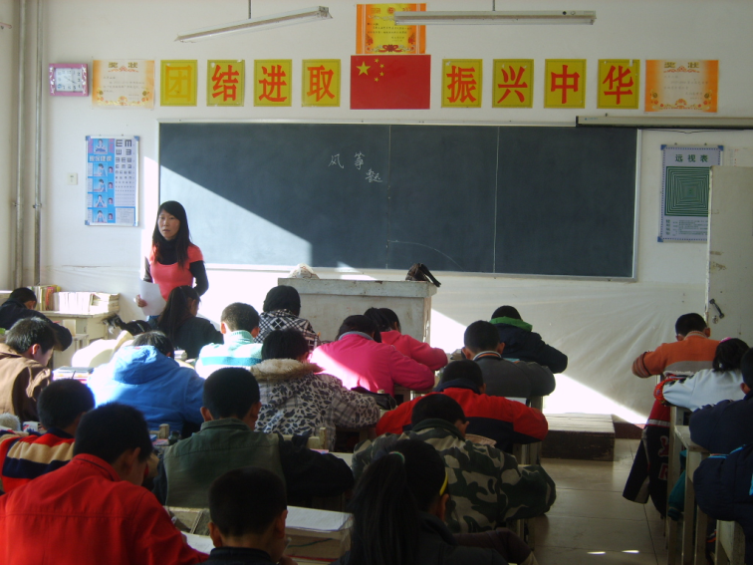
What time do you usually have classes?
From half past eight to half past nine.
9:30
8:30
half past nine
half past eight
have classes

Slide 7
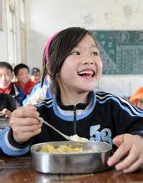
have lunch
12:00
1:30
twelve o'clock
half past one
What time do you usually have lunch?
From twelve o'clock to half past one.

Slide 8
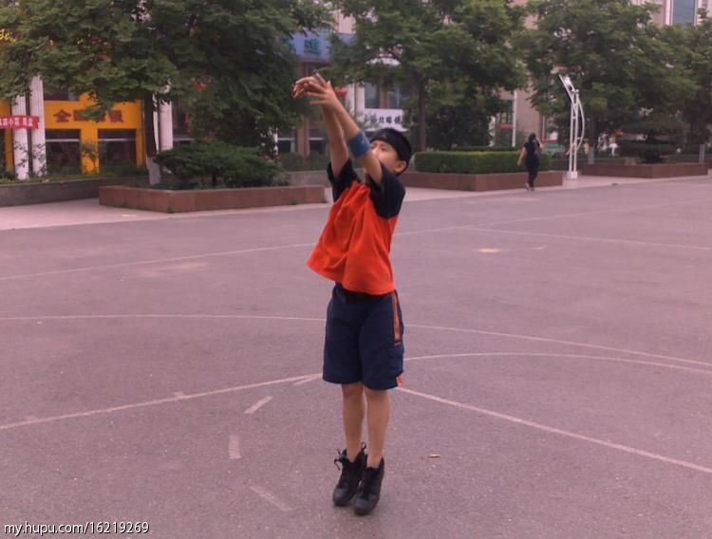
take exercise
4:30
5:30
half past four
half past five
What time do you usually take exercise?
From half past four to half past five.

Slide 9
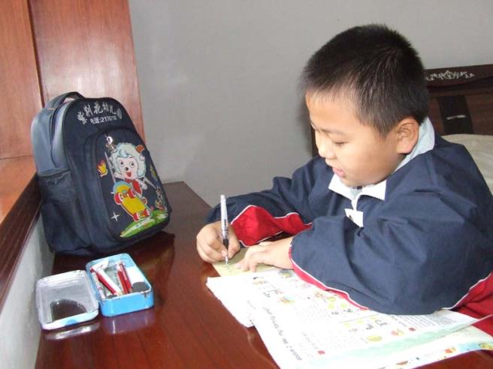
do homework
7:00
8:30
seven o'clock
half past eight
What time do you usually do homework?
From senen o'clock to half past eight.

Slide 10
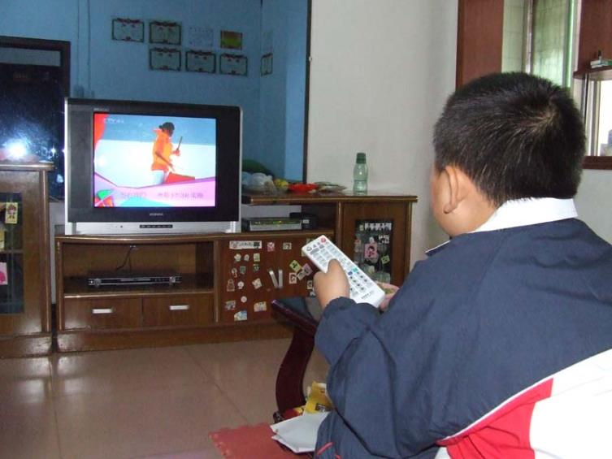
watch TV
8:30
9:30
half past eight
half past nine
What time do you usually watch TV?
From half past eight to half past nine.

Slide 11
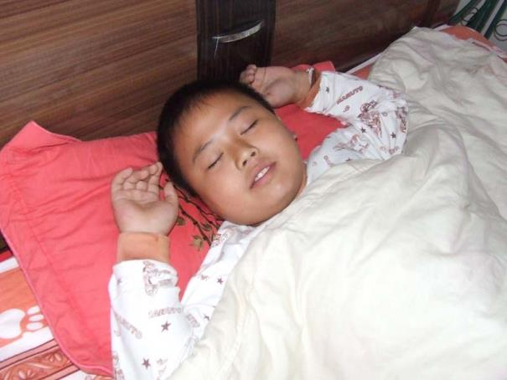
What time do you usually go to bed?
At nine o'clock.
9:00
nine o'clock
go to bed

Slide 12
What time do you go to bed?

Slide 13
What time do you do your homework?

Slide 14
What time do you
come home?

Slide 15
Lucky!

Slide 16
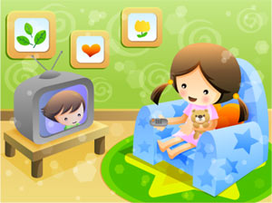
What time do you watch TV?

Slide 17
What time do you______?

Slide 18
Lingling's Day
get up
have breakfast
go to school
have English class
come back home
go to bed
6:50
7:00
7:30
9:20
4:00
9:30

Slide 19
It’s time for us to say

