Slide 1
Unit4 Neighbourhood
He lives next to me.
WWW.PPT818.COM

Slide 2

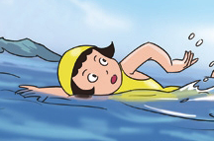
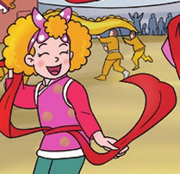



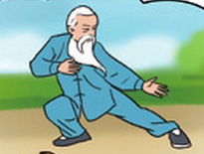
What's your hobby?
I like ……
yangge dance
singing
swimming
playing basketball
playing ice hockey
doing Taijiquan
reading

Slide 3

Where's she from?
Sh'e's from France.
She likes dancing.
neighbour

Slide 4
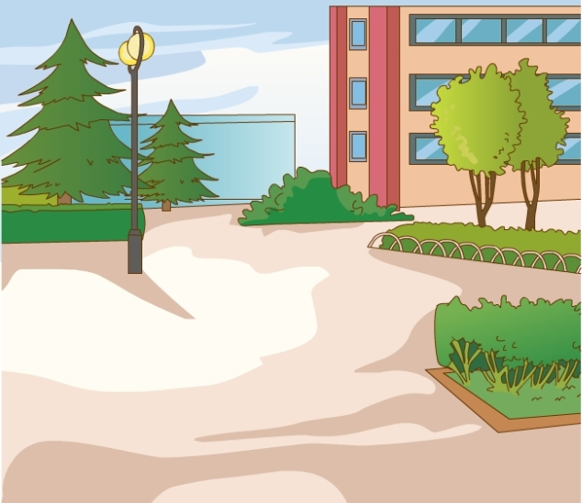
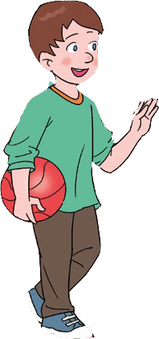
This is Andy.
He’s from Ottawa.

Slide 5
Watch and answer.（读课文。）
1. Where does Andy live now?
(Andy现在住在哪里？)
2. Who is from Ottawa,too?

Slide 6
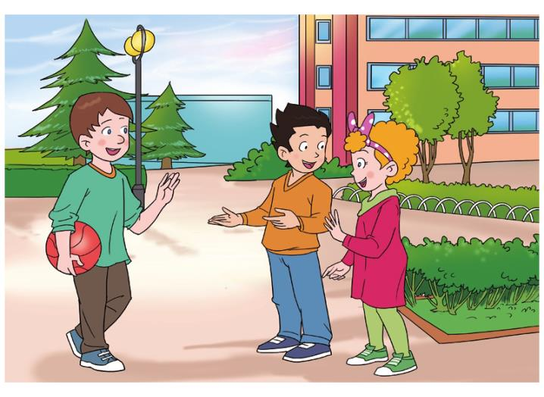

Slide 7
Watch and answer.（读课文。）
1. Where does Andy live now?
(Andy现在住在哪里？)
Andy lives in Beijing now.
LiMing
He lives next to _______.
2. Who is from Ottawa,too?
Jenny is from Ottawa，too.

Slide 8
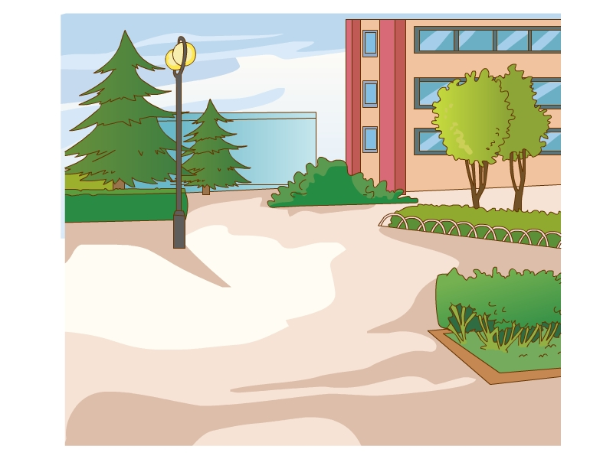
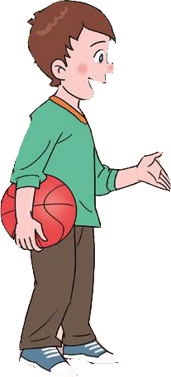
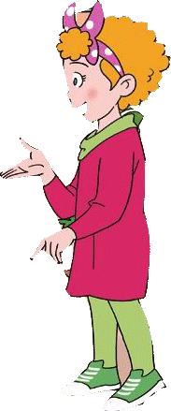
Where did you live in Ottawa?
I lived in
Young Street.
Oh, we were neighbours in Canada.

Slide 9
Read and answer. (自读课文并回答。）
Andy and Jenny were neighbours in Canada.
And _____ and ______ are neighbours in China!
Andy
Li Ming

Slide 10
Watch and answer. （读课文。）
Does Andy enjoy his stay in Beijing?
（Andy喜欢呆在北京吗？）
Why?
Yes ,he does.
He likes Chinese food.
And the new neighbourhood is nice.

Slide 11
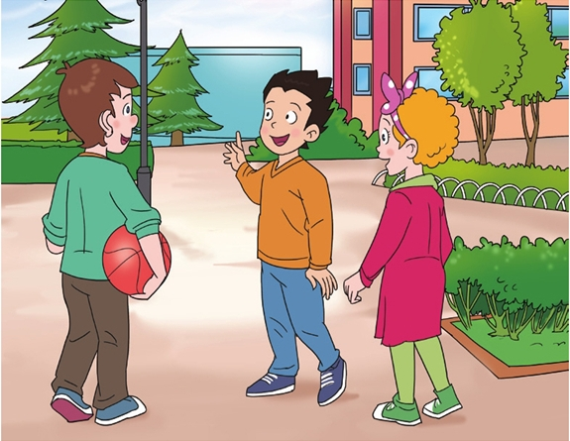
Shall I show you around?
know
snow
show
Good idea .
Thank you.

Slide 12
Introduce Andy to your friends.（向朋友们介绍Andy。）
Choose and fill in the blanks.(选词填空。）
This is my friend Andy. He is from________.He lived in Yong Street. He and Jenny were ______ in Canada.
Now, he lives in _____. He and ________ are neighbours. His new ______ is nice. He enjoys his stay here.
neighbours
Beijing
Li Ming
neighbourhood
Ottawa

Slide 13
Introduce Andy to your friends.（向朋友们介绍Andy。）
Choose and fill in the blanks.(选词填空。）
This is my friend Andy. He is from________.He lived in Yong Street. He and Jenny were _______ in Canada.
Now, he lives in _______. He and ________ are neighbours. His new ____________ is nice. He enjoys his stay here.
Ottawa
neighbours
Beijing
Li Ming
neighbourhood

Slide 14
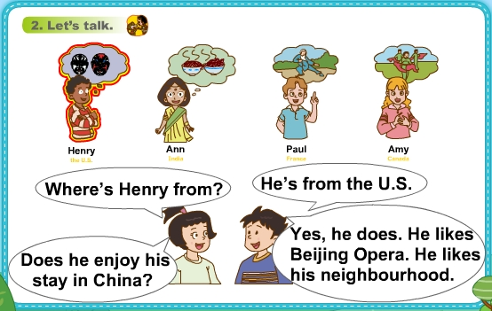
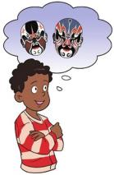
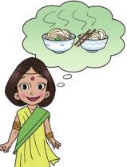
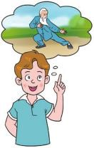




Let’s talk。（同桌讨论介绍4位新朋友。）
Henry the U.S.
Ann India
Paul France
Amy Canada
Where is Henry from?
He’s from the U.S.
Does he enjoy
his stay in China?
Yes,he does. He likes
Beijing Opera. He likes
his neighbourhood.

Slide 15
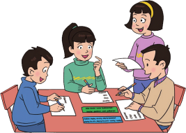
Let’s do.（小组讨论介绍自己的邻居。）
Jobs
doctor
nurse
businessman
teacher
gardener
cook
policeman
Hobbies
singing
dancing
playing basketball playing the erhu
playing the piano running
reading
is my neighbour.
from .
a/an .
likes .

Slide 16

Let’s do （小组讨论介绍自己的邻居。）
Mary is my neighbour.
She’s from Beijing.
She’s a teacher.
She likes dancing.
Tips（要求）:
1.Fill in the blanks. （填空）
2.Talk in groups.
（小组交流）
3. Report.
（汇报）
is my neighbour.
from .
a/an .
likes .
LiLei
He’s
Yantai
He’s
teacher
√
He
reading

Slide 17
Let’s do （小组讨论介绍自己的邻居。）
Jobs
doctor
nurse
businessman
teacher
gardener
cook
policeman
Hobbies
singing
dancing
playing basketball playing the erhu
playing the piano running
reading
is my neighbour.
from .
a/an .
likes .

