Slide 1
Module 4 The world around us
Hello
第一课时
WWW.PPT818.COM
Notes:
1

Slide 2
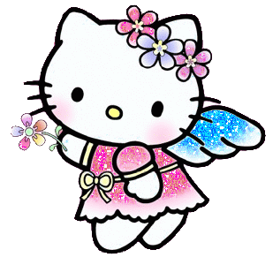

Slide 3
p-e-n
b-e-d
h-e-ll-o

Slide 4
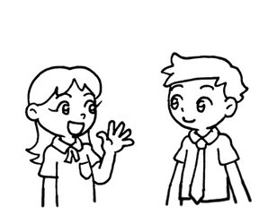
…
Look and say
Hello!
Hello!

Slide 5
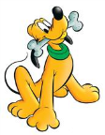
…
Look and say
Hello!
Hello!
Hello!
Hello!
Hello!

Slide 6
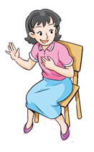
…
Let's learn
Hello! I’m .
Miss Fang.
b-i-g
p-i-g
M-i-ss

Slide 7
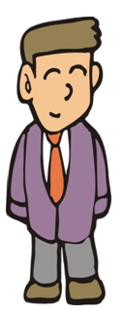
…
Mr
Li

Slide 8
Mr
Mr
Miss
Mr
Mr
Miss
Miss
Miss
Miss
Miss
Mr
Miss

Slide 9
…
Let's learn
Hello! I’m Peter.
h-e
sh-e
Let’s chant
P-e-t-er
Peter, Peter,
I see you.
Peter, Peter,
Hello, hello.

Slide 10
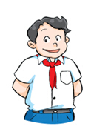
…
Let's learn
Hello! I’m Joe.
g-o
n-o-se
Let’s chant
J-o-e
Joe, Joe,
Hello, hello.
Joe, Joe,
Let’s go.

Slide 11
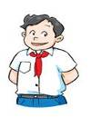
Task :
Choose, read and write
Miss miss
M
mr Mr
M
P
Peter peter
joe Joe
J

Slide 12
…
Let's learn
Hello! I’m Kitty.

Slide 13
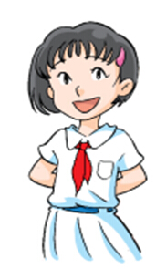
…
Let's learn
Hello! I’m Alice.

Slide 14
True or false
…
I’m = I am
I’m Miss Fang.

Slide 15
True or false
…
I’m = I am
I’m Alice.

Slide 16
True or false
…
I’m = I am
I’m Joe.

Slide 17
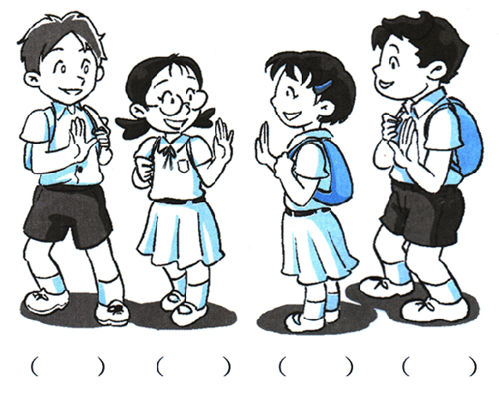
4
2
1
3

Slide 18
Do you have an English name?
Hello, I’m

Slide 19
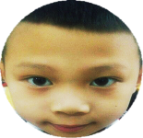
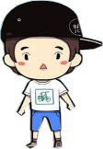
Hello, I’m Leo.
I am a boy.
I can run.

Slide 20
Let’s play. （一起玩闯关游戏吧）
连闯三关

Slide 21
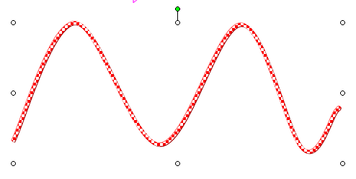
Let’s go!
start

Slide 22
Round 1
Let’s sing.

Slide 23
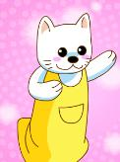
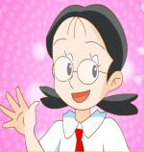
Let’s sing
I’m Dolly. Hello, hello!
I’m Dolly. Hello, hello!
I’m Dolly. Hello, hello!
Hello! Hello! Hello!
I’m Kitty. Hello, hello!
I’m Kitty. Hello, hello!
I’m Kitty. Hello, hello!
Hello! Hello! Hello!

Slide 24
Let’s make a new song.
I’m . Hello, hello!
I’m . Hello, hello!
I’m . Hello, hello!
Hello! Hello! Hello!
I’m . Hello, hello!
I’m . Hello, hello!
I’m . Hello, hello!
Hello! Hello! Hello!

Slide 25
Let’s go!
start

Slide 26
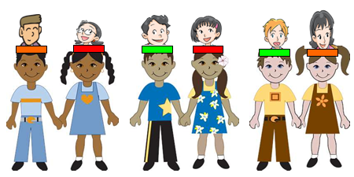
Round 2
Let’s do a show.
小组内角色扮演
Hello, I’m Miss Fang.
I am tall.
I can dance.

Slide 27
Let’s go!
start

Slide 28
Round 3
Read and write 找茬：下面的每个句子
都有一处错误，请你圈出来并把正确的句子写在四线格中。
hello! I’m Peter.
Hello! I’m miss Fang.

Slide 29
Let’s go!
start

Slide 30
Koreans'greeting is a bow.
朝鲜人打招呼行鞠躬礼，表示尊敬。
Australians shakes hands to say hello.
澳大利亚人相互握手打招呼。
In Thailand, the men place hands in the facial front,
women place at the chest to greet each other.
泰国打招呼，男士双手在额前，女士在胸前。
Maoris'greeting is to touch the noses,
the more the number and the longer,
the more intimate.
毛利人碰鼻子来打招呼，次数越多，时间越久，表示越亲密

Slide 31
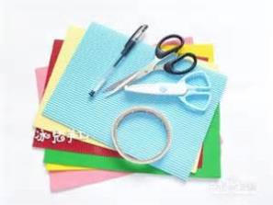
Homework:
Listen and repeat.
Make a name card and say.

Slide 32
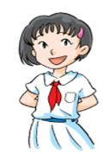
Thank you!

