Slide 1
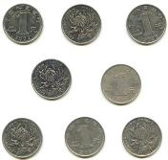
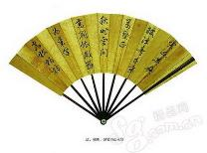
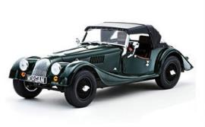
Module 6 Hobbies
Unit 1
Do you collect anything?
WWW.PPT818.COM

Slide 2
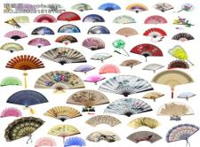
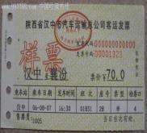
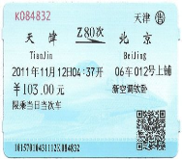
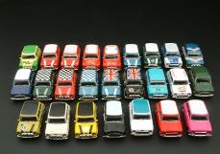
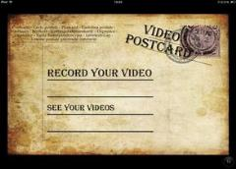
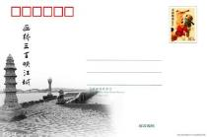
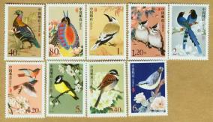
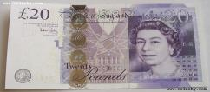
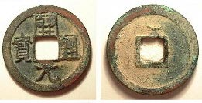
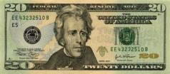
Look at the pictures. Do you know the names of the collections.
Lead-in
fans
tickets
toy cars
postcards
stamps
notes
coins

Slide 3
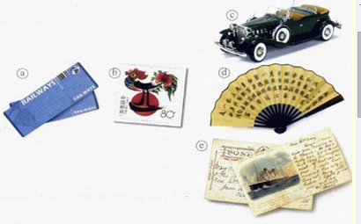
Listen and find out who collects the things in the pictures.
Activity 1
Tony
Tony's dad
Tony's mum
a,c
b,c
d,e

Slide 4
Answer the questions.Use the words and expression in the box to help you.
1 What does Tony's mum want him to do？
2 Which hobby does Tony think is expensive？
3 Which hobby do you think takes up the most space？
Activity 2
collect fan postcard stampticket tidy up toy
Tony's mum wants him to tidy up his room and
find a place to put all his toy cars.
Collecting stamps.
Collecting toy cars.

Slide 5
Watch the video and answer the questions.
Activity 3
1.What are they talking about?
2.What kind of hobby do they like?
Their hobbies.
Collecting.

Slide 6
Read the dialogue and answer the questions.
Speaking
What?
Why?
What?
Betty’s
hobbies
What?
Lingling’s
hobby
Tony’s
hobby
Why?
Why?
Hobbies

Slide 7
The answers to the questions.
Speaking
Lingling's hobby:
Betty's hobby:
Tony's hobby
Collecting fans.
Because she likes them.
Collecting coins, notes and stamps.
Because they are valuable.
Collecting old tickets.
Because he wants to remember some wonderful places.

Slide 8
Discuss in groups.
Reading
For a hobby,
is the value important or not?

Slide 9
Discuss in groups.
Reading
The value isn’t important.
We collect things just to remember something important in our lives.

Slide 10
Reading
Reading time

Slide 11
Language points.
Lingling: Hi，everyone! Come in and find somewhere to
sit down. Sorry, it's a bit of a mess. I'll put the
fans on the shelf.
Betty: Let me have a look.You've got so many fans.
Lingling: Yes, about sixty.
Betty: Where did you get them?
Lingling: Most of them are presents. People often give
me fans as presents because they know I like
them. Do you collect anything?
Reading

Slide 12
Language points.
Betty: Yes, I collect coins and notes, you know, like
British pounds and US dollars.
Lingling: Coins? They must be really valuable. Can I
see them？
Betty: Sure! I'll show you my stamps too. I've
collected stamps from all over the world. I've got
six or seven books of stamps.
Tony: My hobby doesn't cost as much as yours—I
collect tickets, bus tickets and train tickets！
Reading

Slide 13
Language points.
Betty: You can't do anything with old tickets！
Tony: I know，but when I look at them，I remember
some wonderful places.
Lingling: Right！Their value isn't always important.
People also collect things just to remember
something important in their lives.
Reading

Slide 14
Everyday English
Reading
● Sorry, it's a bit of mess.
● Let me have a look.
● Can I see them?
● Right!
抱歉，有点乱。
让我看一看。
我能看看它们吗？
对！

Slide 15
Complete the passage with the correct form of the words in the box.
Activity 4
coin dollar pound remember shelf somewhere
Many people collect things,like postcards and toys. They like to put them（1）___________ special to look at. Lingling collects fans and keeps them on a（2）_______ in her bedroom. Betty collects （3）_______ and notes, such as British（4）__________and US （5）_________.
somewhere
shelf
coins
pounds
dollars

Slide 16
Complete the passage with the correct form of the words in the box.
Activity 4
coin dollar pound remember shelf somewhere
She also collects stamps from all over the world.Tony collects tickets，but Betty thinks that you cannot do anything with old tickets.Lingling thinks that people also enjoy collecting things to
(6)____________ something important in their lives.
remember

Slide 17
Groupwork: Survey and Report
Interview two friends’ hobbies in your groups and do a report.
Activity 6
You can ask: Do you have a hobby? What’s your hobby? Why do you enjoy your hobby? When did you start doing it? How often do you …? Where do you…? ... …

Slide 18
Groupwork: Survey and Report
Interview two friends’ hobbies in your groups and do a report.
Activity 6
You can do a report like this: My friend is __________. She/He likes __________ because she/he thinks it’s _________. She /He liked_________ when she was _______. She/He___________ every day/once a week/twice a week… and she usually __________ at school/at home/in the library/on the playground...

Slide 19
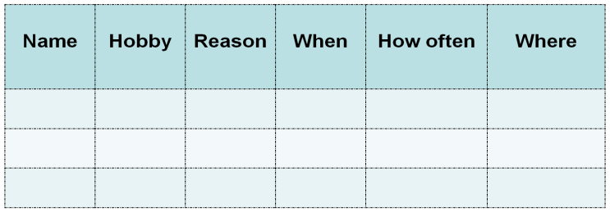
Homework
Homework
①Remember the new words and important sentences of unit1.(必做）
②Make a survey in your family and do a report next class.（选做）

