Slide 1
精通版·四年级上册
Unit 2 What’s your number?
Lesson 12
WWW.PPT818.COM

Slide 2
Review
three
seven
five
nine
two
one
ten

Slide 3
four
six
eight

Slide 4
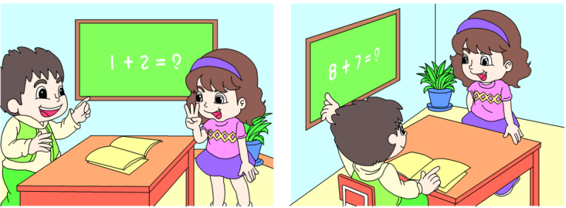
Fun story

Slide 5
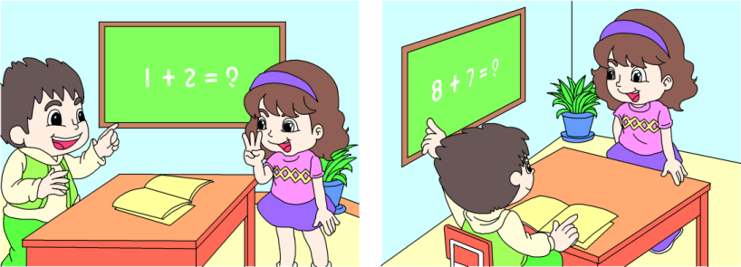
Read and act.
Um...fifteen.
What’s one and two?
It’s three.
Good!
What’s eight and seven?

Slide 6
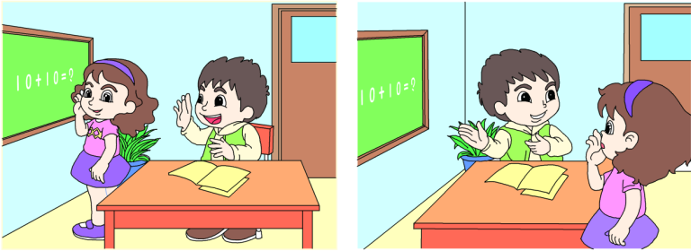
What’s ten and ten?
No!
Why not?
Twenty!

Slide 7
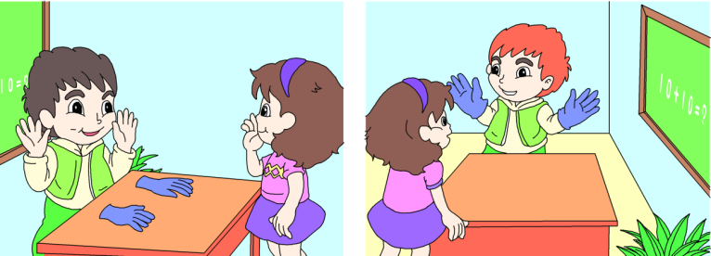
Oh, that’s funny!
So, ten and ten is ten.
Look! Ten and ten.

Slide 8
Let’s check
Listen and number.
Class 4, Grade 3
20
18
15
Class 1, Grade 4
2
3
1

Slide 9
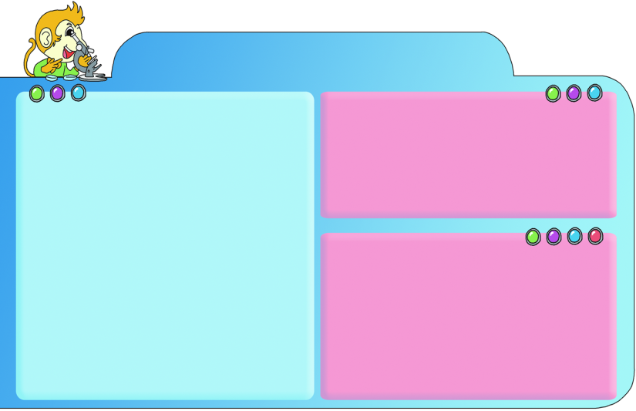
Language Focus
class grade
thirteen fourteen
fifteen sixteen
seventeen eighteen
nineteen twenty
Which class are you in?
I’m in Class One, Grade Four.
What’s your number?
I’m number thirteen.
What’s seven and eight?
It’s fifteen.
What’s eight and nine?
It’s seventeen.
What’s the time?
It’s 7:20.
one two three four five
six seven eight nine ten

Slide 10
Play roles
询问年级和班级
I’m in Class two, Grade Four.
Which class are you in？

Slide 11
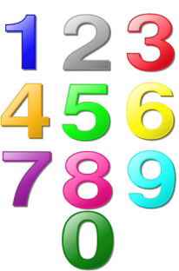
询问编号或数字
What’s your number?
I’m number eight.

Slide 12
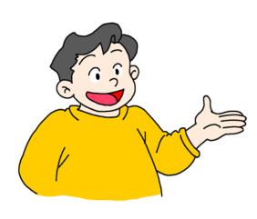
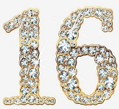
如何用英文描述加法
What’s seven and nine?
It’s sixteen.

Slide 13
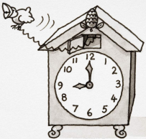
如何用英语询问具体时间点
What’s the time?
It’s 9:00.

