Slide 1
What colour is it?
第1课时
WWW.PPT818.COM

Slide 2
I have a red pencil.
red

Slide 3
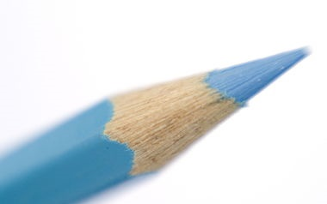
I have a blue pencil.
blue

Slide 4
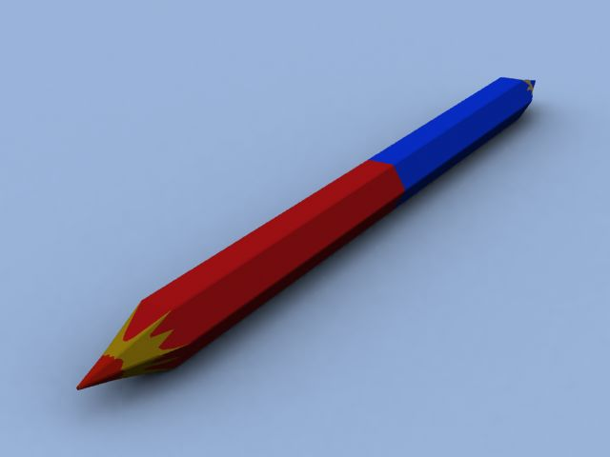
The pencil is red and blue.

Slide 5
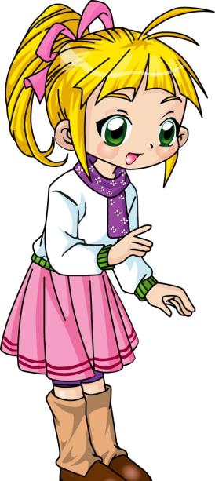
Hi, Li Yan. I have
a new pencil.

Slide 6
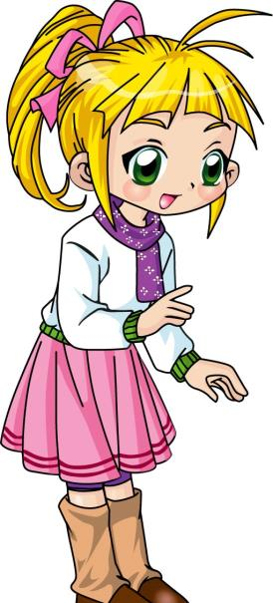
What colour is it?

Slide 7
Look!
Red and blue.
Oh, how nice!

Slide 8
Let's sing
I have a new pen.
I have a new pen.
What colour is it ?
What colour is it?
Red and blue.
Red and blue.
How nice!
How nice!

Slide 9
Lisa: Hi, Li Yan. I have a new pencil.
Li Yan: What colour is it?
Lisa: Look! Red and blue.
Li Yan: Oh, how nice!

Slide 10
Homework
1.Practice the chant again.
2.Use “What colour is it?” to make a dialogue.

Slide 11
Thank You.

