Slide 1
Unit 5
What are the shirts made of?
Section B 2a-2e
WWW.PPT818.COM

Slide 2
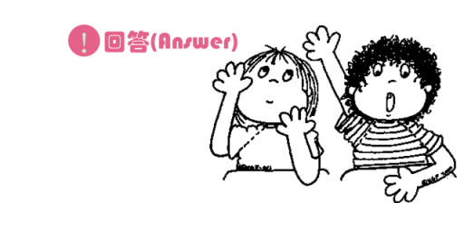
Free Talk
Do you know about any Chinese traditional arts in?
Notes:
2
2

Slide 3
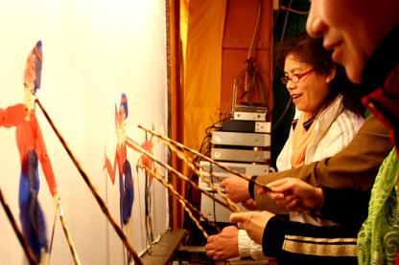
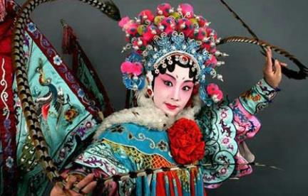
shadow figures
Beijing Opera

Slide 4
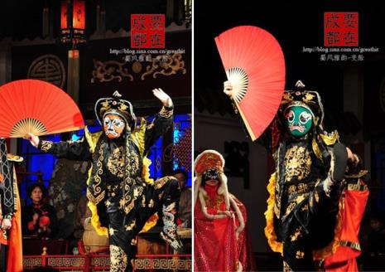
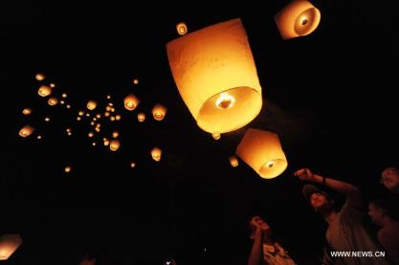
Face-Changing
in Sichuan Opera
sky lantern

Slide 5
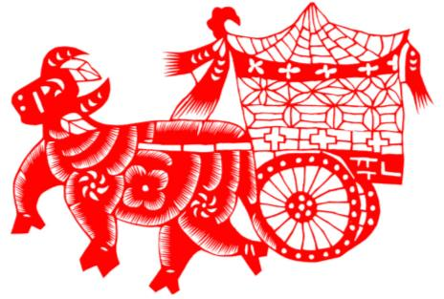
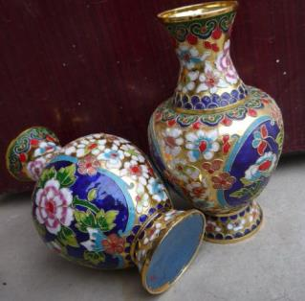
paper cutting
china

Slide 6
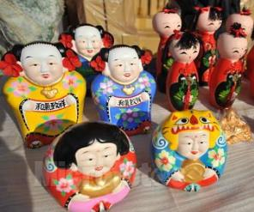
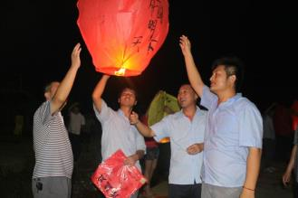
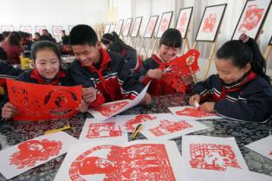
Which art form would you like to learn? Why?
Notes:
6
6

Slide 7
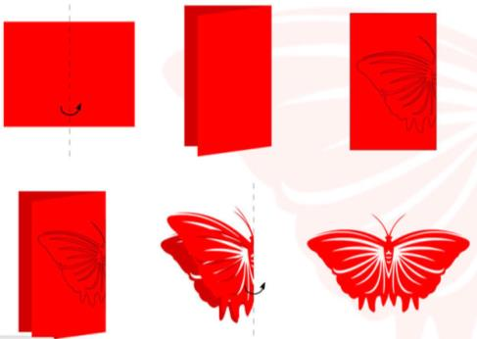
How to cut out a butterfly?
Steps:
Print out design.
2. On another sheet of paper, trace out the design.
3. Using scissors, cut out the traced design.

Slide 8
2a What do you know about folk or
traditional art, like paper cutting?
Tell your partner about it.
Paper cutting is a famous traditional art in China. We cut out different animals, characters, flowers with scissors. And we put them on windows, doors and walls for a happy new year.

Slide 9
2b Read the passage and complete the
chart below.
Reading Strategy
MOVING FROM GENERAL
TO SPECIFIC
A general introduction of the topic is
usually followed by specific details and examples.

Slide 10
Beauty in Common Things
Each different part of China has its own special forms of traditional art. These usually try to show the things that are important in life, such as love, beauty and family. The most common things, from paper to clay to bamboo, are turned into objects of beauty.
According to Chinese history, sky lanterns were first used by Zhuge Kongming. He sent them out to ask for help when in trouble.

Slide 11
Today, sky lanterns are used at festivals and other celebrations. They are made of bamboo and covered with paper. When the lanterns are lit, they slowly rise into the air like small hot-air balloons for all to see. They are seen as bright symbols of happiness and good wishes.
Paper cutting has been around for over
1,500 years. Paper cutting sounds very easy but it can be difficult to do. The paper, usually red, is folded before it is cut with scissors.

Slide 12
The most common pictures are flowers, animals, and things about Chinese history. During the spring festival, they are put on windows, doors and walls as symbols of wishes for good luck and a happy new year.
Chinese clay art is famous because the clay
pieces are so small but they look very real. The pieces are usually cute children or lively
characters from a Chinese fairy tale or
historical story. The pieces are carefully
shaped by hand from a very special kind of

Slide 13
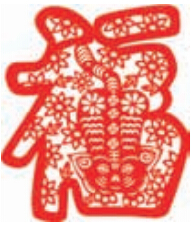
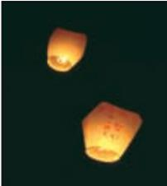
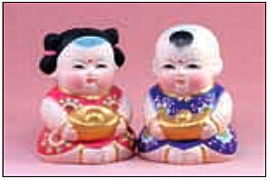
clay and then allowed to air-dry. After drying, they are fired at a very high heat. They are then polished and painted. It takes several weeks to complete everything. These small pieces of clay art show the love that all Chinese people have for life and beauty.

Slide 14
Traditional art form | Materials used
1.
2.
3.
sky lanterns
bamboo, paper
paper cutting
paper
Chinese clay art
clay

Slide 15
Language points
1. Each different part of China has its own
special forms of traditional art.
中国每个不同的地 区都有各自独特的传统艺术形式。
form (sort; kind) 此处用作可数名词，意为
“形式;类型”。
►These are two different forms of the same thing.这是同一事物的两种不同形式。

Slide 16
(2) form (a piece of paper on which you write
information)作名词,还可以表不“表格(纸)”。
► Please fill in this form, giving your name, address and business.
请填一下这张表, 写上你的姓名、地址、和 职业。
(3) form还可以作动词，意为“构成;组成”。
►We formed a study group.
我们组成了一个学习小组

Slide 17
2. These usually try to show the things
that are important in life, such as
love, beauty and family.
★ such as常用来列举同类人或事物中的多个例子。
e.g. I like animals, such as dogs, bears
and pandas.
我喜欢动物，如狗、熊、熊猫。

Slide 18
such as和for example都有“例如”的意思，但是它们的用法有所不同。
★ for example一般只以同类人或事物中的“一个”为例。
e.g. He has ever been to many countries,
for example, Australia.
他曾经去过许多国家，如澳大利亚。

Slide 19
3. The most common things, from paper to clay to bamboo, are turned into objects of beauty. 最普通的东西，从纸到黏土再到竹子,都变成了美丽的物品。
turn ... into …是动词短语，意为“把……变
成……”。
► The farmers are turning wasteland into rice fields.
农民们正把荒地变成稻田。

Slide 20
拓展：
turn on 打开
turn off 关闭
turn up 调大(音量)
turn down调小(音量)
turn against 背叛
turn in 上交
turn over 翻转

Slide 21
4. He sent them out to ask for help when in
trouble. 当遇到麻烦的时候，他就放孔明灯
以寻求帮助。
(l) send out意为“发出；放出；发送”，是
“动词+副词”短语，代词作宾语时，要放在
两者之间。但如果名词作宾语，可以放在
短语后 面，也可放在短语中间。
► The sun sends out light and heat.
太阳发出光和热。

Slide 22
(2) when in trouble是状语从句的省略句，当主句主语和从句主语相同且从句中有be动词时,可以把从句中的主语以及be动词省略。
► I saw him while (I was) waiting for the bus.
等公共汽车的时候我看见他了。
► He fell asleep when (he was) on duty.
他值班的时候睡着了。

Slide 23
5. They are made of bamboo and covered with paper. 它们由竹子制成，外面被糊上纸。
be covered with 意为“被......覆盖”。
►The whole land is covered with white snow now.
现在整个大地都被白雪盖住了。
be covered by 也表示“被……覆盖”是被动语态结构，而be covered with是系表结构，侧重于事物的状态，可译为“到处都是”。
►The field is covered by water. 地被水淹了。
►The field is covered with water.
地里到处都是水。

Slide 24
6. When the lanterns are lit, they slowly rise into the air like small hot-air balloons for all to see. 孔明灯被点燃后会慢慢上升到空中,像小型的热气球,能被所有人看见。
(1)时间状语从句中，谓语are lit是被动语态结
构，意为“被点燃”。light作及物动词时，
意为“点燃”，过去式和过去分词都是lit。
► He lit a cigarette and began to smoke.
他点着了 一支烟开始抽起来。

Slide 25
(2) rise into意为“上升到；升人”。
► Chang’e-3 rose into space within
seconds.
短短几秒钟之内，“嫦娥三号”升入
太空。

Slide 26
7. They are seen as bright symbols of happiness and good wishes.
它们被看作是幸福和美好祝福的光明的象征。
as介词，意为“作为;当作”。
► He works in the school as a teacher of math. 他在学校里担任数学教师。

Slide 27
拓展：
as作连词的用法
(1) as 意为“因为；由于”引导原因状语从句。
► You must hurry up as there is little time left.
你必须快点，因为剩下的时间不多了。
(2) as 意为“像；按照”引导方式状语从句。
► You must do everything as I asked you to.
你必须按我要求的那样做每件事。
(3) as 意为“当……的时候；一边…一边…”引导时间状语从句。
► She sings as she walks. 她边走边唱歌。

Slide 28
8. The paper, usually red, is folded before it is
cut with scissors.
通常是红色的纸,在用剪刀裁剪之前要先折叠。
scissors意为“剪刀”，是名词复数形式，常用表达： a pair of scissors 一把剪刀。“a pair of + 复数名词 ” 做主语时，谓语动词与pair形式一致。
► A pair of scissors costs a little, in fact.
一把剪刀实际上花不了几个钱。

Slide 29
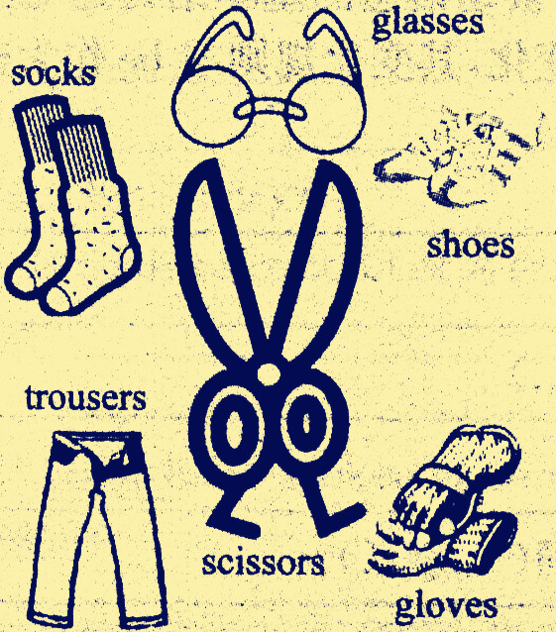
拓展：
常见a pair of修饰的名词

Slide 30
9. The pieces are usually cute children or
lively characters from a Chinese fairy tale
or historical story.
这些工艺品通常是可爱的孩 子，或者是源
自中国童话故事或者历史故事 中的活泼的
人物形象。
lively (full of life and energy)形容词，意为“生气勃勃的;活泼的;(色彩)鲜艳的”。
► She may be 80, but she’s still lively.
她也许有八十岁了，但仍精力充沛。

Slide 31
辨析：
lively,alive与living
lively | 生气勃勃的；精力充沛的”，可作定语或表语
alive | 活着的”，常作表语或后置定语
living | 活着的”，常作定语
►Who is the lively boy in the picture?
照片中那个活泼的男孩是谁？
►Luckily, the dog is still alive.
幸运的是，这只狗仍然活着。

Slide 32
►He is one of the oldest men alive in the world.
他是世界上仍健在的最老的人之一。
►The river is so dirty that no living things can
live in it.
河水这么脏，以至于没有生物 能在里面生
存。

Slide 33
10. After drying, they are fired at a very high heat. 干了以后它们被高温烧制。
heat (high temperature )名词，意为“热;高温”。
at a very high heat 意为“通过高温”, heat虽是不可数名词, 但前面有修饰成分时，要用冠词a。
► You can feel the heat of the sun.
你可以感觉到太阳的热气。
heat还可作动词，意为“加热；变热”
► Heat some water! 烧些水吧！

Slide 34
11. It takes several weeks to complete
everything. 完成每件作品需花费好几个星期。
(1)该句为“It takes (sb.) + 一段时间+ to do
sth.” 句型，意为“做某件事花费（某人）
多长时间”。
► It took him an hour and a half to write the
letter.
写这封信花了他一个半小时。

Slide 35
(2 ) complete ( to finish doing or making
something )动词，意为“完成”。
►The builders will complete the new sports
center next year.
建筑工人将在明年建成这 个新的运动中心。
complete (with no parts missing)还可作形容词，意为“完整的；完全的”。
►Is this a complete story?
这是一个完整的故事吗？

Slide 36
2c Read the passage again and answer the questions.
1.What do traditional Chinese art forms try to
show?
They try to show the things that are important in life, such as love, beauty and family.
2.What were sky lanterns used for before and
what are they used for now?
They were used for asking for help before,
and they are used for making wishes at
festivals and other celebrations now.

Slide 37
3.What kinds of pictures are usually found on
paper cuttings?
On paper cuttings, the most common
pictures are flowers, animals, and things
about Chinese history.
How do people use paper cuttings during
the Spring Festival?
People put paper cuttings on windows, doors and walls as symbols of wishes for good luck and a happy new year.

Slide 38
5.What are the steps for making clay art pieces?
First, they are carefully shaped by hand from
a very special kind of clay and then allowed to air-dry. After that, they are fired at a very high heat and then polished and painted.
6.Which art form do you think is the most interesting? Why?
Chinese clay art. Because they are so small
but they look very real.

Slide 39
2d Complete the sentences using the correct forms of the phrases in the box.
such as turn ... into send out
cover with rise into put ... on
People used to _________ sky lanterns when
they were in trouble. But today, people light the lanterns and watch them _________ the sky with their wishes.
send out
rise into

Slide 40
2. The art of paper cutting _______ a simple
thing like a piece of paper _____ a beautiful
piece of art. People often _____ these art
pieces ____ the doors, windows and walls of
their homes to celebrate the Spring Festival.
3. To make Chinese clay art, the clay is shaped
by hand into things ________ cute children
or characters from Chinese fairy tales and
stories. They are then ___________ paint.
turns
into
put
on
such as
covered with

Slide 41
2e Discuss the questions in your group.
Which art form do you think is the easiest? Which is the most difficult? Why?
I think paper cutting us the easiest, because
we just cut a a piece of paper into what we want with scissors. I think Chinese clay art is the most difficult, because there are too many steps to make a clay piece.

Slide 42
2.Which art form would you like to learn? Why?
I want to learn paper cutting, not only because it is easy to learn, but also because we can do it at any time.

Slide 43
练习

Slide 44
I. 单项选择。
1. In order to find a job, I ___ my information
on the Internet.
A. asked for B. found out
C. sent out D. heard from
2. The table is so dirty. Why don’t you ____
the table ____ a piece of cloth?
A. put; on B. cover; with
C. turn; into D. take; from
C
B

Slide 45
3. How much are _______?
A. the pair of scissor
B. these pairs of scissor
C. the pair of scissors
D. these pairs of scissors
D
4. Although he is old, he is _____ and strong.
A. living B. alive C. lively D. lived
C

Slide 46
5. One third of the earth’s surface _____water.
A. is covered by B. was covered by
C. covers by
6. ________ is used for making knives in most
of China.
A. Steel B. Bamboo C. wood
7. This is a __________ story that I will never
forget.
A. historical B. history C. historic
A
A
A

Slide 47
8. Water ___ ice if the weather is below zero
A. will be turned off
B. will be turned to
C. will be turned into
9. This _____ is made of metal and plastic.
A. pair of scissors B. scissors
C. piece of scissors
C
A

Slide 48
10. _____ are usually put on windows or
doors during the Spring Festival.
A. Clays B. Paper cuttings
C. Sky lanterns
11. People often _____ on Lantern Festival.
A. fly sky lanterns
B. cut paper
C. make clay
B
A

Slide 49
II.句型转换。
Longjing Tea is produced in Hangzhou.
(对 画线部分提问）
______ ____ Longjing Tea __________?
2. He seems very angry.(改为同义句）
___ ______ ____ he is very angry.
3. Our school holds a sports meeting every
year. (改为被动语态）
A sports meeting ___ ______ in our school every year.
Where is
produced
It seems that
is held

Slide 50
4. The food is cooked with very high
temperature. (改为同义句）
The food is cooked ___ ___ _____ _____ _____.
5. Do people grow rice in South China?
(改为 被动语态）
___ rice ________ by people in South China?
at a very high heat
Is grown

Slide 51
Homework
Preview the writing in 3b.
Master the words and expressions
in this unit.

Slide 52
Thank You!

