Slide 1
I’m in Class One, Grade Three.
第6课时
WWW.PPT818.COM

Slide 2
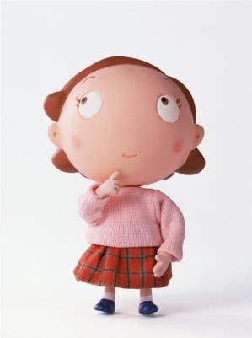
numbers
around us

Slide 4
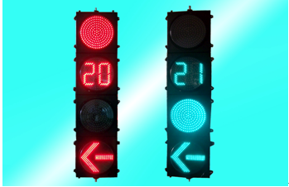

Slide 5
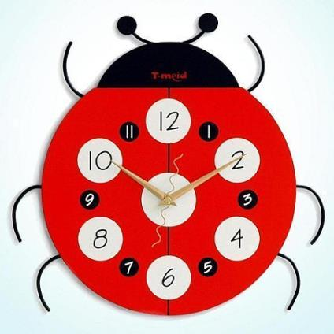

Slide 6
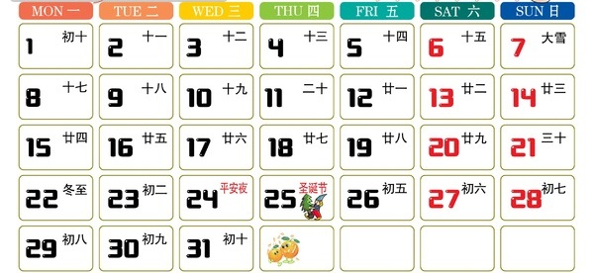

Slide 7
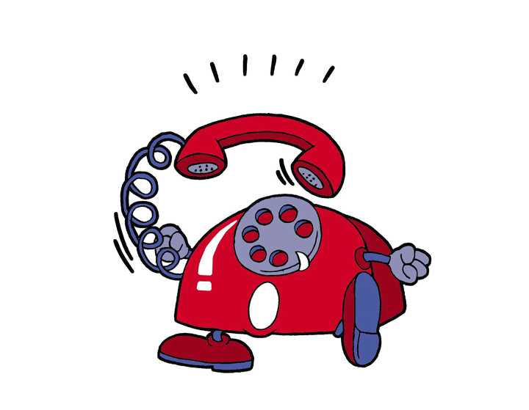

Slide 8
Can you remember?

Slide 9
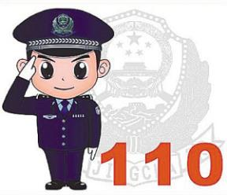
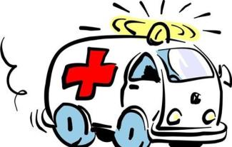

Slide 10
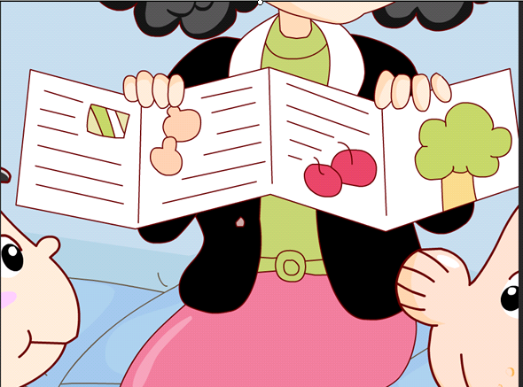
Let's check!

Slide 11
1.What time is it, dad? It’s eleven.
2.Peter is in Class One, Grade Three.
3.How old are you, Li Yan? I’m eight.
4.Hello, what’s your name? My name is cat.
2
4
6
6.How old are you, Gao Wei? I’m ten.
5.What time is it, Lisa? It’s seven.
5
1
3

Slide 12
Fun story

Slide 13
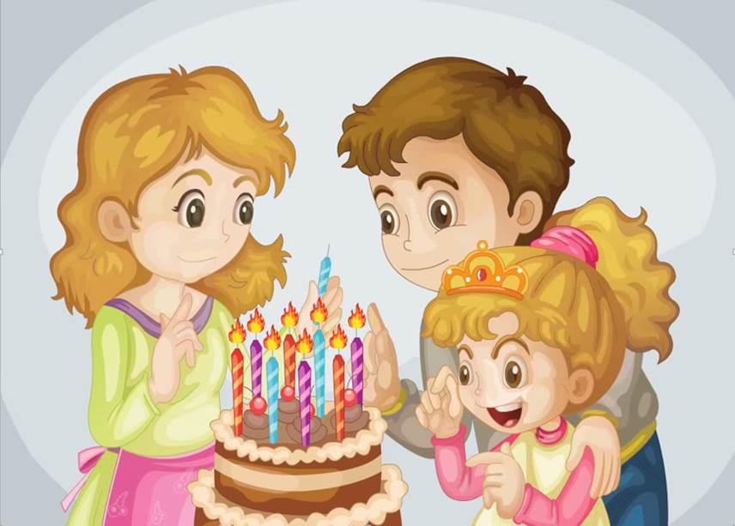
Happy
birthday!

Slide 14
Questions:
1: Whose birthday is today?
2: How old is Wendy?
3: Who is in Class One, Grade Three?
4: Who is Bobby?

Slide 15
Answer:
1: Whose birthday is today?
Wendy’s birthday.
2: How old is Wendy?
Eight.
3: Who is in Class One, Grade Three?
Li Yan.
4: Who is Bobby?
Wendy’s brother.

Slide 16
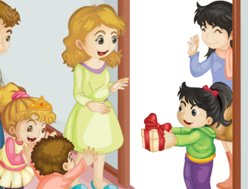
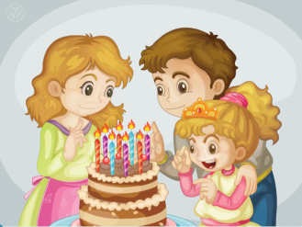
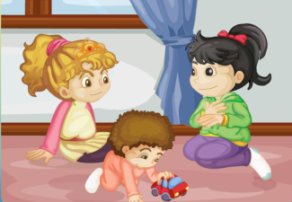
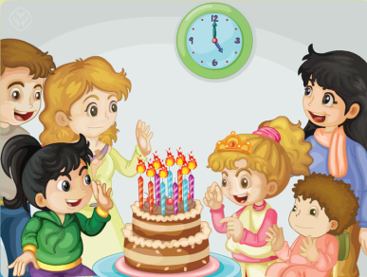
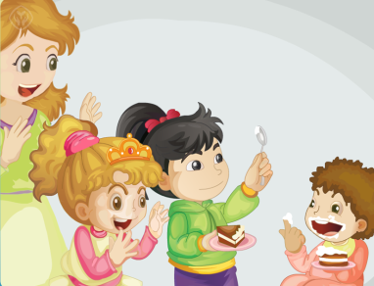
ACT

Slide 17
Congratulations!

Slide 18
Multi-level homework
爱读书的你
Listen to the tape and read the dialogue.
爱思考的你
Make up a new dialogue with your friends.

Slide 19
Thank You.

