Slide 1
Unit 8
Have you read Treasure Island yet?
Section B 3a—3b
WWW.PPT818.COM

Slide 2
Who has a good memory?
Key words:
Sarah
Country music
Garth Brooks

Slide 3
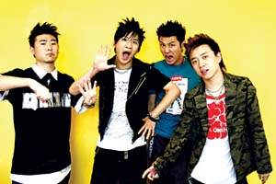
What’s your favorite singer?

Slide 4
How much you know?
Who is the singer/writer?
When did the singer/writer first become famous?
How and why did he/she become famous?
How do you feel about his/her music/books?
Have you ever played/sung his/her songs yourself?
…

Slide 5
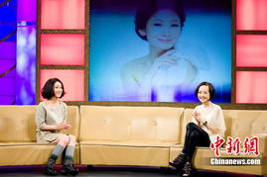
Interview

Slide 6
Interview
A: Welcome to our program.
B: It’s my honor.
A: You are popular among the young people. A lot of fans collect your posters, your videos and so on. They want to know more about you. Do you remember your first song?
B: …

Slide 7
Write your trouble in this unit on the paper and put it on the blackboard, let’s help each other.
?
?
?
?

Slide 8
Homework
假如你是歌手Sally的经纪人，请为她做个合理的周计划。要有适当发挥，使用现在完成时。

