Slide 1
Unit5 Amazing things
Task
WWW.PPT818.COM

Slide 2
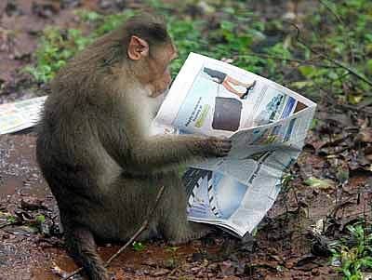
What is the monkey doing?
Isn’t that interesting?

Slide 3
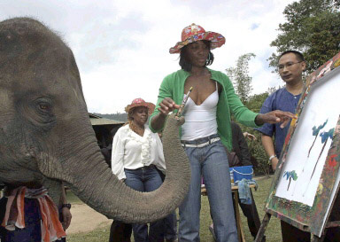
1.What is the elephant doing?
2. Isn’t that amazing?

Slide 4
Beijing Sunshine Secondary School is holding a writing competition. The topic is ‘Amazing things’. Here are Millie, Simon and Amy’s notes :

Slide 5
The tallest man
a man in the USA
born on 22nd February 1918
died on 15th July 1940
2.72 m tall
weight 222.71kg when he was 21 and 199kg when he died
hands 32.4cm long

Slide 6
Sandwiches
a man’s name
loved playing cards
did not want to stop to have dinner
put meat between two pieces of bread
People learnt to make this kind of food and loved to eat it very much.
People named the food after the man.

Slide 7
Amazing TV
not sure who invented TV
in 1928, the world’s first colour TV show, showed some scarves, a policeman’s hat, some flowers, a man and a cigarette
in 1928, the first TV star–Felix the Cat
in 1936, only 2,000 TV sets around the world
By 1967, more people used colour TV sets than black-and-white TV sets.

Slide 8
Simon wrote the draft about the amazing things on his computer .However, he could not remember some of the facts. Help him complete it with the notes in Part A.
Do you know the tallest man in the world? The tallest man in history was from _________. He _________ on 22nd February 1918 and _______ on 15th July 1940. He ___________ tall. Even his hands ____________ long. At the age of 21, he ______________ kg. When he died, he ____________ kg.
Most people like eating sandwiches but few of them know the history of them. I read in a book that once there was a ________ called sandwich. He _________________ with his friends all day and he ___________________________________. Then he ____________________________________ and ate it as dinner so he could keep on playing. Soon many people learnt to make this kind of food and loved it. They named the food after _________.
the USA
was born
died
was 2.72m
were 32.4 cm
weighed 222.71
weighed 199
man
loved playing cards
didn’t want to stop to have dinner
put meat between two pieces of bread
the man

Slide 9
Do you know anything about the first TV star? It was ______________. It appeared in ________. At the same year, there was ________________________________________show. It showed ____________________________________________________________. Very few people had TV before. In 1936, there were ________________ around the world. By 1967, more people used _________________________________________. Today, most of us have one. However, it is still not sure ___________________. Isn’t that amazing?
Felix the Cat
1928
the world’s first colour TV
only 2000 TV sets
some scarves ,a policeman’s hat, some flowers, a man and a cigarette
colour TV sets than black-and-white TV sets
who invented TV

Slide 10
New words
scarf
scarves
cigarette

Slide 11
PK
1
2

Slide 12
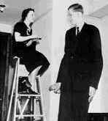
The tallest man in the world
1. Where was the man from?
He was from the USA.
2. When was he born?
He was born on 22nd February 1918.
3. When did he die?
He died on 15th July 1940.
4. How tall was he?
He was 2.27 meters tall.
5. How much did he weigh ?
He weighed 222.71kg when he was 21and 199kg when he died.
6. How long was his hand?
32.4 cm.

Slide 13
Do you know the tallest man in the world?
The tallest man in history was from ______________.He_______ on 22nd February 1918 and __________ on 15th July 1940.He ____________tall. Even his hands____________long. At the age of 21, he _____________kg. When he died, he ______________.
the USA
was born
died
was 2.72m
were 32.4cm
weighed 222.71
weighed 199

Slide 14
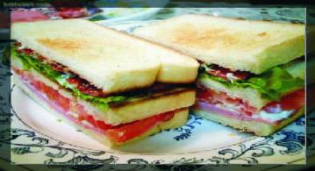
1.what was the man’s name?
His name was sandwich.
2.What did he love doing?
He loved playing cards.
3.Did he want to stop to have dinner?
No, he didn’t.
4.What did he do then?
He put meat between two pieces of bread.
5.Did people love sandwiches very much?
Yes, they did

Slide 15
Most people like eating sandwiches but few of them know the history of them. I read a book that once there was a _________called Sandwich. He _________________with his friends all day and he____________________________________
Then he _________________________________and ate it as dinner.so he could keep on playing. Soon many people learnt to make this kind of food and loved it.They named the food after __________.
man
loved playing cards
did not want to stop to have dinner
put meat between two pieces of bread
the man

Slide 16
1. Who invented TV?
2. When did the first colour TV appear?
3. Who was the first TV star?
4. How many TV sets were there in 1936?
5.Did more people use colour TV sets than black-and –white TV sets?

Slide 17
Do you know anything about the first TV star? It was __________________ . It appeared in _____________. At the same year, there was _______________________show . It showed _____________________________________ ________________________very few people had TV before. In 1936, there were______________ around the world. By 1967,more people used___________________________________. Today. Most of us have one. However, it is still not sure _________________.Isn’t that amazing?
Felix the Cat
1928
the world’s first colour TV
Some scarves, a policeman’s hat, some flowers,a man and a cigarette
only 2000 TV sets
colour TV sets thanblack-and-white TV sets
who invented TV

Slide 18
The Last PK

Slide 19
选择适当的词填空
1. died on
2. two pieces of bread
3. Stop to play
4. learnt to make
5. Keeps on singing
1. Millie is a hard-working student, she doesn’t want to _________.
2. Our great leader Chair Mao ________ Sep 9th, 1976.
3. Daniel came to China a year ago. He ________dumplins by himself.
4. What did you have for breakfast yesterday morning?
_________.
5. Kate wants to be a singer one day, so she ______every day.

Slide 20
Do you know anything unusual?

Slide 21
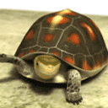
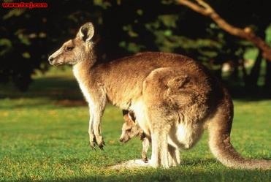
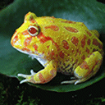
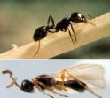
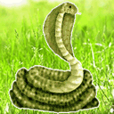
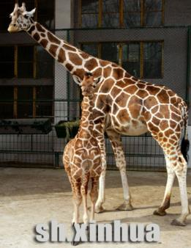
Amazing animals

Slide 22
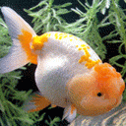
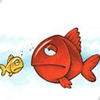
fish

Slide 23
Notes about ‘Do fish sleep?’
Fish sleep with their eyes open
Fish live in water and sleep in water
Some fish sleep in the daytime but some sleep at night
Fish are sleeping when they are not moving
Fish sleep and float in water; sometimes they stay on the sea bed
Fish usually do not have eyelids

Slide 24
Do you know that fish ______ with their ____ open? Do you know why?
Fish live in _____ .Some fish ______ in the daytime but some sleep at ______. If fish are not moving in the water, they are ________. They may _____ in the water or stay on the _______ when they sleep. They do not close their _____ because they do not have _______.
sleep
eyes
water
sleep
night
sleeping
float
seabed
eyes
eyelids

Slide 25
You want to write about an amazing thing for a writing competition.
If you cannot find information about an amazing thing, I’ll give you some information about elephants!

Slide 26
Elephants
1.elephants are the biggest living animals on land
2.elephants can eat 100 to 1,000 pounds of grass in a day
3.elephants can live 60-70 years
4.there are no bones in the back of elephants’ feet—only fat
5.elephants walk on tiptoe---can walk in the mud easily
6.elephants are big but they can move quietly
7.elephants grow large teeth --- we call them tusks

Slide 27
Do you know elephants?
Do you know that elephants are the biggest living animals on land? Elephants can eat 100 to 1,000 pounds of grass in a day. They can live 60-70 years.
Elephants are very big but they can move quickly. They walk on tiptoe and can walk in the mud easily. There aren’t any bones but some fat in the back of elephants’ feet. The large teeth of elephants are called tusks.

Slide 28
Class work
Write an article about kangaroos

Slide 29
Kangaroo
1.a kind of lovely animal, eat grass and leaves
2. jump high and quickly, use its tail for pushing off
3.mother kangaroos, pockets, carry their sons and daughters

Slide 30
Kangaroo
Kangaroo are a kind of lovely animals. They live
on land. They eat grass and leaves. They can
jump high and quickly, but they can't jump at all
without their tails. They use their tails for pushing
off, and their tails are very strong.
There is another amazing fact about them. Mother
kangaroos have pockets in their bodies. They can
carry their sons and daughters in the pockets.
Animals are lovely. We should protect the animals
to make our world more beautiful and lovely .

Slide 31
homework
Write amazing things
for a competition.

