Slide 1
Unit 1 It might snow.
WWW.PPT818.COM

Slide 2
Words and expressions
/klaud/
/'ʃauə/
/snəu/
/stɔ:m/
/'klaudi/
/reIni/
/'snəui/
/'sʌni/
云，云雾 n.
cloud
阵雨 n.
shower
雪 n.下雪 v.
snow
暴风雨 n.
storm
多云的 adj.
cloudy
多雨的；下雨的 adj.
rainy
多雪的；下雪的 adj.
snowy
sunny
晴朗的 adj.

Slide 3
/'wIndi/
/skeit/
/θIk /
/aIs/
/dʒəuk/
/maIt/
/'temprItʃə /
/'maInəs/
windy
多风的；刮大风的 adj.
滑冰 v.
skate
厚的 adj.
thick
冰 n.
ice
说玩笑；开玩笑 v.
笑话；玩笑 n.
joke
might
可能；也许 v.aux.
温度 n.
temperature
负的；零下的 adj.
minus

Slide 4
/dI'gri:/
/ɔ:l'ðəu /
/wet/
/'naIðə:'ni:ðə/
/'terəbl/
/wiʃ/
/'prɒbəbli /
come on
度；度数 prep.
degree
然而；尽管 conj.
although
下雨的；湿的 adj.
wet
neither
(某人或某事物)也不 adv.
使人烦恼的；可怕的 adj.
terrible
但愿；希望 v.
wish
probably
或许；可能 adv.
快点

Slide 5
Say some words about the weather
rain
snow
sunny
windy
wind
shower
Weather
cloudy
rainy
cloud
storm
snowy

Slide 6
sun
ny
cloud
y
晴朗的
多云的

Slide 7
rain
y
wind
y
下雨的
刮风的

Slide 8
storm
暴风雨
y
shower
阵雨
y

Slide 9
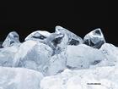
snow
下雪的
y
freezing
冰冻的

Slide 10
n.
adj.
shower
storm
rain
wind
cloud
snow
sun
stormy
rainy
windy
Weather
cloudy
snowy
sunny
warm
cool
cold
hot

Slide 11
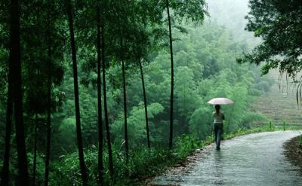
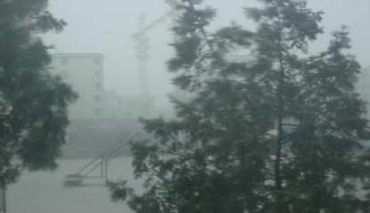
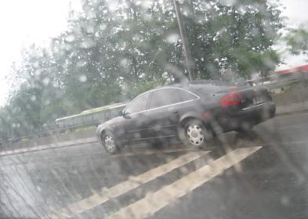
What’s the weather like?
foggy
rainy
It’s ______.
It’s ______.
a heavy shower
It’s _____________.
it’s________
stormy

Slide 12
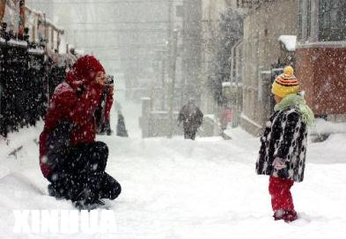
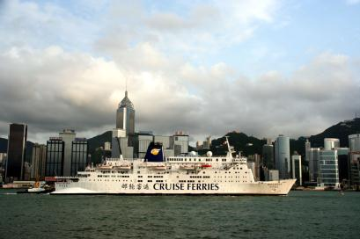
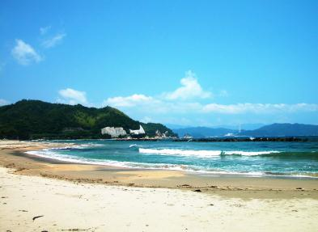
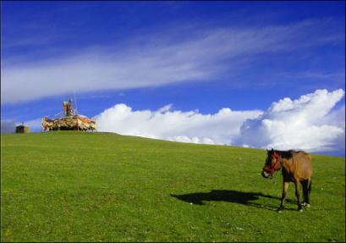
It’s ______.
It’s _______.
snowy
cloudy
It’s _______.
windy
sunny
It’s _______.

Slide 13
Say what the weather may or might be like in your town.
tomorrow \next week \next month
It may\might snow tomorrow.
May\might 意为 “可能” . 是情态动词，后直接加动词原形。
May,might没多大区别，形式上might是may过去式，但推测将来可能情况时，语气更不确定，可能性更小。

Slide 14
sunny
It might be ______ tomorrow.

Slide 15
Next week
Monday
rain
There may be _____ on Monday.
rainy
It may be _____ on Monday.
Tuesday
cloud
There may be ______ on Tuesday.
cloudy
It may be ______ on Tuesday.

Slide 16
Wednesday
sunny
It may be ______ on Wednesday.
Thursday
windy
It may be ______ on Thursday.
wind
There may be ______ on Thursday.

Slide 17
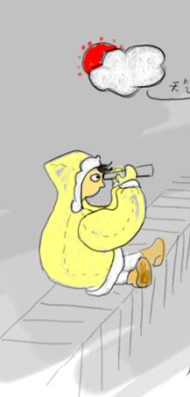
Friday
clear to overcast
It may be _______________ (晴转多云) on Friday.

Slide 18
minus
degree(s)
℃
5
一

Slide 19
Can you read?
-7℃ ~ 2℃
5℃ ~ 8℃
between minus seven and plus two degrees
minus seven to plus two degrees
five to eight degrees

Slide 20
What’s the temperature?
It’s…
-7℃:
1℃:
5~ 8℃：
-1 ~14℃:
10~ 21℃:
17~20℃ :
minus seven degrees
one degree
between five and eight degrees
minus one to plus fourteen degrees
between ten and twenty one degrees
between seventeen and twenty degrees

Slide 21
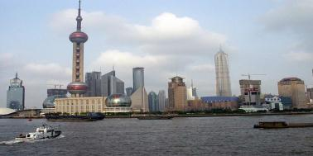
weather forecast
Shanghai
5℃～8℃
What will the weather be like tomorrow?
----It will be…
What will the temperature be?
----It will be…

Slide 22
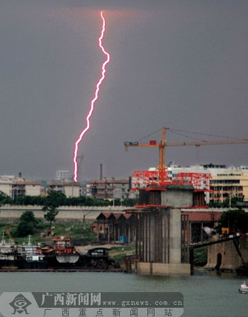
weather forecast
Guangzhou
10℃～21℃

Slide 23
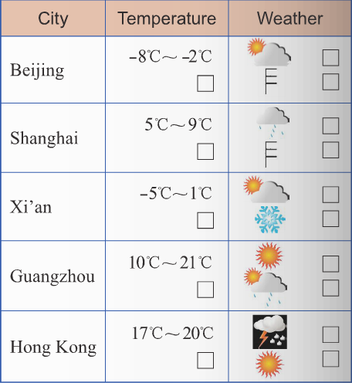
Work in pairs. Talk about the weather.

Slide 24
4. Watch and read
Everyday English
_{Are you joking?}
_{Sounds great!}
_{Me neither.}
_{Come on!}

Slide 25
Check (√) the true sentences.
1. Tony and Daming are going to skate.
2. Winter is colder in Beijing than in England.
3. It sometimes snows in England in winter.
4. It is not hot in the US in Summer.
5. It usually snows in New York in winter.
6. Tony does not like windy weather.
√
√
√
√

Slide 26
5 Complete the passage with the
correct form of the words from the box.
dangerous degree joke may minus skate temperature
skate
When it’s very cold it might be safe to (1)_______
on lakes, but be very careful! Although it
(2) _______feel cold, it might not be safe. The
(3) ___________ has to be at least (4) _______ one or two (5) _______ or even colder for several weeks. Falling through the ice is(6) _________.I am not
(7) _______ !
may
temperature
minus
degrees
dangerous
joking

Slide 27
Language points
1. come on, better get going
better get going = had better go
最好现在走 / 去
如： We’d better get going
(=we’d better go now),or we’ll be late.
我们做好现在就走，不然要迟到了。

Slide 28
情态动词: must may might
1. You must be joking!
2. It may not even be cold.
3. It might be windy.

Slide 29
1. must (一定): 表示具有很大的可能性。
He must be ill. He doesn’t come today.
2. may (可能): 暗含不确定的意思。
He may be at home .
3. might:表可能，但它的含义比 may
更不确定。
He might come soon .

Slide 30
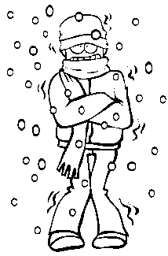
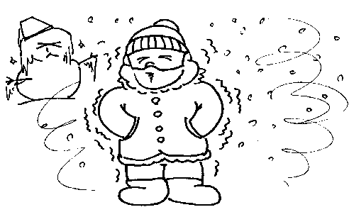
probably 表示推测，放在助动词之后，实意动词之前。
Tomorrow
It’ll probably be cold tomorrow.

Slide 31
Exercise
---Look! The man at the gate ___ be
our headmaster. He is always
standing there every morning.
--- No, it ________ be him. He is
holding a meeting in the office now.
A. must, can’t B. must, mustn’t
C. can’t, can’t D. can’t, mustn’t
(2009·甘肃兰州)
A

Slide 32
2. ---____ I take some photos in the
hall?
---No, you ______.
Can; needn't B. Must; mustn't
C. Could; won't D. May; mustn't
（2009·广州）
D

Slide 33
3.—Whose notebook is this?
—It ____ Jane’s. It has her name on it.
A. must be B. might belong to C. may be
（2009·山东淄博）
4.—May I watch TV for a while？
—No, you ___ You have to finish your homework first.
A. shouldn't B. needn't
C. mustn't D. won't
（2009·湖北武汉）
C
C

Slide 34
5. ---Could you please come to the museum with me this afternoon?
---Sorry, I ______ . I have to take a piano lesson at 2 pm.
A. couldn’t B. mustn’t C. can’t D. needn’t
（2009·山东威海）
6. ---What would you send to your sister as the Christmas gift?
---I haven’t decided yet. I ______ send her a handbag.
A. shall B. may C. must
（2009·四川成都）
C
B

Slide 35
7. — Bob, shall we go and meet our new
classmate?
— Sorry. I'm busy now. But you____
ask David to go with you．He is free．
A．need B．may C．would D．must
8. —What will the weather be like
tomorrow?
— It ______ be rainy, cloudy or sunny.
Who knows?
A. must B. might C. shall D. should
B
B

Slide 36
Homework
Listen to the tape and read the dialogue.

