Slide 1
Module 12 Help
Unit1
What should we do before help arrives?
WWW.PPT818.COM

Slide 2
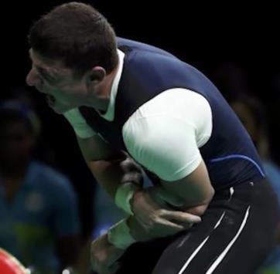
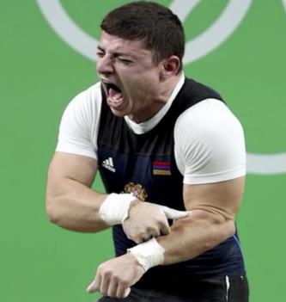
Some accidents
in Rio
Why they are in pain?
It's dangerous to play sports. Please be careful.
broke
Because they (break)their legs and arms.
/They have (break) legs and arms.
broken

Slide 3
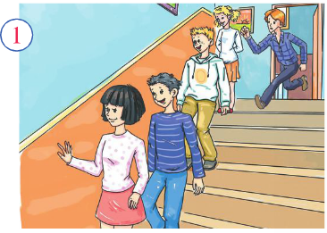
What's the boy doing?
stairs
What could happen to him?
He is running down the .

Slide 4
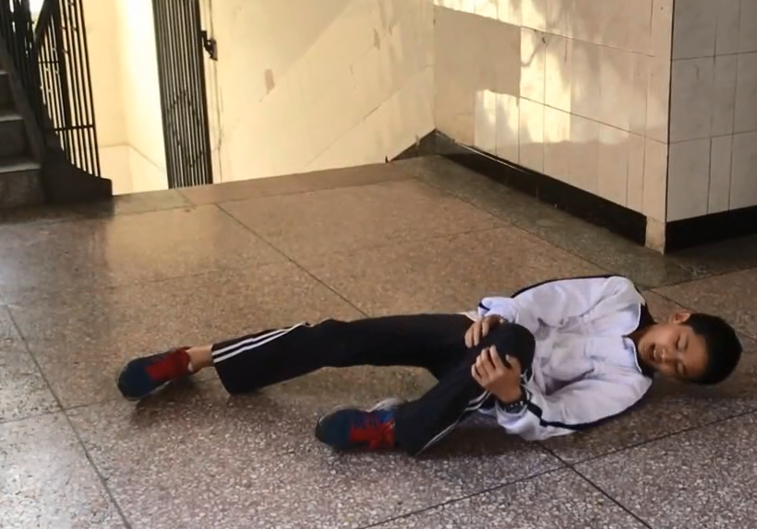
What happened to him?
Where is the boy lying?
He fell down the stairs.
He is lying at the of the stairs.
It's dangerous to run down the stairs.
bottom

Slide 5
We may meet different accidents in our life.
I my glass .
lifted up
dropped
Then, I it on the ground because of my carelessness.
So, I my glass, and there was some glass
on the ground.
broke
broken
We'd better not pick up the broken glass, because it could cut our hands.

Slide 6
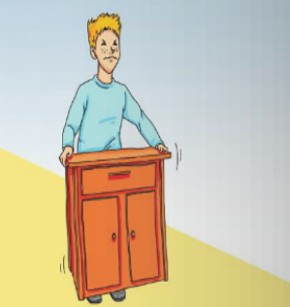
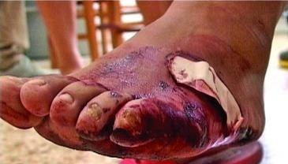
What's the boy moving?
He's moving a piece of
furniture, and it's so heavy.
What could happen?
It could hurt his feet.

Slide 7
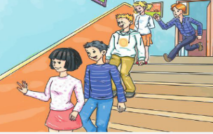
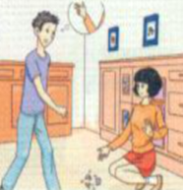
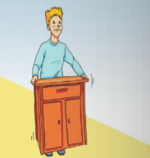
1.Listen and learn more.
Accidents often happen before you notice them. You could when you go down the
at school. It’s quite dangerous in the kitchen at home because ________ glass or knives can cut you. And moving heavy
is dangerous too. You could it and your foot.
fall
stairs
broken
furniture
drop
hurt

Slide 8
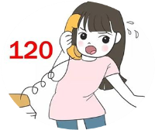
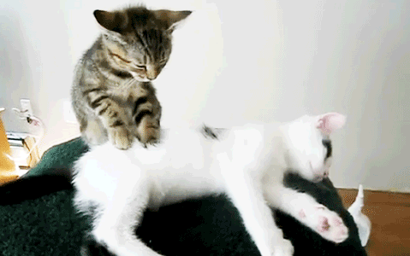
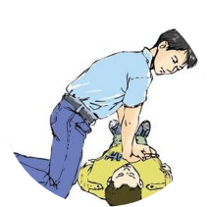
Imagine you are in those situations, if someone is hurt, what will you do to help them?
shout for help
call 120
How to help them?
give some first aid
make him/her comfortable

Slide 9
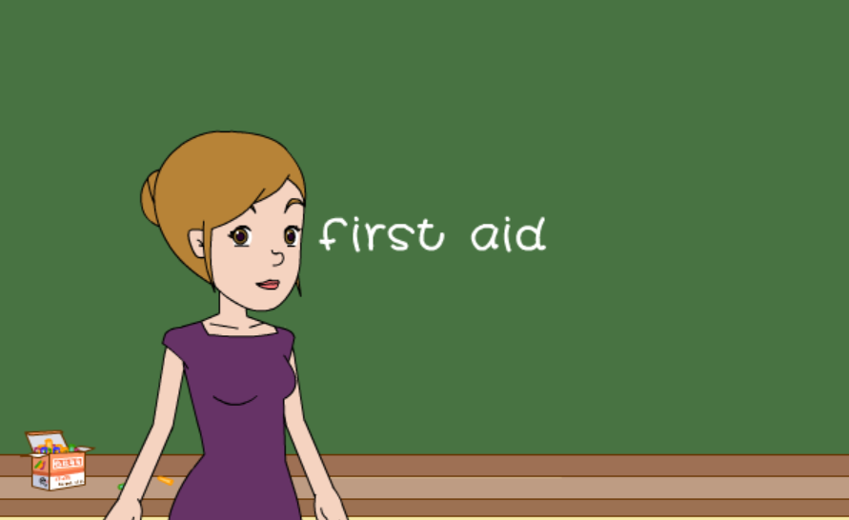
Ms.James is giving class about first aid.

Slide 10
4.Now read these first aid suggestions and decide
if they are good ideas(√) or bad ideas(×).
If it’s wrong, please correct it!
1. Ask the boy what is wrong.
2. Get help.
3. Shout so the boy can hear you.
4. Move the boy to a more comfortable place.
5. Make sure the boy is warm.
√
√
He could have some trouble hearing you.
×
That could be harmful!
×
√

Slide 11
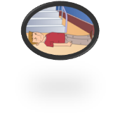
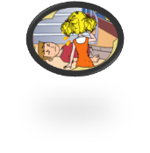
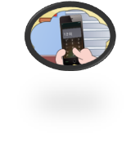
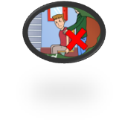
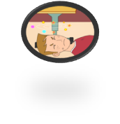
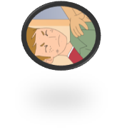
5. Read and fill.
bottom
stairs
What's wrong with the boy? | 1.He is lying at the of the . 2.He isn't or a sound. 3.He is .
What should we do to help him? | 1.We can him,but he might have hearing you or to you. 2.We should help or call 120. 3.We can't him because that could be . 4. We need to him a coat to make sure he's .
moving
making
in pain
ask
trouble
speaking
shout for
lift up
harmful
cover
with
warm

Slide 12
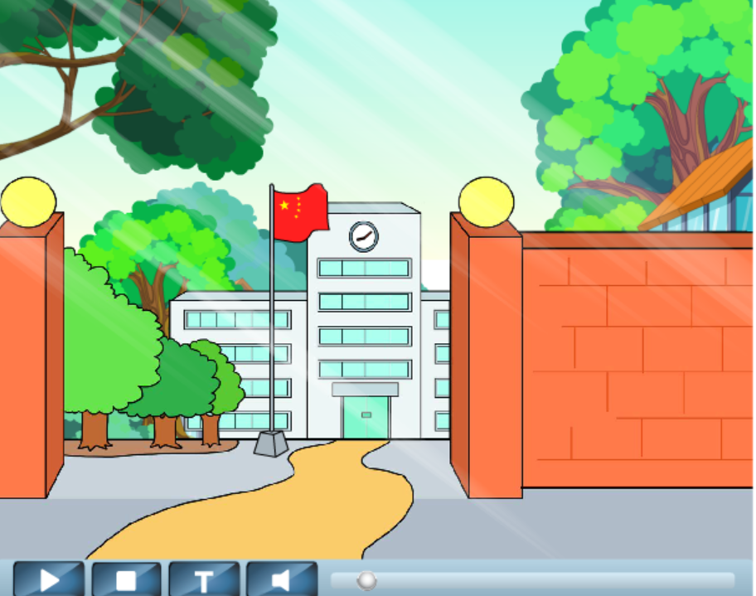
Watch and say!

Slide 13
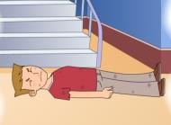
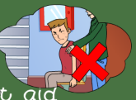
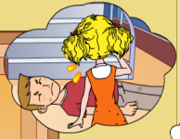
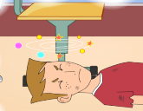
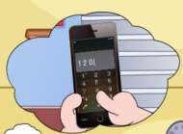
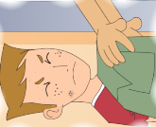
6. Retell the conversation.
lift him up,
sit him on
the chair
lying at...,
in pain
ask him,
have trouble…
be harmful to,
drop him,
hurt him
shout for…,
call…
comfortable,
cover…with
warm

Slide 14
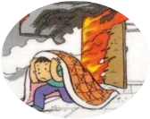
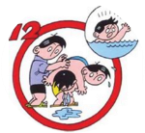
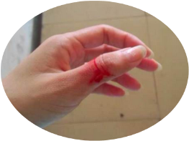
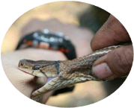
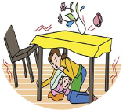
7. What can we do in these situations?
If we see someone drowning, we should…
If we are in a fire, we should…
Calm down and search for help;
Cover...with wet cloth (布料) ;
Run down stairs quickly
Call 120;
Shout for help;
Clean the mouth
and nose;
Push the water out
Do CPR(人工呼吸)
If we cut our fingers, we should…
stop bleeding first.
Then, we should wash it and bind
it up.
Finally, we can go to a doctor.
If the snake bit us, we should…
If we are in an earthquake, we should…
Call 120;
Bind up the wound(伤口); /wuːnd/
Wash the wound;
Try to suck the poison(毒) out. /ˈpɔɪzn/
Stay in a safe place
Cover your head
with...
Try not to run
...

Slide 15
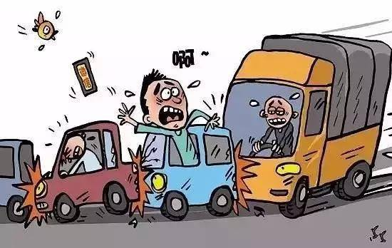
Hundreds of people died from car accidents every day!

Slide 16
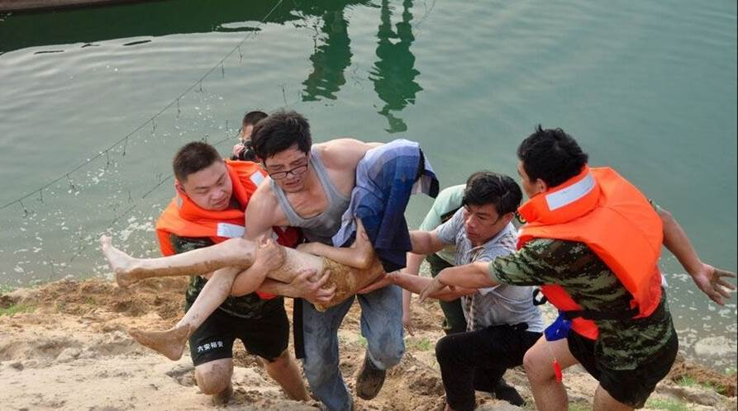
Thousands of children drowned every year!

Slide 17
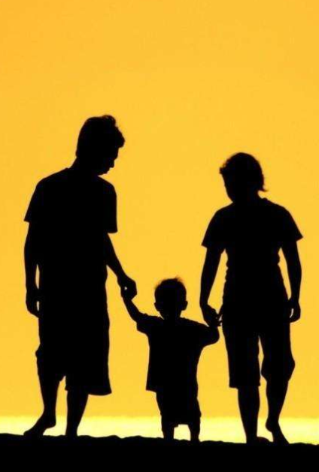
Our parents gave the life
to us!

Slide 18
Life is so frigile!
Cherish our life and keep growing!

Slide 19
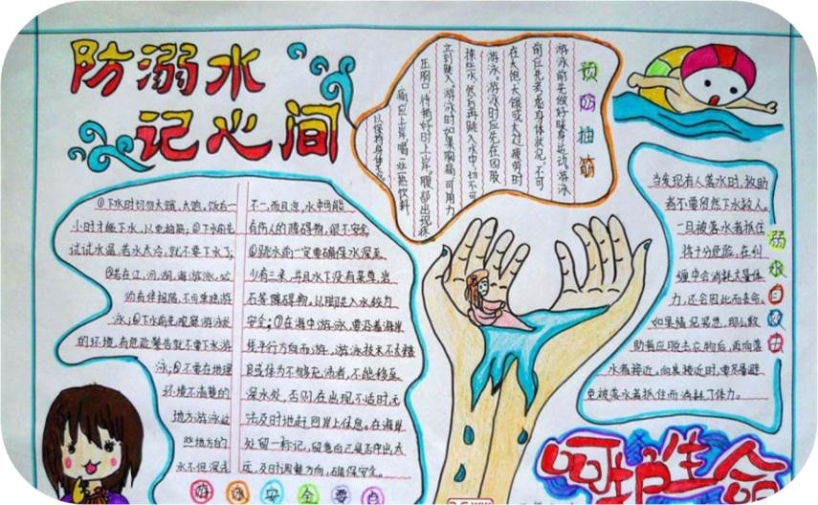
Homework

