Slide 1
Unit 6 Christmas
I got a football
WWW.PPT818.COM

Slide 2
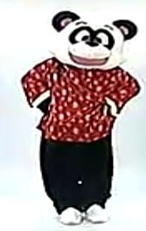
What did Panpan do just now?
（刚才盼盼都做了些什么？）

Slide 3
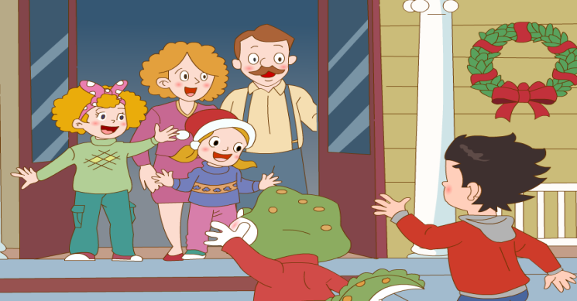
Where did Li Ming and Danny go on Christmas Day?

Slide 4
Li Ming and Danny went to Jenny’s home.
(go的过去式)

Slide 5
went
Yesterday they _____to the park.

Slide 6
went
They _____ to the zoo yesterday.

Slide 7
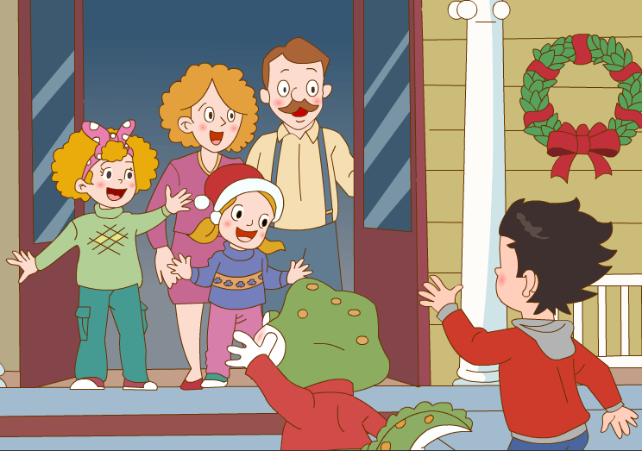
They said “______________”to Jenny’s family.
Merry Christmas
(say的过去式)

Slide 8
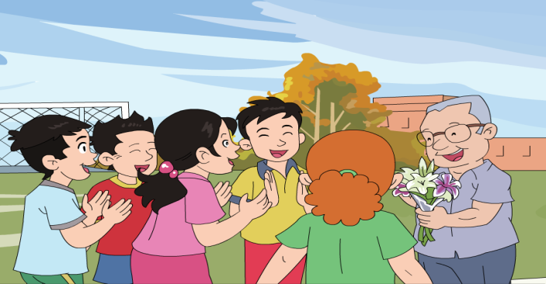
said
They _____ “Happy Teachers’ Day” to Mr Wang.

Slide 9
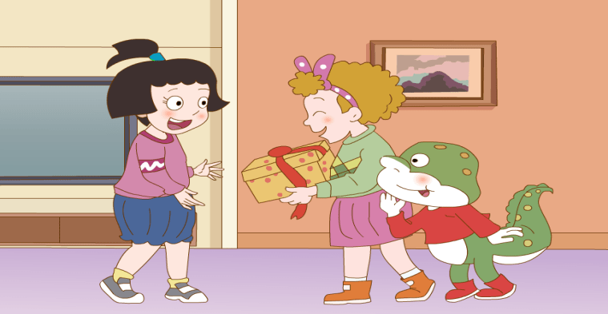
said
Jenny and Danny _____ “Happy birthday”
to Wang Hong.

Slide 10
They said Merry Christmas to Jenny’s family.

Slide 11
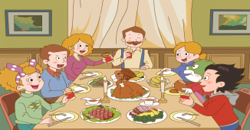
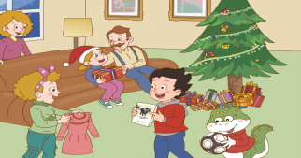
How did they celebrate the Christmas Day?
（他们是怎样庆祝圣诞节的？）
Let’s read the text and think.
（自读课文2、3、4段并思考。）
They had...
They had a big dinner.
They got…
They got presents.

Slide 12
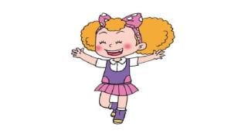
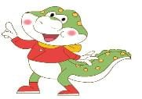
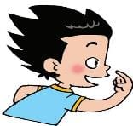
What presents did the children get?（孩子们得到了什么礼物)）
Let’ s listen and find the answer.
dress
Jenny got a nice ______.

Slide 13
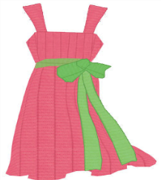
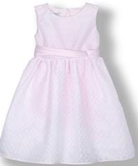
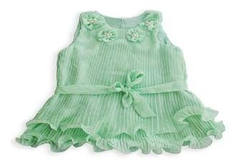
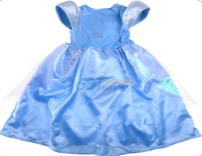

Slide 14
What presents did the children get?（孩子们得到了什么礼物)）
Let’s listen.
dress
Jenny got a nice _______.
football
Danny got a ________.
animals
Li Ming got a book about _______.

Slide 15
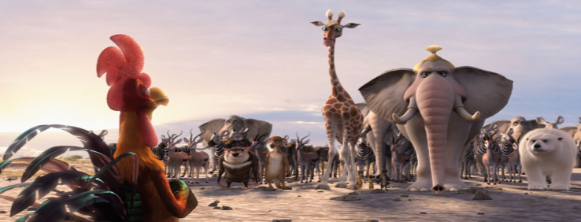
animals
A film about _________.

Slide 16
animals
A story about _________.

Slide 17
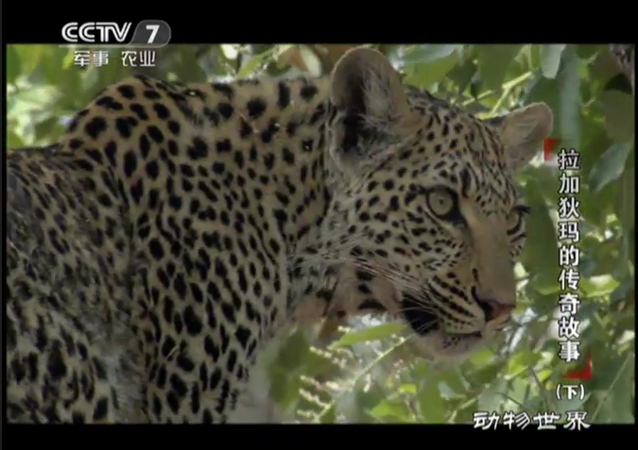
animals
A TV about _________.

Slide 18
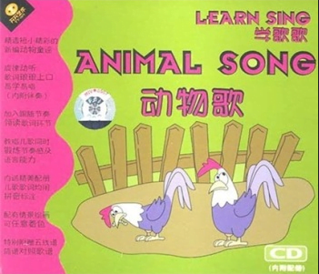
animals
A song about _________.

Slide 19
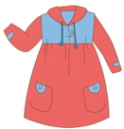
Free talk.
A: What present did you get?
B: I got…

Slide 20
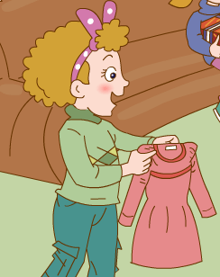
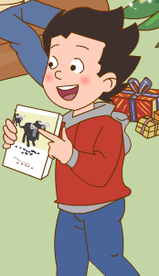
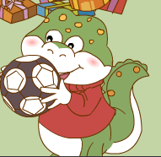
laughed
They all _______.

Slide 21
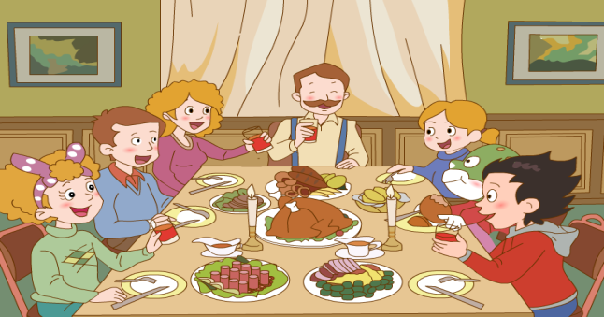
evening
They had a big dinner in the ________ .
Everyone had a __________ day.
（晚上）
wonderful

Slide 22
Let’s chant.
Jenny, Jenny, Jenny, she got a nice dress.
Li Ming, Li Ming, Li Ming, he got a book,
a book about animals.
Danny, Danny, Danny, he got a football.
They were very happy. They all laughed.
They were very happy. They all laughed.

Slide 23
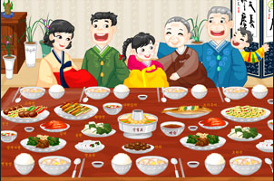
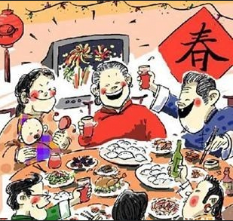
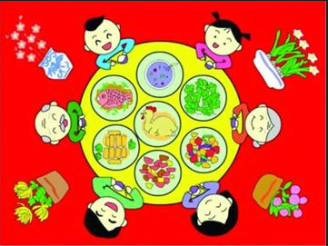
The more we get together, the happier we’ll be！
（相聚越多，我们就越快乐！ ）

Slide 24
Let’s write.
Dear Guo Yang:
Yesterday was Christmas Day. I and Danny ____ to Jenny’s home. We ____“Merry Christmas” to Jenny’s family. There were many presents under the Christmas tree. I got a book about _______. Jenny got a nice _____. Danny got a football. We all ________.
In the_______, we had a big dinner. We had a ______ day.
Yours
Li Ming

Slide 25
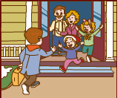
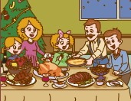
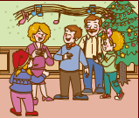
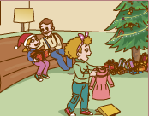
Let’s talk.
Talk about your Christmas Day in groups.
（运用以下语言组内交流：如何过圣诞节）
Where did you…?
What did you…?
…got…
What…did you…?

Slide 26
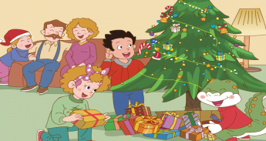
Enjoy different culture, enjoy our life!
Happiness and health every day!
（接触不同的文化，精彩我们的生活！
开心、幸福每一天！）

Slide 27
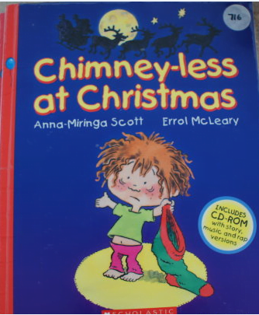
We should read good books.
Read more books as possible as you can!
（我们应多读书，读好书！）

Slide 28
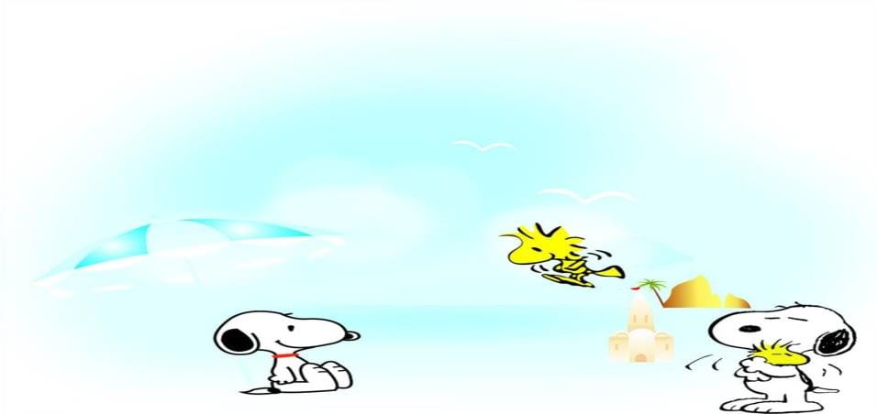
Homework:
1.repeat the text for 3 times.
2.Talk about what people did at Christmas.

Slide 29
Thank You

