Slide 1
Unit 1 Topic 2
The population in developing countries is growing faster.
Section C
WWW.PPT818.COM

Slide 2
Tongue twister
8
88
888
8,888
88,888
888,888
8,888,888
88,888,888
888,888,888
8,888,888,888
88,888,888,888
888,888,888,888

Slide 3
The population in developing countries is ________ than that in developed countries.
Which country has the largest population?
larger

Slide 4
1a 1. Before you read the passage, discuss the questions with your partner.
1) Why does China carry out the one-child policy?
2) What social problems do you think China’s large
population has caused?

Slide 5
1a Read and understand.
2. Write the title of the passage.
Population Problems
1b Read 1a and match the main idea with each paragraph.
B
1. _____ Paragraph 1 A. the measures to deal with the
problems
2. _____ Paragraph 2 B. the world’s and Asia’s population
3. _____ Paragraph 3 C. the problems caused by large
population
C
A

Slide 6
1c Read 1a again and complete the table.
1.3 billion
Population of China | ____________________
Social problem | less ______________ fewer _______ opportunities less _______ and ______ crowded ________ heavy _________ ________ natural environments
Government measure | _____________________
living space
job
energy
water
cities
traffic
worse
the one-child policy

Slide 7
Paragraph 1
The world’s and Asia’s population.
Read Paragraph 1 and fill in the blanks.
Asia has a population of _________________. That’s to say, almost ______ of the people in the world live in Asia now.
more than 3 billion
half

Slide 8
Almost half of the people in the world live in Asia.
3 billion÷ 6.8 billion≈1／2
(half)
50 percent (50%)

Slide 9
Paragraph 2
The problems caused by large population.
1.3 billion÷6.8 billion≈1 ／ 5
20 percent (20%)
one
fifth
About one fifth of the people in the world live in China.
What social problems has it caused

Slide 10
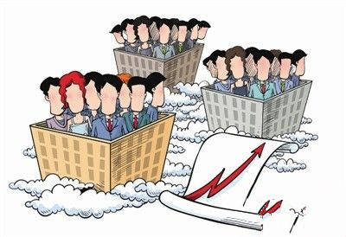
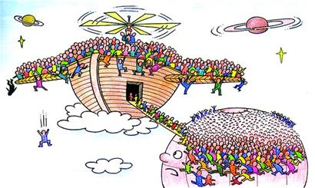
Read Paragraph 2 and fill in the blanks
Because of the large population,
there is __________________ for each family.
less living space

Slide 11
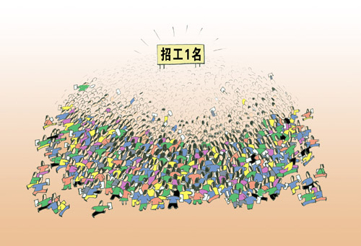
Because of the large population,
it is difficult for lots of people ______________.
to find jobs

Slide 12
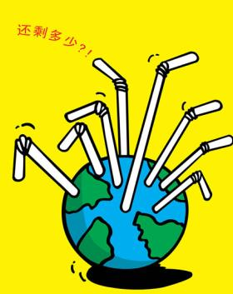
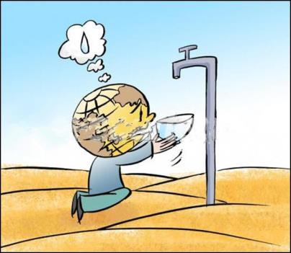
Because of the large population,
it is hard for China to supply _______ and ______ to satisfy people’s daily needs.
energy water

Slide 13
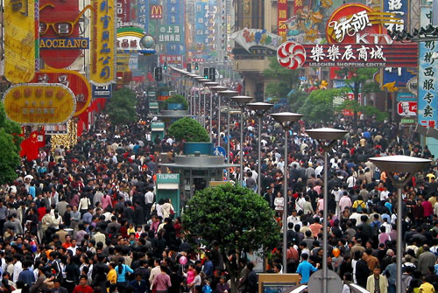
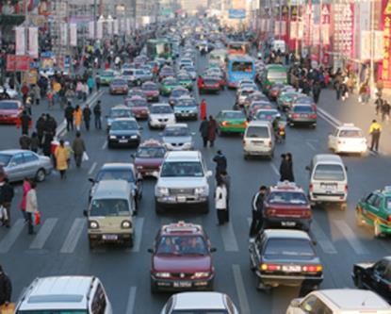
Because of the large population,
most cities are ______________ than before, and the traffic is much __________.
more crowded
heavier

Slide 14
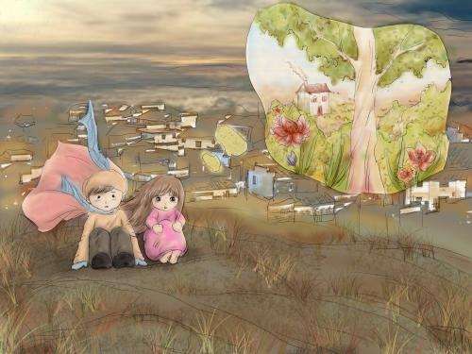
Because of the large population,
natural environments are becoming _______
_____________.
worse
and worse

Slide 15
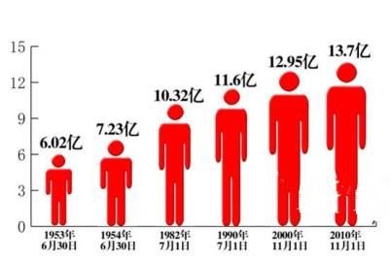
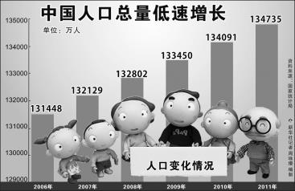
Paragraph 3
The measures to deal with the problems.
The one-child policy
— Every couple can have only one child.
So far, the one-child policy has worked well in
controlling China’s population.
We still have a long way to go.

Slide 16
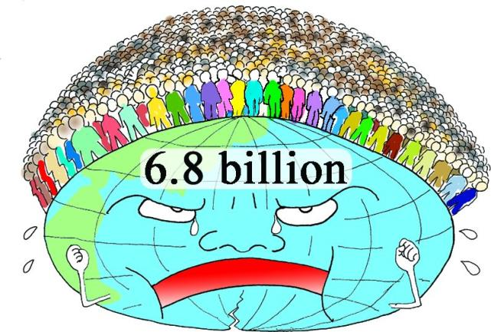
2 Complete the following passage with the correct forms
of the given words or phrases.
grow reach have find work become face carry out
Every minute, about 261 babies are born in the world. That means people have to _____ food for about 375 840 newborn babies every day. The world’s population _______________ faster and faster. It has _______ one of the biggest social problems today.
China ______ the largest population in the world. There are about 1.3 billion people in China. It has ________ 20 percent of the world’s population. China has ____________ some policies to control the population, and these policies have _______ well. But China still _______ a serious population problem.
find
grows/ is growing
become
has
reached
carried out
worked
faces

Slide 17
3a Work in groups and search for the information
about the following questions. Then share your
idea with your group members.
1. How do you think we can get more living space?
2. What should the government do to offer more
job opportunities?
3. The energy and water is less and less. What
should we do to deal with it?
4. The traffic in cities is much heavier than before.
How can we solve the problem?

Slide 18
3b Write a short passage of three paragraphs based on 3a.
One possible version:
China has the largest population in the world. It has caused many problems. Everyone should do something to solve them.
First, the government should keep the one-child policy to control the increasing population, and practice the reform and opening-up to develop our economy. Only in this way can we get more jobs and improve our living conditions.
Second, the energy and water is becoming less and less. We’d better save them as much as possible, and try to find more new energy. In order to solve the problem of heavy traffic, we call on everyone to take a bus or walk as often as possible.

Slide 19
Exercises
Choose the best answer.
1. _____ of the students are boys in our school.
A. Two third B. Two threes
C. Two thirds D. Second three
2. The one-child policy has _____ controlling China’s
population.
A. been good at B. done well in
C. taken care of D. worked well in
3. Edison is known _____ a great inventor.
A. for B. as C. in D. on
4 ._____ your help, I made great progress in math.
A. Thanks for B. Thanks to
C. Thank to D. Thank for
C
D
B
B

Slide 20
summary
1. Some words:
social, supply, natural, worse, government,
paragraph, opportunity, newborn, percent, offer
2. Some phrases:
half of, one fifth, because of, satisfy people’s daily
needs, so far, take measures to do, be known as,
work well in, thanks to
3. Some sentences:
We still have a long way to go.
We learn:
We can:
1. Read the fractions in English.
2. Talk about population problems.

Slide 21
Homework
1. Read 1a aloud.
2. Write the composition in 3b.
3. Finish Section C in your workbook.
4. Preview Section D.

