Slide 1
Unit2 Spring is Coming!
第3课时
WWW.PPT818.COM

Slide 2
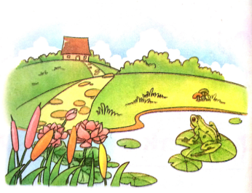
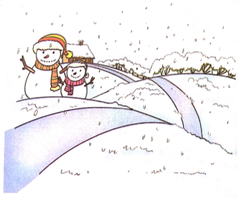
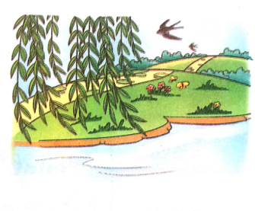
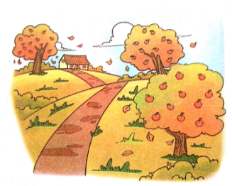
>>Review
Let’s guess
What season is it?

Slide 3
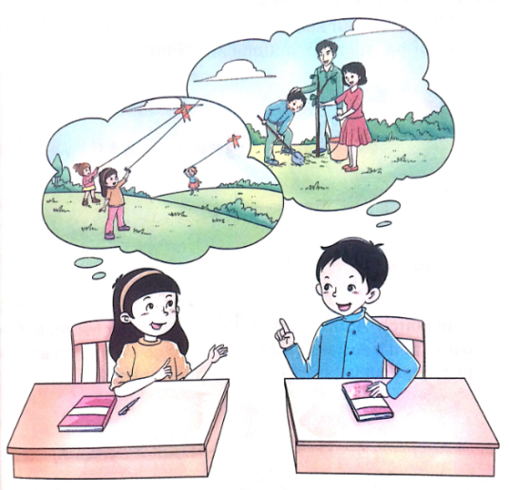
>>Review
Role-play

Slide 4
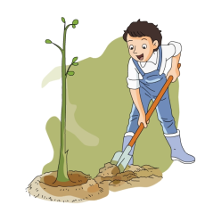
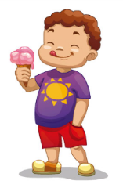
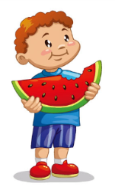
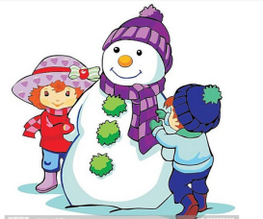
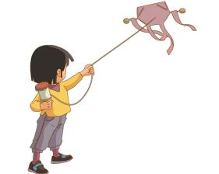
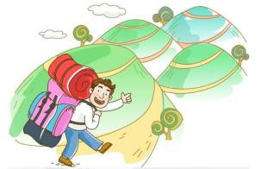
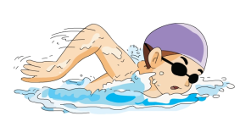
>>Warming-up
Look and say
What do you do in spring?

Slide 5
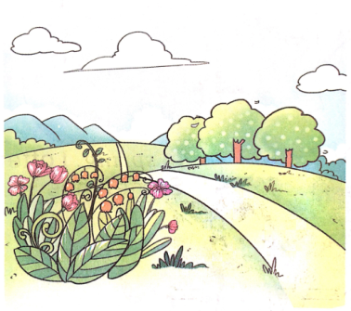
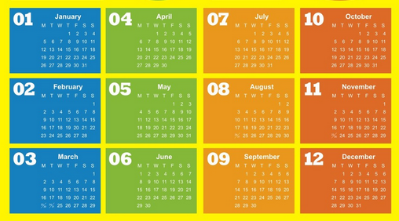
>>Presentation
Let’s Learn
What season is it?
March April May

Slide 6
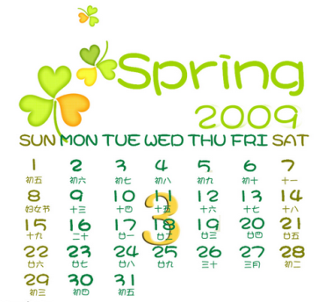
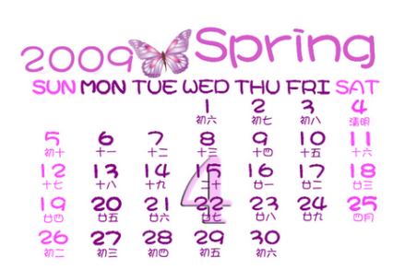
>>Presentation
Let’s Learn
March
April

Slide 7
>>Presentation
Let’s Learn
May
March, April and May are in spring.

Slide 8
>>Presentation
Quick response

Slide 9
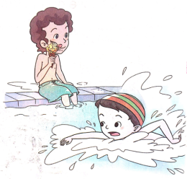
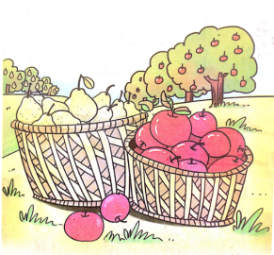
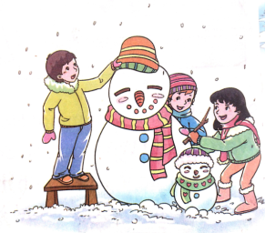
>>Presentation
Let’s Learn more

Slide 10
>>Presentation
Read and answer
What are the four seasons in a year?
What’s the weather like in spring/summer/autumn/winter?
What do you have in spring/summer/autumn/winter?

Slide 11
>>Presentation
Read again and answer the questions
What are the four seasons in a year?
There are spring, summer, autumn
and winter.
Why do people like to go out in spring?
Because it’s warm and trees are green.

Slide 12
>>Presentation
Read again and answer the questions
What can we do in summer?
We can go swimming and eat
ice-cream.
When can we make snowmen?
We can make snowmen in winter.

Slide 13
>>Practice
Think and say
Which season do you like best? Why?
Why is autumn rich?
Do you like winter? Why or why not?

Slide 14
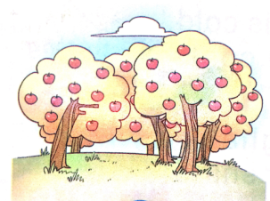
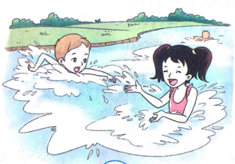
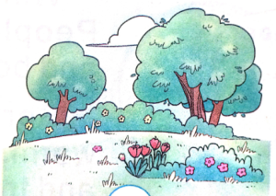
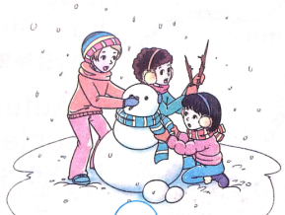
>>Practice
Listen and number
3
2
4
1

Slide 15
>>Practice
Try to write
It’s warm in spring. The trees are green and there are flowers here and there.

Slide 16
>>Summary
1. 词汇：
March/April/May
2. 句子：
It’s warm in spring. The trees are green and there are flowers here and there.

Slide 17
>>Homework
1.观看课文动画，按照正确的语音、语调朗读课文对话。
2.根据你写出的四季的特征，与同伴交流。
3.预习“Read the words”。
close

