Slide 1
Unit 1 Teachers’ Day
He was young then
WWW.PPT818.COM

Slide 2
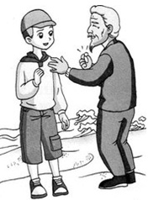
y____
oung
old

Slide 3
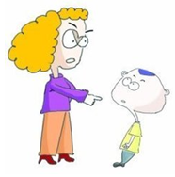
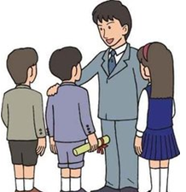
k____
strict
ind

Slide 4
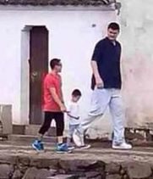
short
t____
all

Slide 5
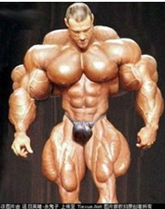
s_____
trong

Slide 6
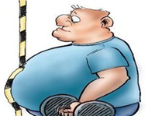
f___
at

Slide 7
My favourite teacher
My favourite teacher is…
She’s/ He’s…
She’s/ He’s…
She/ He has…
I love my teacher.

Slide 8
Miss Zhang is Danny’s favourite teacher.
This is Miss Zhang. She’s…
She’s…
She’s…
She’s…
She has…

Slide 9
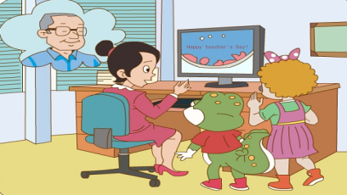
Q: Who’s Miss Zhang’s favourite teacher?
It’s _________.
Mr Wang
Miss Zhang is making a card for Mr Wang.

Slide 10
Q: 如何用英语来表达教师节对老师的祝福？
Happy Teachers’ Day.
Q: 当别人对你说Thank you时，你该如何回应？
You’re welcome.

Slide 11
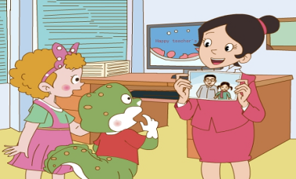
then
Q: What was Mr Wang like ?
He was _______ then.
He was ______ then.
His hair was ______ then.
young
strong
black

Slide 12
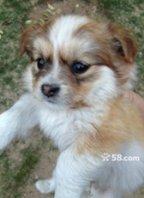
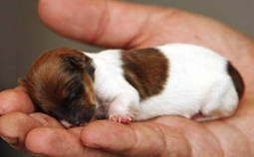
It was ________ then.
small
now
then

Slide 13
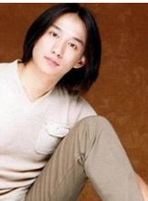
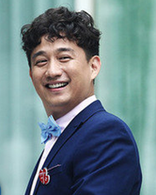
His hair was ______ then.
long

Slide 14
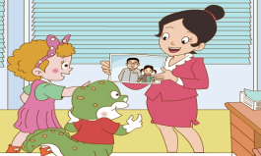
Who’s this little girl?
It’s ___.
me
I was _____ then.
I was ____ and ____ then.
nine
short
thin
interesting
lovely

Slide 15
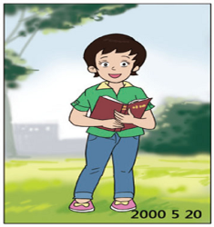
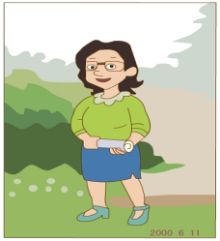
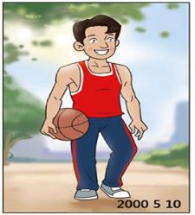
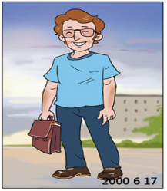
She was young.
Her hair was short.
She’s Miss Liu.

Slide 16
Talk about you.
I was ____ then. （年龄）
Now I’m _____.
I was _____ then. （外貌、性格）
Now I’m _____.

Slide 17
Homework:
Read for 3 times.
Talk about you with your friends.

Slide 18
Thank You

