Slide 1
Unit 6 Outdoor fun
Reading
WWW.PPT818.COM

Slide 2
Period 2 Reading
课前自主预习
单 词 闯 关 | 1. 洞 /həʊl/ ________ 2．落下，掉落；倒 /fɔːl/ ________ 3．她自己 /hɜːˈself; həˈself/ ________ 4．注意，察觉 /ˈnəʊtɪs/ ________ 5．兔，家兔 /ˈræbɪt/________ 6．手表 /wɒtʃ/________
hole
fall
herself
notice
rabbit
watch

Slide 3
Period 2 Reading
单 词 闯 关 | 7. 侧，边 /saɪd/________ 8．到达；击中，撞 /hɪt/________ 9．使惊奇，使措手不及 /səˈpraɪz/ ________ 10．锁上的 /lɒkt/ ________ 11．到……里面 /ˈɪntə； ˈɪntu; ˈɪntuː/ ________ 12．独自，单独 /əˈləʊn/ ________
side
hit
surprise
locked
into
alone

Slide 4
Period 2 Reading
短 语 互 译 | 1. 逃脱；离开 ____________ 2．把……从……中拿出来 ____________ 3．跳下去 ____________ 4．在另一边 ________________ 5．坐在河边 ____________
get away
take…out of
jump down
on the other side
sit by a river

Slide 5
Period 2 Reading
短 语 互 译 | 6. 站起身，起立 ____________ 7．pass by ____________ 8．run after sb. ____________ 9．put…into __________________ 10．jump down a big hole __________________
stand up
经过
追赶某人
把……放进……
跳下一个大洞

Slide 6
Period 2 Reading
句 型 在 线 | 1. She ________ ________ and saw a white rabbit in a coat ________ ________. 她抬起头看见一只穿着外套的白兔经过。 2．It ________ a watch ________ ________ its pocket and looked at the time. 它从口袋里拿出一块手表看了一下时间。
looked up
passing by
took
out of

Slide 7
Period 2 Reading
句 型 在 线 | 3．Alice stood up and ________ ________ the field after the rabbit. 爱丽丝站起来并追着兔子跑过了田地。 4. She ________ ________ ________ in a long, low hall. 她发现自己一个人在一个长而低的厅里。
ran across
found herself alone

Slide 8
Period 2 Reading
句 型 在 线 | 5．Alice tried to ________ ________ the door, but she was too big. 爱丽丝努力地想通过那扇门，但是她个子太大了。 6．______ ________ Alice a long time ______ ________ the ground. 爱丽丝花了很长时间才落到地面。
go through
It took
to hit

Slide 9
Period 2 Reading
课 文 初 探 | 根据课文内容，判断正(T)误(F)。 ( )1. The girl in the story is called Ruby. ( )2. The girl ran after the amazing rabbit to a low hall. ( )3. The girl was small enough to get through the door.
F
T
F

Slide 10
Period 2 Reading
课堂互动探究
词汇点睛
1 look up 抬头看
[观察] She looked up and saw a white rabbit in a coat passing by.
她抬起头看见一只穿着外套的白兔经过。
She looked up as I entered the room. 我进房间时她抬起头看了看。
[探究] look up是固定短语，意为“抬头看”。

Slide 11
Period 2 Reading
[拓展] (1)look up还可译为“________”。
You can look up new words in a dictionary.
你可以在词典中查找生词。
(2)与look相关的短语：
look at 看 look after 照顾，照料
look for 寻找 look out 小心，当心
look around 环顾四周 look forward to 期待
查阅

Slide 12
Period 2 Reading
活学活用
2018·云南We can ________ some information about this city on the Internet.
A．look up B．look like
C．look after D．look forward to
A
【解析】考查动词短语辨析。句意：我们可以在网上查询一些关于这座城市的信息。look up意为“查阅”；look like意为“看起来像”；look after意为“照顾，照料”；look forward to意为“期待”。故选A。

Slide 13
Period 2 Reading
2 fall vi. 落下，掉落；倒
[观察] Alice fell for a long time, and then she hit the ground.
爱丽丝掉了很长时间，然后才落地。
The cat fell into a hole.
这只猫掉入了一个洞里。

Slide 14
Period 2 Reading
[探究] fall的过去式为________。常用短语：
fall into 掉入 fall off 从……滑落
fall asleep入睡 fall behind落后，掉队
fell
[拓展] fall 还可作名词，意为“秋天；落下；瀑布”。
We visited the Niagara Falls in the fall of 2015.
我们在2015年秋天参观了尼亚加拉大瀑布。
I had a fall (from a horse) and broke my arm.
我(从马上)跌下来把胳膊摔断了。

Slide 15
Period 2 Reading
活学活用
(1)单项选择
Was it possible to ________ the third floor without being hurt?
A．fall off B．fall into
C．fall down D．fall behind
A
【解析】考查动词短语辨析。句意：从三楼掉下而没有受伤，可能吗？fall off意为“跌落，从……掉下来”，后直接接宾语；fall down意为“滑倒，倒下”，后接宾语时应加上介词from；故选A。

Slide 16
Period 2 Reading
(2)根据汉语意思完成句子
我妹妹很累，很快就睡着了。
My sister was very ________ and ________ ________ quickly.
tired
fell asleep

Slide 17
Period 2 Reading
3 alone adj. & adν. 独自，单独
[观察] She found herself alone in a long, low hall.
她发现自己一个人在一个长而低的厅里。
You'd better not go alone. 你最好不要单独去。
[探究] alone既可作形容词，也可作副词，意为“独自，单独”，侧重说明独自一人或一方，没有同伴或助手，相当于on one's own或by oneself。

Slide 18
Period 2 Reading
[辨析] alone与lonely
(1)alone 作形容词，意为“独自，单独”，侧重说明独自一人或一方，没有同伴或助手，没有感情色彩，只表示客观的状态。在句中只能作表语，不能作定语。
(2)lonely 作形容词，意为“孤独的，寂寞的”，表示主观上感到孤独、寂寞，有较浓的感情色彩，在句中作表语或定语。作定语时，意为“荒凉的；偏僻的”，多修饰表示地点的名词。
He is alone, but he doesn't feel lonely. 他独自一人，但并不感到孤独。

Slide 19
Period 2 Reading
活学活用
His grandpa lives ________ in a small ________ house, but he doesn't feel ________.
A．lonely; alone; alone B．alone; lonely; alone
C．lonely; alone; lonely D．alone; lonely; lonely
D
【解析】句意：他的祖父独自住在一个小的偏僻的房子里，但是他不感到孤独。第一空alone 作副词，意为“独自”；第二空lonely作形容词，意为“偏僻的”，在句中作定语；第三空lonely作形容词，意为“孤独的”，在句中作表语。故选D。

Slide 20
Period 2 Reading
句型透视
1 It took a watch out of its pocket and looked at the time.
它从口袋里拿出一块手表看了一下时间。
[探究] take…out of意为“把……从……中拿出来”。
If you take the fish out of the water, they will die soon.
如果你把鱼从水里拿出来，它们很快就会死去。

Slide 21
Period 2 Reading
[拓展]与take相关的短语：
take away拿走 take off起飞；脱下
take down拆掉；记录 take back收回
take care of照顾，照料 take action采取行动
take part in 参加，加入

Slide 22
Period 2 Reading
活学活用
(1)2017·深圳—It's going to rain. Remember to ________ your
umbrella with you when you go to school, dear.
—All right, Mum. Bye!
A．take B．buy C．put D．get
A
【解析】考查动词辨析。句意：“要下雨了，去上学的时候记得带一把伞，亲爱的。”“好的，妈妈。再见！”take sth. with sb.意为“某人随身带某物”。故选A。

Slide 23
Period 2 Reading
(2)2018·河池It's getting hot, you can ________ your coat.
A．put off B．take off
C．set off D．get off
B
【解析】考查动词短语辨析。put off意为“推迟”；take off意为“脱掉；(飞机)起飞”；set off意为“动身出发”；get off意为“下车”。故选B。

Slide 24
Period 2 Reading
2 Alice did not want to let the rabbit get away, so she jumped
down the hole too.
爱丽丝不想让兔子跑掉，所以她也跳进了洞里。
[探究] (1)let 是使役动词，意为“让，使”，后接动词原形。let sb. do sth.意为“让某人做某事”。
My mother lets me play computer games on Sunday evening.
我妈妈让我星期天晚上玩电脑游戏。

Slide 25
Period 2 Reading
(2)get away意为“逃脱；离开”。
Do you want to get away early in the morning?
你想一大早就离开吗？
(3)句中so作连词，意为“因此，所以”，引导结果状语从句。
The ship was late, so we had to wait for twenty minutes.
轮船晚点了，因此我们不得不等20分钟。

Slide 26
Period 2 Reading
活学活用
(1)—Would you please help me give out the invitations to all my
friends?
—Sure, you'd better let me ________ their phone numbers.
A．to know B．know
C．knowing D．knew
B

Slide 27
Period 2 Reading
(2)2018·天水Taxi Apps(打车软件) can help us travel around more
easily. ________ more and more people like using them.
A．Or B．So C．And D．But
B
【解析】考查连词辨析。or意为“或者；否则；不然”，表示选择或转折关系；so意为“因此”，表示前因后果关系；and意为“并且”，表示并列关系；but意为“但是”，表示转折关系。根据句意可知这里要用连词so。故选B。

Slide 28
Period 2 Reading
3 Then Alice noticed a small door and put the key into it.
然后爱丽丝注意到一扇小门并把钥匙插了进去。
[探究] notice 作及物动词，意为“注意，察觉”。
She noticed a note on her desk.
她注意到她的书桌上有一张便条。

Slide 29
Period 2 Reading
[拓展] (1)notice sb. do sth. 意为“注意到某人做某事”，强调注意到某事的全过程或动作经常发生。notice sb. doing sth. 意为“注意到某人正在做某事”，强调动作正在发生。
I noticed them come in.我注意到他们进来了。
She noticed some boys playing football.
她注意到一些男孩正在踢足球。
(2)与notice用法类似的动词还有see, hear, watch等。

Slide 30
Period 2 Reading
活学活用
—Did you notice Mrs White _____ in the park when you passed it?
—Yes. I often see her _____ in the park.
A．dance; dance B．dancing; dance
C．dancing; dancing D．dance; dancing
B
【解析】考查非谓语动词的用法。句意：“当你经过公园的时候，你注意到怀特夫人正在跳舞吗？”“是的。我经常看到她在公园跳舞。”notice sb. doing sth.，意为“注意到某人正在做某事”；see sb. do sth意为“看到某人做某事(强调全过程)”。故选B。

Slide 31
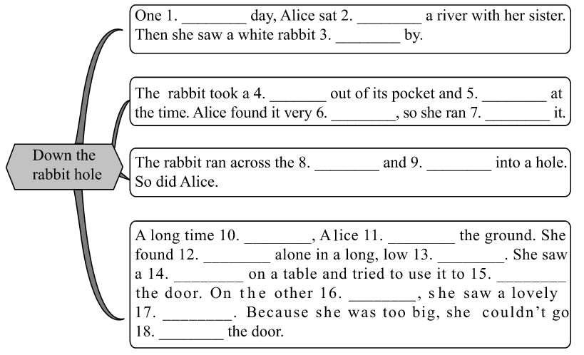
Period 2 Reading
课文回顾
sunny
by
passing
watch
looked
amazing
after
field
jumped
later
hit
herself
hall
key
open
side
garden
through

