Slide 1
Our school in the future
第二课时
WWW.PPT818.COM

Slide 2
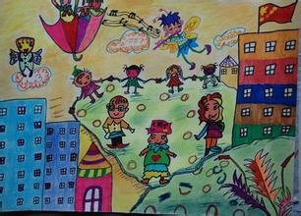
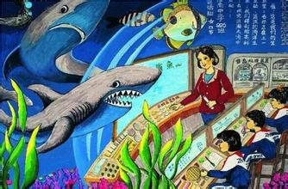
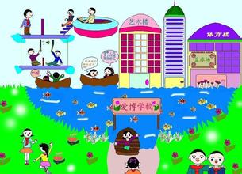
Warm up

Slide 3
Listen and answer
1.Who will help us find books in the library?
2.Will we use computer in all our lessons?
3.Will we carry books to school?
Robots
Yes.
No.

Slide 4
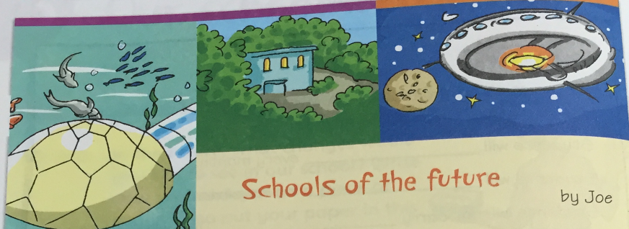
Read and write
In the future, schools will be different. They will be under the ______, on high __________ and even in ________ .
sea
mountains
space

Slide 5
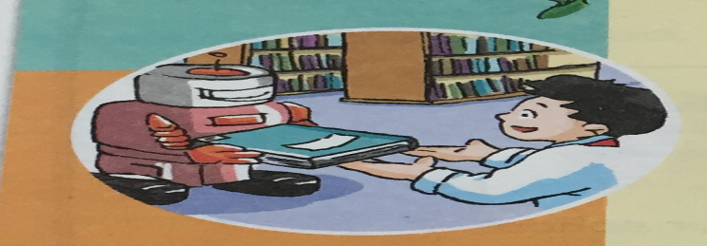
Read and write
Robots will help us __________ in the library. They will also _____________ in schools.
find books
do other things

Slide 6
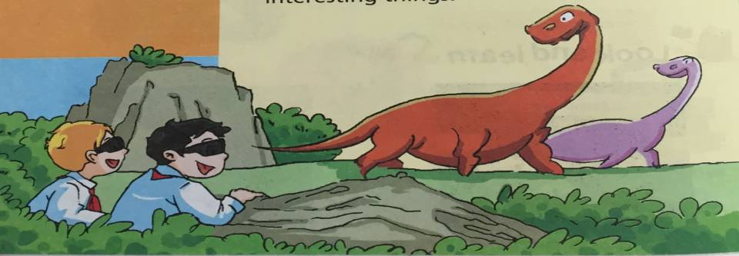
Read and write
We will use ________ in all our lessons. They will help us see __________ and other interesting things.
computers
dinosaurs

Slide 7
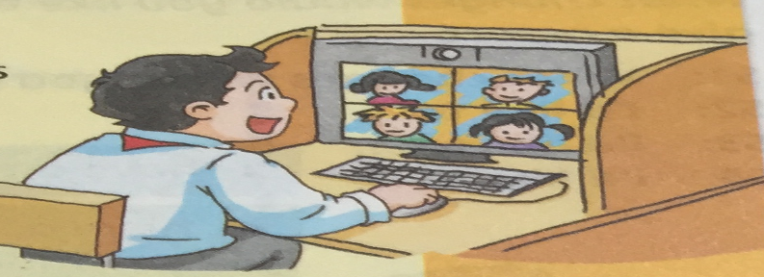
Read and write
We will have lessons with students from _____________. We will do a lot of things ________ together.
other countries
online

Slide 8
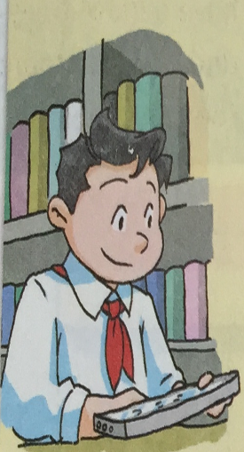
Read and write
We will not ______ books to school. All our books will be on ______________.
carry
a small computer

Slide 9
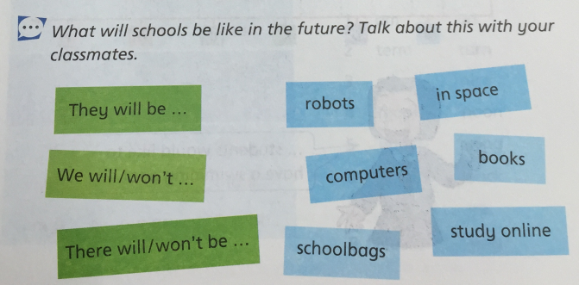
Practice
In the future, we will / won’t…

Slide 10
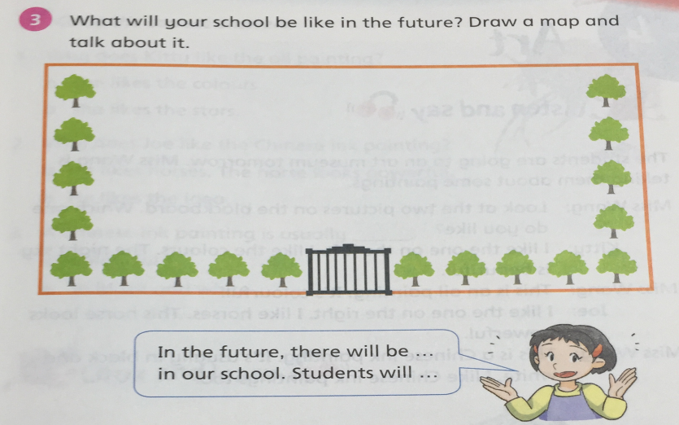
Practice

Slide 11
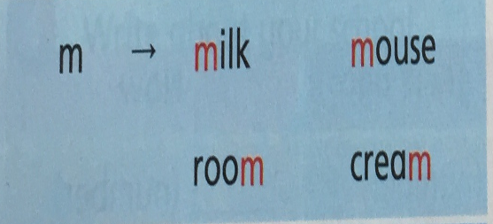
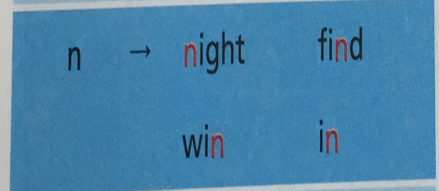
Sounds
my …
nice…

Slide 12
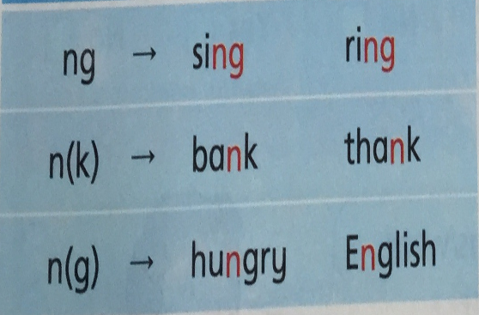
Sounds
bring …
ink …
language …
1.在音素[k][g]前面发[ŋ]。但前缀例外。如:think, thank, English, language, uncle …
2.与g组合在词尾时发[ŋ]。 如:long, strong, song, sing，bring, ring …

Slide 13
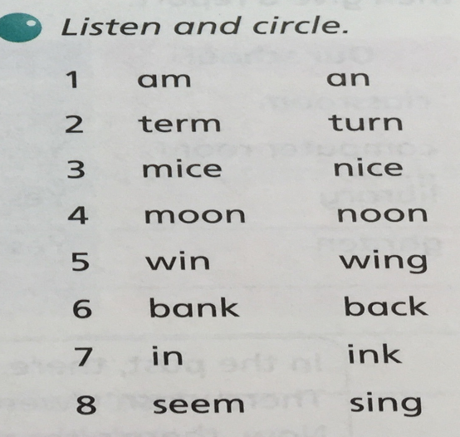
Warm up

Slide 14
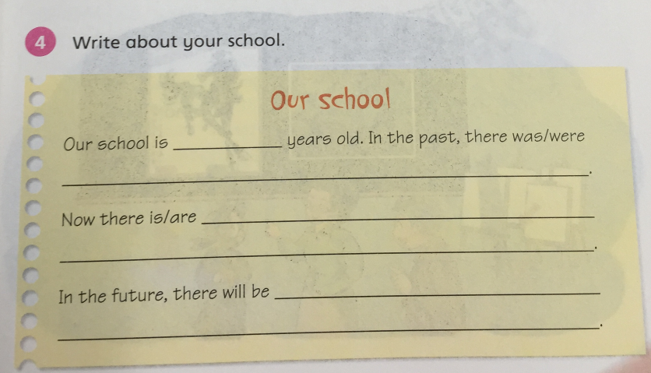
Homework
Finish it.

Slide 15
The End

