Slide 1
We're watching the games
WWW.PPT818.COM
Notes:
1

Slide 2
I am sailing 我在航行！
I am sailing 我在航行！
...
I am sailing stormy waters 我在暴风中航行。
...
I am flying 我在飞翔！
I am flying 我在飞翔！
...
I am flying passing high clouds 我在白云中穿越飞翔。
...
I am sailing. / I am flying .
现在进行时

Slide 3
Pair work(同桌操练)
What are they doing?
They are playing …

Slide 4
playing badminton

Slide 5
playing tennis

Slide 6
playing ping-pong

Slide 7
Can you sing?
What are they doing?
What are they doing?
They are playing badminton. They are playing tennis.
They are playing ping-pong. La la la la la la...
I like them all. I like them all.

Slide 8
That's my
favourite
sport.
最喜爱的
Really? Can I play it with you?
Certainly!

Slide 9
Mr. ['mɪstə(r)]先生
Mrs. [misiz] 女士 (已婚)
Miss [mis] 小姐 (未婚)
Ms. [miz] 女士 (婚姻状况不明)

Slide 10
趣味练习:每张图片后有不同的惊喜哦！

Slide 11
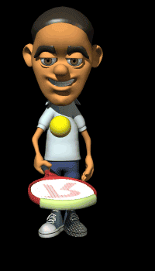

Slide 12
Can you sing?
What are they doing?
What are they doing?
They are playing badminton. They are playing tennis.
They are playing ping-pong. La la la la la la...
I like them all. I like them all.

Slide 13
Let’s say
listen
wash
write
play
swim
run
read
shop
draw
sing
watch
make

Slide 14
Group Work（小组活动）：
根据提示，完成新的对话吧！

Slide 15
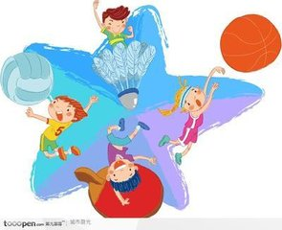
We should do more exercise to keep our health.
我们应该多做运动，保持身体健康。

Slide 16
Summary：总结梳理
和同桌讨论：
1、这堂课你学到了哪些知识？
2、你觉得你的表现如何？
3、其他同学的表现如何？

Slide 17
Thank you ！
Goodbye！

