Slide 1
Unit 3
It’s time to get up
WWW.PPT818.COM

Slide 2
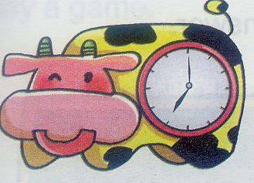
What time is it?
It’s seven o’clock.

Slide 3
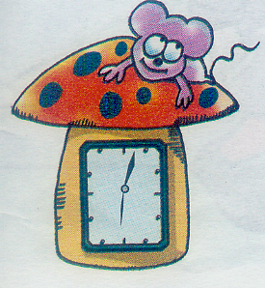
half past
…点半
What time is it ?
It’s half past twelve.

Slide 4
a quarter to…
……点45分
What time is it?
It’s a quarter to one.

Slide 5
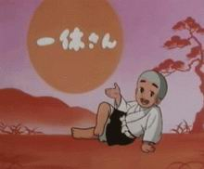
What time is it ?
It’s…o’clock.(整点）
It’s half past…（半点钟）
It’s a quarter to…（…点45分）

Slide 6
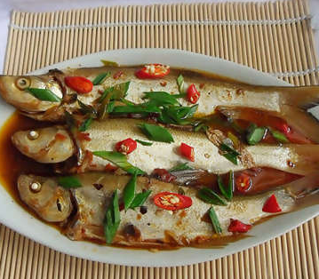
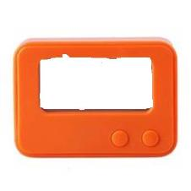
Time for lunch .
Have some fish .
11:45

Slide 7
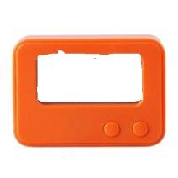
Time for dinner .
Eat some rice .
6:30

Slide 8
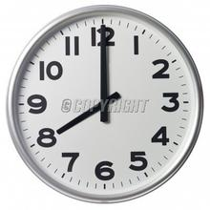
Time for English .
Read and write .

Slide 9
Time for art class .
Draw a picture .

Slide 10
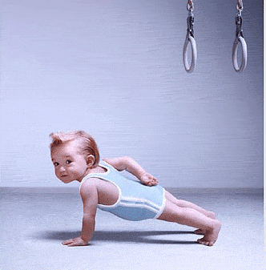
Time for P.E.
Jump and run .

Slide 11
Time for computer class .
Play computer games .

Slide 12
Let’s do
Time for lunch . Have some fish.
Time for dinner. Eat some rice .
Time for P.E. Jump and run .
Time for English . Read and write .
Time for music . Sing and dance !

Slide 13
Get up！

Slide 14
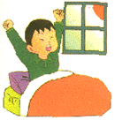
Get up , get up
Time to get up .
It’s time to get up .

Slide 15
It’s 7 o’clock.
It’s time to get up .
It’s half past 6.
It’s time to get up .
It’s a quarter to 7. It’s time to get up

Slide 16
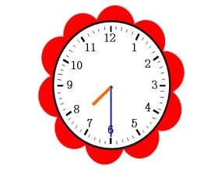
Go to school , go to school .
Time to go to school .
It’s time to go to school .

Slide 17
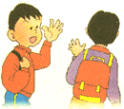
Go back home , go back home .
Time to go back home .
It’s time to go back home.

Slide 18
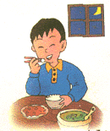
Have dinner , have dinner .
Time to have dinner .
It’s time to have dinner .
11:45

Slide 19
Go to bed , go to bed .
Time to go to bed .
It’s time to go to bed .
9:45

Slide 20
Let’s chant
Get up , get up .
Time to get up .
It’s time to get up .
Go to school , go to school .
Time to go to school .
It’s time to go to school .
Go home , go home .
Time to go home .
It’s time to go home .
Go to bed , go to bed .
Time to go to bed .
It’s time to go to bed .

Slide 21
( ) 1. go home a. 6:00
( ) 2. have lunch b. 22:00
( ) 3. go to bed c. 12:00
( ) 4. do homework d. 18:00
( ) 5. go to school e. 19:00
( ) 6. have breakfast f. 7:00
( ) 7. have dinner g. 6:30
( ) 8. get up h. 17:00
h
c
b
e
f
g
d
a

Slide 22
class
It’s time to … .
get up
go to school
lunch
go home
It’s time for … .
English
dinner
go to bed

Slide 23
Conclusion :
It’s time for … . 后面跟名词；
It’s time to … . 后面跟动词。

Slide 24
 | Sarah | John | Peter | Chen Jie
Get up | 06:00 | 06:15 | 06:30 | 06:25
breakfast | 06:30 | 06:45 | 06:55 | 06:50
Go to school | 07:00 | 07:00 | 07:20 | 07:15
lunch | 11:00 | 11:00 | 11:00 | 11:00
P.E. class | 2:45 | 2:45 | 2:15 | 2:15
Go home | 4:00 | 4:00 | 4:00 | 4:00
dinner | 6:00 | 6:45 | 6:10 | 6:30
Go to bed | 8:30 | 9:00 | 9:30 | 10:00

Slide 25
name
Get up
breakfast
Go to school
lunch
P.E. class
Go back home
dinner
sleep

Slide 26
GOODBYE!

