Slide 1
Unit3
Welcome to my house!
WWW.PPT818.COM

Slide 2
My House

Slide 3
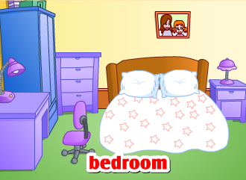
What’s in the bedroom?
There is/are …in the bedroom.

Slide 4
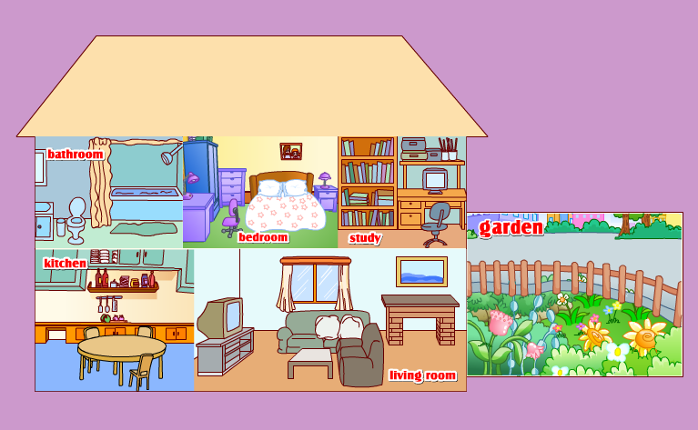
My House
PPT模板：www.1ppt.com/moban/ PPT素材：www.1ppt.com/sucai/
PPT背景：www.1ppt.com/beijing/ PPT图表：www.1ppt.com/tubiao/
PPT下载：www.1ppt.com/xiazai/ PPT教程： www.1ppt.com/powerpoint/
资料下载：www.1ppt.com/ziliao/ 范文下载：www.1ppt.com/fanwen/
试卷下载：www.1ppt.com/shiti/ 教案下载：www.1ppt.com/jiaoan/
PPT论坛：www.1ppt.cn PPT课件：www.1ppt.com/kejian/
语文课件：www.1ppt.com/kejian/yuwen/ 数学课件：www.1ppt.com/kejian/shuxue/
英语课件：www.1ppt.com/kejian/yingyu/ 美术课件：www.1ppt.com/kejian/meishu/
科学课件：www.1ppt.com/kejian/kexue/ 物理课件：www.1ppt.com/kejian/wuli/
化学课件：www.1ppt.com/kejian/huaxue/ 生物课件：www.1ppt.com/kejian/shengwu/
地理课件：www.1ppt.com/kejian/dili/ 历史课件：www.1ppt.com/kejian/lishi/

Slide 5
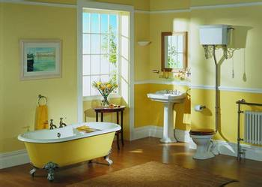
bathroom
A big bathroom

Slide 6
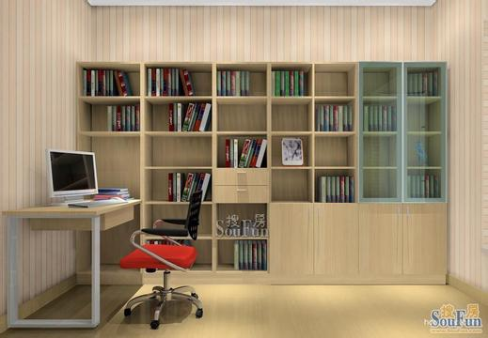
study
A small study

Slide 7
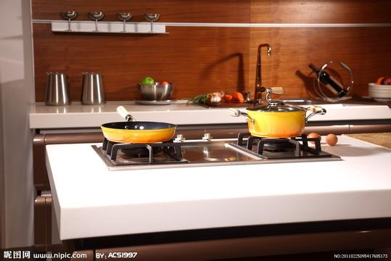
kitchen
A clean kitchen

Slide 8
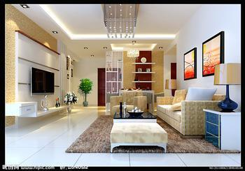
living room
A large living room

Slide 9
garden
A beautiful garden

Slide 10
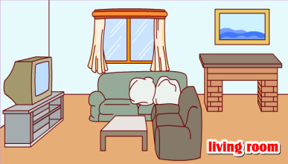
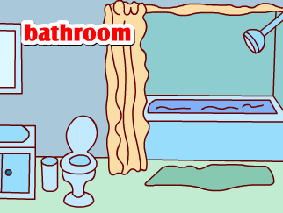
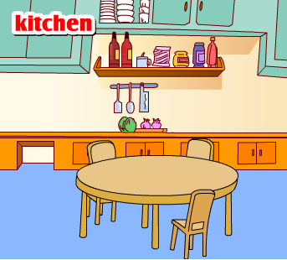
garden

Slide 11
Chant:
Bedroom, bedroom, sleep in the bedroom.
Bathroom, bathroom, wash in the bathroom.
Living room, living room, sit in the living room.
Kitchen, kitchen, cook in the kitchen.
Study, study, read in the study.

Slide 12
设计房间
What’s in the …?
There is/are …in the …

Slide 13
Thank you!

