Slide 1
Module
6
Around town
Unit 1
Could you tell me how to get to the National Stadium?
WWW.PPT818.COM

Slide 2
Language points
1. Excuse me! Can you tell me the way to Wangfujing Dajie?
Is there a bookshop near here?
How can I get to the National Statium?
Could you tell me how to get to the National Statium?
以上都是问路的常用表达方式，总结如下：
Where is …? …… 什么在地方？
How can I get/go to …? 到……怎么走？
Excuse me. Can you tell me the way to …? 劳驾,到……怎么走？
Can you show me the way to …? 能告诉我到…… 怎么走？
Is it far from … to …? 从教堂到车站有多远？

Slide 3
指路的常用表达方式，总结如下：
Take the No. 22 bus/this street.
Go along the street …
Follow this road …
Turn left/right …
Turn left into …
It’s a ten-minute walk.
Take the first/second road/acrossing on the left/right
Go straight on until you come to …
It takes about ten minutes by bus.
You can’t miss it.
…

Slide 4
2. Go across Dong Chang’an Jie…
此处的 go across = cross , 表示“穿过”，前者across是介词，而后面的cross是动词。
【辨析】 across和through
across和through都可表示“从（一定范围的）一边
到另一边”，其区别在于across表示某一范围的表
面进行某一动作。 through表示在某一范围的内部
空间进行某一动作。
e.g.:
Be careful when you go across the street.
It took us two hours to walk through the forest.

Slide 5
go through the forest/park
through

Slide 6
go across the street
Center Street
across
across: 表示从一定范围的一边到另一边, 动作在物体
表面进行。
through: 从中间穿过, 动作在内部进行。

Slide 7
3. … opposite the bank.
此处的opposite用作介词,相当于across from在……
的对面, 其还有 adj.对面的，adv.在对面，n.对立面
e.g. : Black is the opposite of white.
opposite用作形容词,常用于be opposite to和
……相对,
e.g.:Her house is opposite to mine.
opposite用作副词, e.g.:He stood opposite.
opposite用作名词, 常用于the opposite of...的
反义词/对立面

Slide 8
4. turn left/right 向左/右转
e.g.: Turn left,and you’ll find the hospital.
【拓展】
常见left/right搭配:turn left/turn right向左/右转;
on the left/on the right of...在……的左边/右边;
2)常见turn搭配:
turn to... 翻到……(页);
turn over 翻身;
turn on 打开;
turn off 关上;
turn up 调高;
turn down 关小，调低

Slide 9
Complete the questions with the correct from of the words from the box.
could excuse policeman street tourist underground
Excuse
__________ me, is Wangfujing Dajie far from Tian’anmen Square?
There’s a bookshop neat here. What’s the name of the _________?
Can a _________ ask a __________ the way to get to places in Beijing?
_______ you tell me how to get to the National Statium?
Where’s the _______________ station?
street
tourist
policeman
Could
underground

Slide 10
Read activity 3 again and complete the table.
Ask | answer
Can you tell me the way to …? | Go across …
1. Go across Dong Chang’an Jie,
go along the street and turn left
at the third street on the left.
Can you tell me the way
to Wangfujing Dajie?
2. Yes, there is a big bookshop
over there.
2. Is there a bookshop
near here?
3. Go along the street and you’ll
see an underground station.
Take the Underground to
the Olympic Sports Centre,
or you can take a bus or a taxi.
3. Could you tell me how to
get to the National Stadium?
…

Slide 11
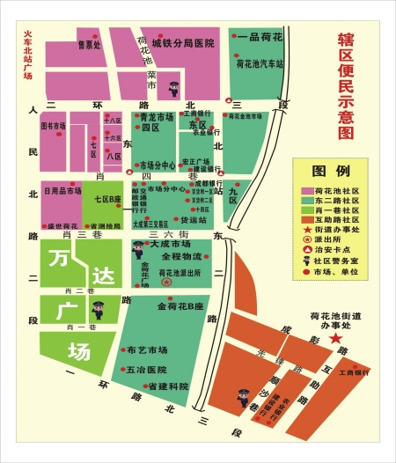
Work in pairs. Draw a map of where you live.
-- Where is the market?
-- It’s on …
-- How do I get there?
-- Go along …

Slide 12
“交通标志知多少”
go straight
turn left
turn right
on the left
on the right

Slide 13
Walking
forbidden.
Don’t turn right.

Slide 14
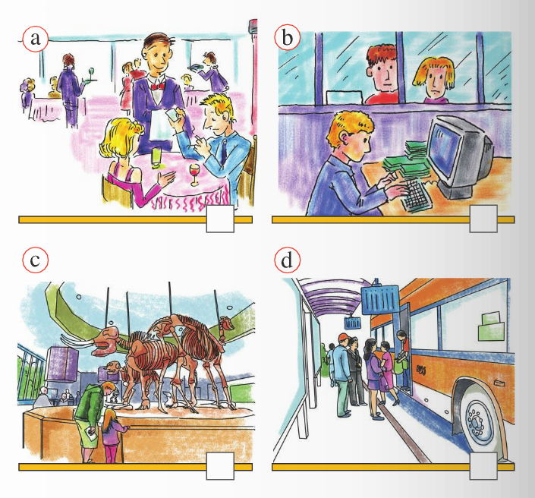
Match the words from the box with the pictures.
Listening and vocabulary
b
bank
museum
restaurant
station
c
a
d
3
2
1
4

Slide 15
Now answer the questions.
How will the tourist get to Wangfujing Dajie from Tian’anmen Square?
Where is the bookshop?
Who does the tourist ask for the way to the National Statium?
Go across Dong Chang’an Jie, go along the street
and turn left at the third street on the left.
The bookshop is just along Xi Chang’an Jie,
on the right, opposite the bank.
A policeman.

Slide 16
Exercises
补全下列单词
1. b__n__ 2. a__o__g
3. mu__ __um 4. a__ __oss
5. opp__s__te 6. t__u__i__t
7. str__ __t 8. unde__gr__ __nd
a k
l n
s e
c r
o i
o r s
e e
r o u

Slide 17
翻译短语。
1. 麻烦您/请问……
2. 直着走然后左转
3. 在左边
4. 隔壁
5. 不用谢。
6. 沿着这条街下去……在街的右边。
Excuse me.
go straight and turn left
on the left
next to
You are welcome.
It is down this street on the right.

Slide 18
填空
1. I can get to the library by bus.(就划线部分提问)
________ ________ I get to the library?
2. He does well in English.(同义句)
He ________ ________ ________English.
3. The bookstore is across from the bank. (同义句)
The bookstore is ________ the bank.
4. Can you tell me how ________(get) there?.
5. ________(walk) in the park is good for you.
6. Why ________(not) you come with us?.
How can
is good at
opposite
to get
walking
don’t

Slide 19
Asking for directions.
1.请问, 去车站怎么走？
2. 请问, 去警察局怎么走？
3. 请问, 去动物园我该走哪条路？
Excuse me. Could/ Can you tell me the way
to the station?
Excuse me. Which is the way to the police
station?
Excuse me. Which way shall I take to the zoo?

Slide 20
4.劳驾,最近的邮局在哪儿？
5.请问,你能帮我找到那家水果店吗？
6.劳驾,往第十四中学怎么走？
Excuse me. Where is the nearest post office?
Excuse me. Could/Can you help me find the
fruit shop?
Excuse me. How can I get to No.14
Middle School?

Slide 21
7.劳驾,附近有医院吗？
8.劳驾,去书店怎么走？
Excuse me. Is there a hospital near here?
Excuse me. Could/Can you tell me how to get
to the bookshop? = Excuse me. Could/Can
you tell me how I can get to the bookshop?

Slide 22
选择题
1. —________, how can I go to the bank ?
—You can take the No.17 bus..
A. Excuse me B. You are welcome
C. Thanks a lot D. Never mind
2. Could you tell me how to ________ the National Stadium?
A. go B. get C. be D. get to
√
√

Slide 23
3. Go ________the street, you will see a shop.
A. to B. cross
C. on D. across
4. Mary is sitting next________me. We are good friends.
A. on B. of
C. to D. in
5. It’s down the street ________ the left？
A. on B. in
C. to D. from
6. The post office is across ________ the park.
A.to B. from
C. on D. near
√
√
√
√

