Slide 1
Module 10 Unit 2
What are you going to study?
WWW.PPT818.COM

Slide 2

认识新单词
·chemistry
·化学

Slide 3

·physics
·物理

Slide 4
Are you going to middle school
this September?
Yes, I am.
No, I’m not.
What are you going to study?
I’m going to study…….

Slide 5


小学
中学
Chinese
Maths
English
Music
Physics
Art
Chemistry
Science
History
PE
Geography

Slide 6
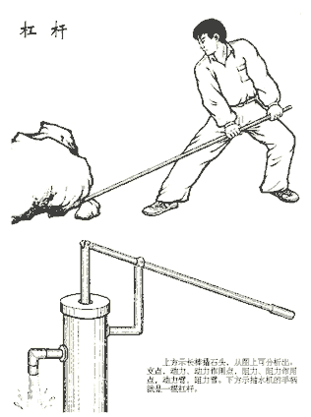


——What are you going to study ？
——I am going to study .
Physics

Slide 7
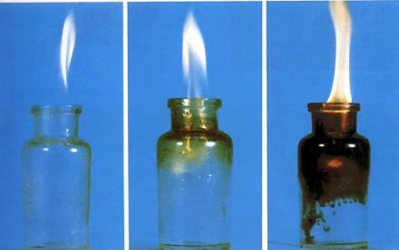

—What are you going to study ?
—I am going to .
study Chemistry

Slide 8

——What are you going to study ?
—— I am going to .
study Geography

Slide 9
Listen and tick.听课文并打勾
 | Amy | Lingling
History
Chinese
Science
Geography
French
Chemistry
Physics
√
√
√
√
√
√
√
√
√

Slide 10
1.I’m going to Park Middle School.
2.I’m going to Lake Middle School.
3.I’m going to study History, Science, Geography and French.
4. I’m going to study Physics, Chemistry and Chinese.
5.I’m also going to study History and Geography.
6. I’m not going to study French.

Slide 11
1. Is Lingling going to middle school in September?
Yes,she is.
2. Which（哪个） school is Amy going to?
Lake Middle School.
3. What is Lingling going to study?
She is going to study Physics, Chemistry,Chinese,
History and Geography .
4 . Which middle school do you like? Why ?

Slide 12

Let’s retell!
Hello! My name is Amy.
I am going to____
Middle School.
I am going to study____,
___, _____ and ___ .
Lake
History
Science
Geography
French

Slide 13

She is my friend,_____.
She’ s going to go to _____.
She’ s going to study____,
________,________,
________and _______.
She’ s not going to study___.
Lingling
Park Middle School
Physics
Chemistry
Chinese
History
Geography
French

Slide 14
本单元重点：
---What are you going to study?
---I am going to study___.
---I am not going to study___.

Slide 15
My Middle School!
Hello, My name is ___.
I am going to ___ Middle School.
It is in ___.I am going to go there by___.
I am going to study ___ , ___ and ____.

Slide 16



