Slide 1
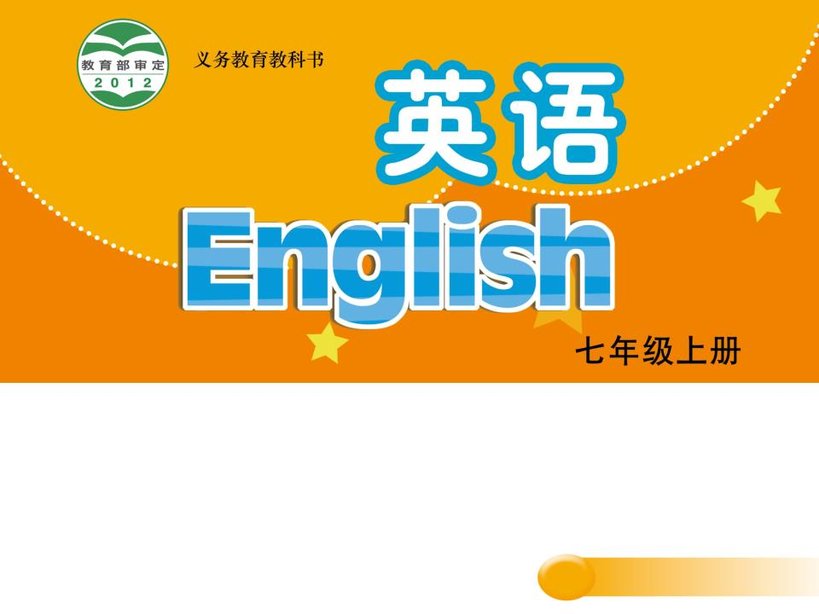
Unit 5 Let’s celebrate!
Task
WWW.PPT818.COM

Slide 2
Different festivals

Slide 3

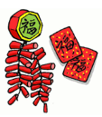
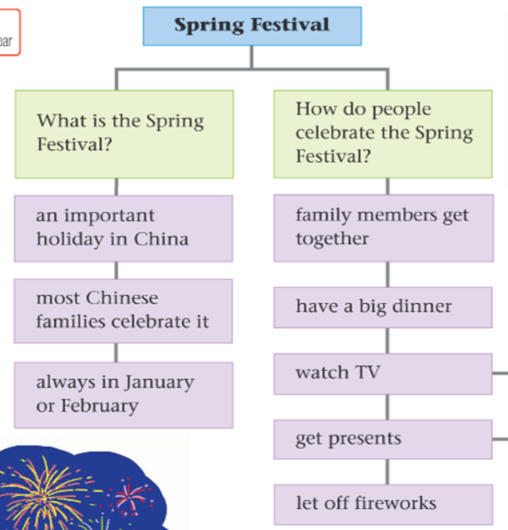
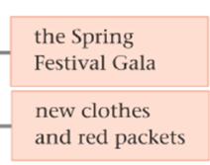
Millie’s writing plan

Slide 4
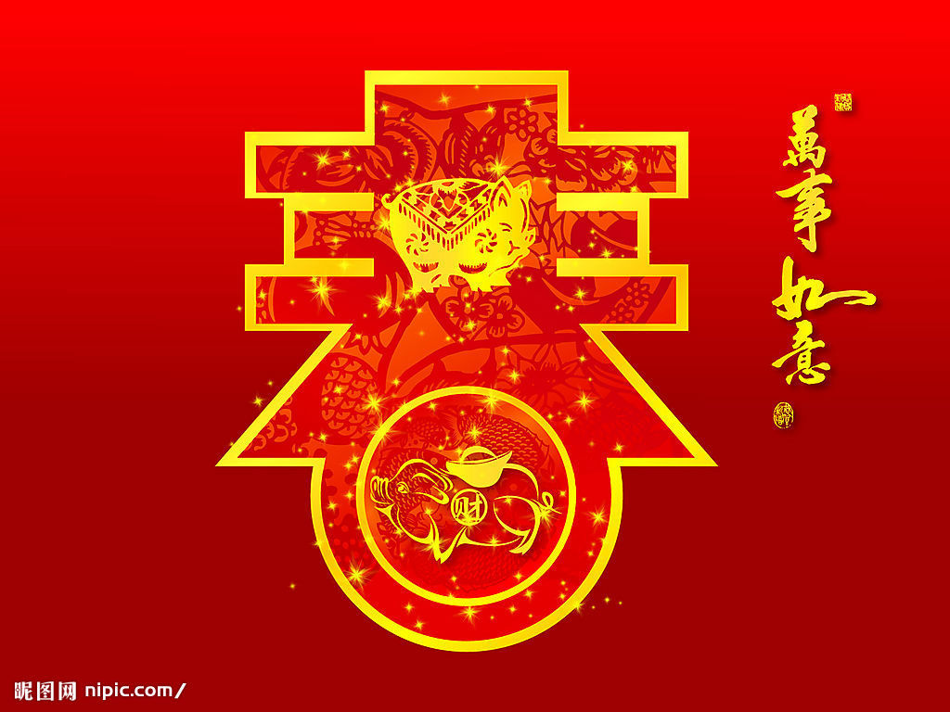
Millie’s favourite festival
The Spring Festival is an important holiday in China.
What?
Most Chinese families celebrate it.
It is always in January or February.
Who?
When?

Slide 5
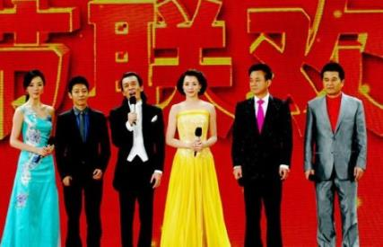
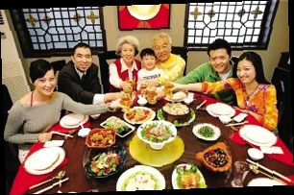
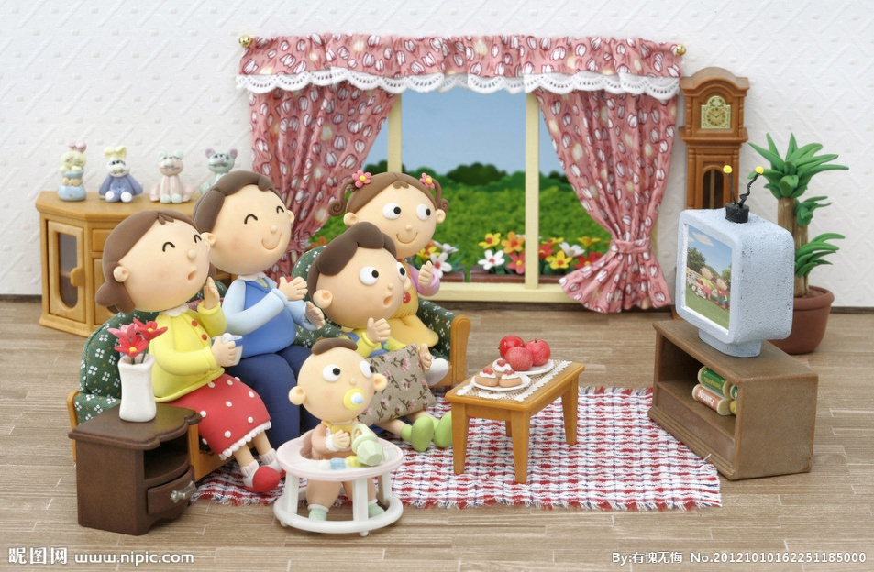
How?
How do people celebrate it?
get together
have a big dinner
watch TV
the Spring Festival Gala

Slide 6
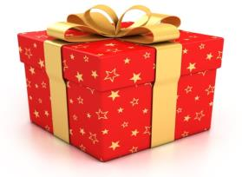
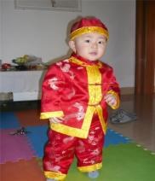
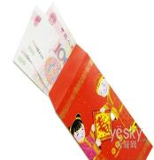

How?
How do people celebrate it?
get presents
new clothes and red packets
let off fireworks at night

Slide 7

topic
Millie’s writing plan
what
how
what
1
who
2
3
3 (1)
when
4
4 (1)
5

Slide 8

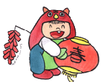
Spring Festival
The Spring Festival is an important holiday in China. Most Chinese families ________ it.
It is always in _______ or ________. It is often cold at this time of year, but people are happy. Family members ___________ and then have a big ______. After dinner, people like to ________. There is a great Spring Festival Gala on TV every year.
Children have lots of fun on this day. We get presents. Usually our parents get ___________ ready for us, and we get __________ from our grandparents, parents, aunts and uncles. We like to let off _________ at night. They are really
wonderful!
celebrate
January
February
get together
dinner
watch TV
new clothes
red packets
fireworks

Slide 9
Topic
Spring Festival
The Spring Festival is an important holiday in China. Most Chinese families celebrate it.
It is always in January or February. It is often cold at this time of year, but people are happy. Family members get together and then have a big dinner. After dinner, people like to watch TV. There is a great Spring Festival Gala on TV every year.
Children have lots of fun on this day. We get presents. Usually our parents get new clothes ready for us, and we get red packets from our grandparents, parents, aunts and uncles. We like to let off fireworks at night. They are really wonderful!
What & Who
When & How
How

Slide 10
Article structure
 | Para 1 | What is your favourite festival? Who celebrates it?
 | Para 2 | When is it? How do people celebrate it?
 | Para 3 | How do children celebrate it?
 | (Para 4) | (Your feelings)
Introduction
Main body
(Conclusion)

Slide 11
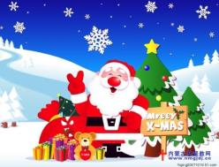
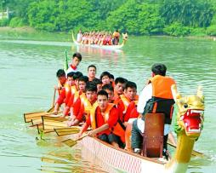
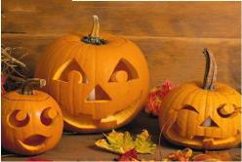
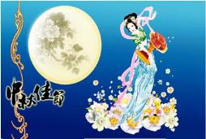
Writing steps
Choose a topic.
Get more details to make a writing plan.
3. Write a passage according to the plan.
4. Check your passage.

Slide 12
Mid-Autumn Festival
Writing plan
What is the Mid-Autumn Festival?
How do people celebrate it?
an important holiday in China
most Chinese families celebrate it
Who celebrates it?
in September or October
When is Mid-Autumn Festival?
Useful expression:
… is an important holiday in/for…
Useful expression:
It is in/on …

Slide 13
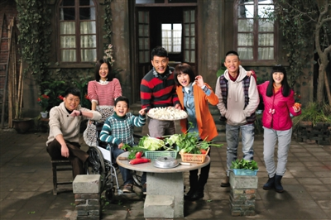
How do people celebrate the Mid-Autumn Festival?
family members get together
have a big dinner

Slide 14
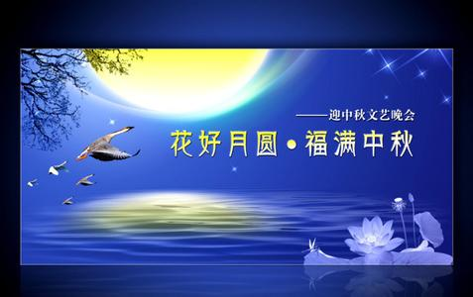
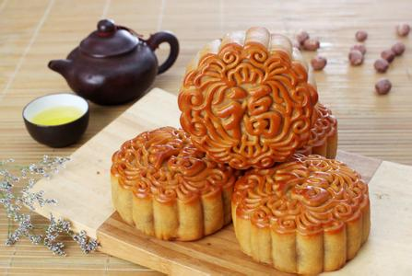
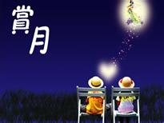
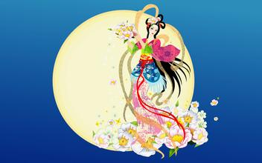
watch TV
eat moon cakes
enjoy the full moon
listen to the story about chang’e

Slide 15
Mid-Autumn Festival
Writing plan
What is Mid-Autumn Festival?
How do people celebrate it?
families members get together
an important holiday in China
have a big dinner
Who celebrates it?
most Chinese families celebrate it
eat moon cakes
enjoy the moon
on 15 August in Chinese lunar calendar
When is Mid-Autumn Festival?
listen to the story of Chang’e

Slide 16
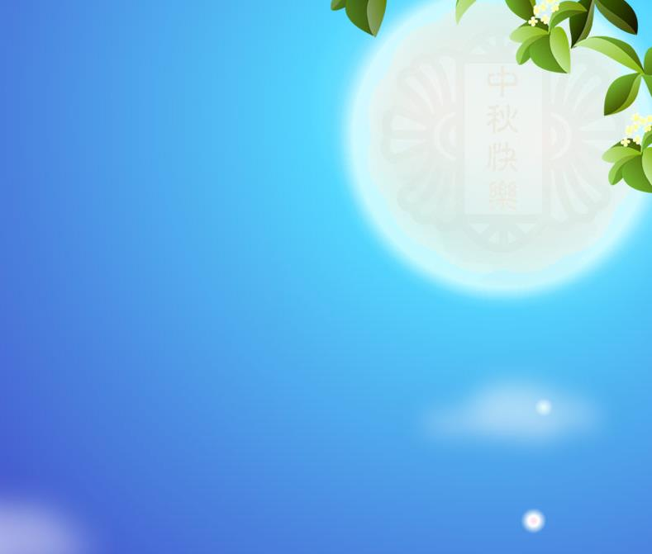

Useful expressions
… is an important holiday in/for …
It is in/on …
It is …, but …
There is/are … on TV …
We/They like to …
Usually we get …
… have lots of fun …

Slide 17
Sample writing
Mid-Autumn Festival
The Mid-Autumn Festival is an important holiday in China. Most Chinese families celebrate it.
It is on 15 August in Chinese lunar calendar. We don’t go to school that day. Family members get together and then have a big dinner.
In the evening we eat different kinds of moon cakes, enjoy the full moon and listen to the story about Chang’e.
I like Mid-Autumn Festival very much. I always have great fun that day.

Slide 18

Check your passage
Content 内容 | • A clear order 条理清晰 • A complete structure 结构完整
Words & Sentences 词句 | • Spell words correctly 单词拼写正确 • Use words and sentences precisely 精确使用词句
Grammar 语法 | • Simple present tense 一般现在时
Handwriting 书写 | • Beautiful and tidy handwriting 书写美观整洁
Writing evaluation table 评价表

Slide 19
Homework
Collect more information about your favourite festival.
Refine your passage according to the evaluation table.

