Slide 1
Unit4 Where do you work?
五年级上册
WWW.PPT818.COM

Slide 2
>>Lead-in
Look and say
What’s her job?
She is a teacher. She works in a school.
work

Slide 3
>>Presentation
Look and say
Now you are a teacher. Where do you work?
I am a teacher. I work in a school.

Slide 4
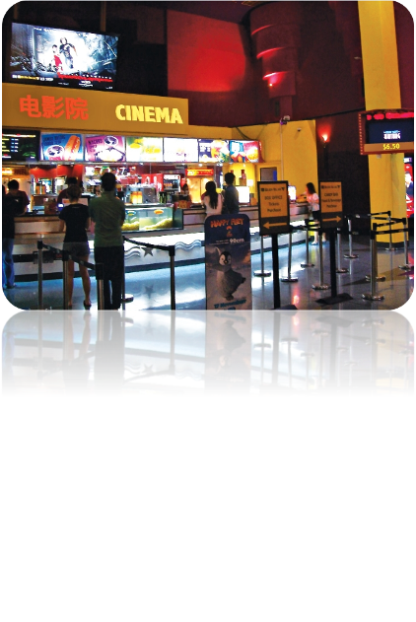
>>Presentation
Look and say
Where do you work?
cinema
I work in a cinema.

Slide 5
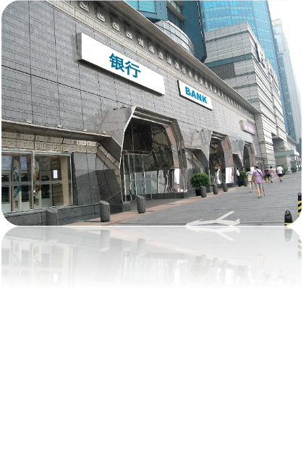
>>Presentation
Look and say
Where do you work?
bank
I work at the Bank of China.

Slide 6
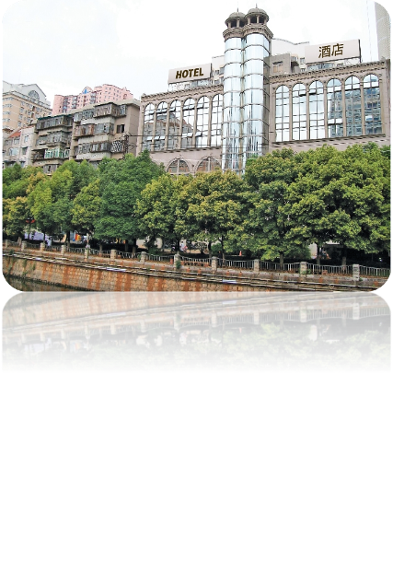
>>Presentation
Look and say
Where do you work?
hotel
I work in a hotel.

Slide 7
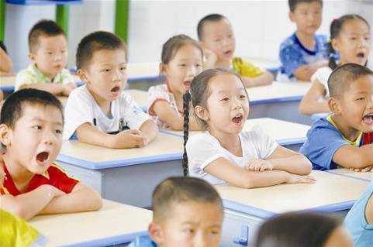
>>Presentation
Look and say
You are students. You study in our school.
study

Slide 8
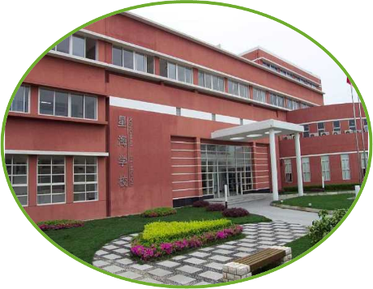
>>Presentation
Look and say
Where do you study?
I study at Xinghai School.

Slide 9
>>Presentation
1. Where does Mrs Wu work now?
2. Where does Mr White work now?
3. Where does Mrs Wu’s daughter study now?
Read and answer
She works in Beijing Cinema.
He works at the Bank of China.
She studies at Sunny School.

Slide 10
>>Presentation
Just talk
Mr White: Hi, Mrs Wu! Nice to see you again.
Mrs Wu: Nice to see you, too!
Mr White: Where do you work now?
Mrs Wu: I work in Beijing Cinema. How about you?
Mr White: I work at the bank of China.
Mr White: How about your daughter? Where do you
study now?
Daughter: I study at Sunny School.

Slide 11
>>Practice
Show time
小组合作，练习对话并表演，其他同学评价。
Pronunciation (语音) |  | Fluency (流利) | Cooperation (合作)
OK!
Great!
Super!

Slide 12
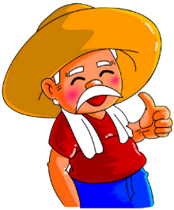
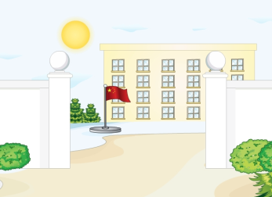
>>Practice
Look and match

Slide 13
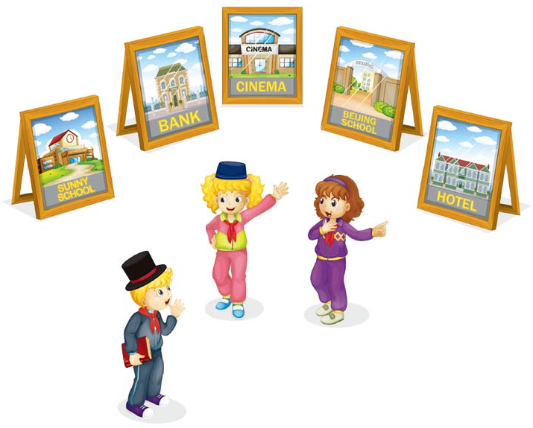
>>Practice
Let’s act
2
I study at Beijing School.
1
4
Where do you study?
I work in a hotel.
3
Where do you work?

Slide 14
>>Practice
活动
Group work
首先，每位学生为自己设计一个身份卡片，如： I’m _______. I work _________. 然后，以小组为单位，组长将组员的卡片收上来，打乱顺序发给不同的学生，学生根据自己手中的卡片内容，自选搭档进行对话练习，如：—What’s your job? —I’m a ____. —Where do you work? —I work in a _____.
a worker
in a factory

Slide 15
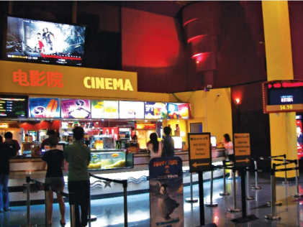
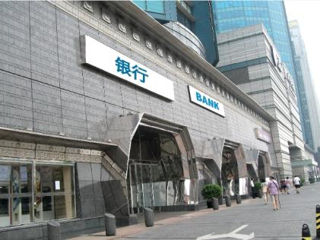
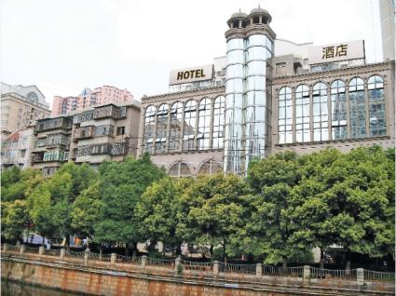
>>Summary
本课的重点单词：
hotel
cinema
bank

Slide 16
>>Summary
如何询问他人工作和学习近况？
—Where do you work/study now?
—I work/study in/at …

