Slide 1
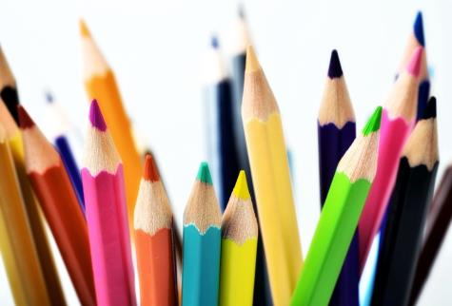
Colours
1
第三课时
WWW.PPT818.COM

Slide 2
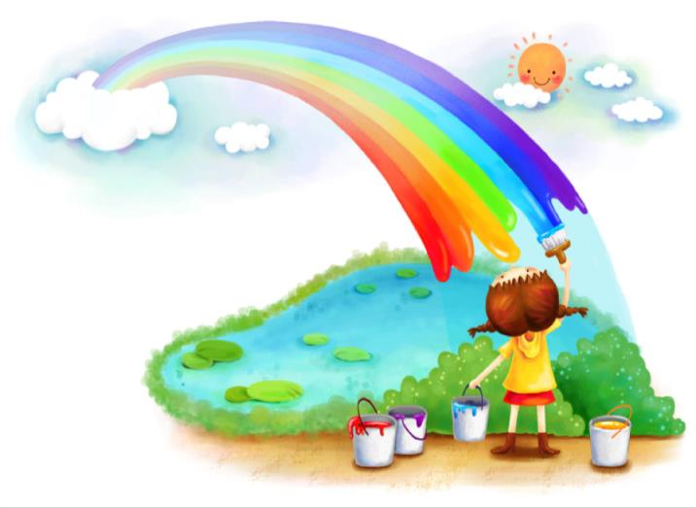
Look at the rainbow,
The rainbow,
The rainbow.
Look at the rainbow
In the sky.
Red, orange, yellow,
Green and blue,
Purple and violet too.
Look at the rainbow,
The rainbow,
The rainbow.
Look at the rainbow
In the sky.
The Rainbow

Slide 3
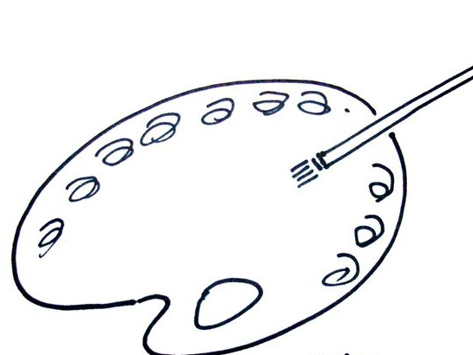
Read and match
red yellow blue green black
white orange purple violet

Slide 4
Look and say
Mix the Colours
red
Mix ______ and ______. What colour is it?
white
pink
It is __________.

Slide 5
Look and say
Mix the Colours
yellow
red
Mix ________ and ______. What colour is it?
orange
It is __________.

Slide 6
Look and say
Mix the Colours
yellow
blue
Mix ________ and ______. What colour is it?
green
It is __________.

Slide 7
Read and spell
pink
red
orange
green
white
black
white
blue
yellow
purple
violet

Slide 8
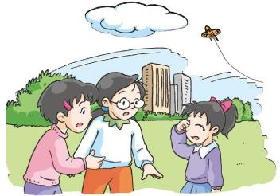
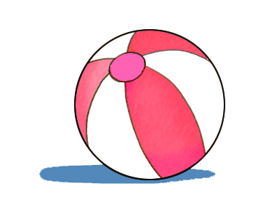
Look and answer
What’s the matter?
I can’t find my ball.
What colour is your ball?
It is red and white.

Slide 9
What’s the matter?
I can’t find my ball.

Slide 10
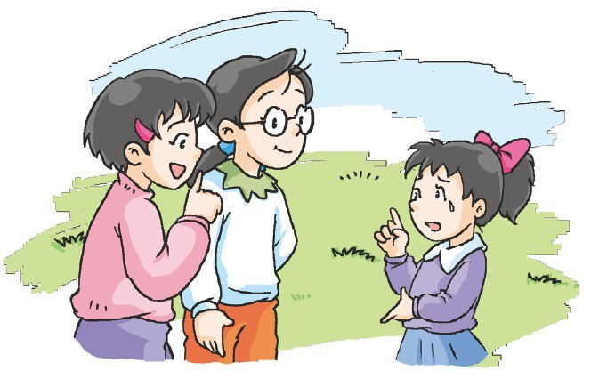
What colour is your ball?
It’s red and white.

Slide 11
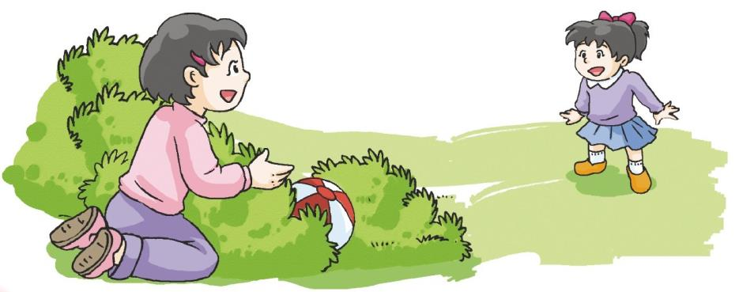
Look! Is this your ball?
Yes, it is! Thank you.

Slide 13
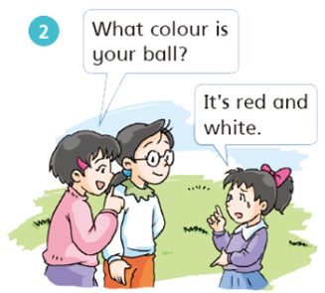
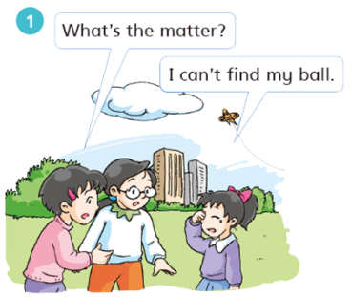
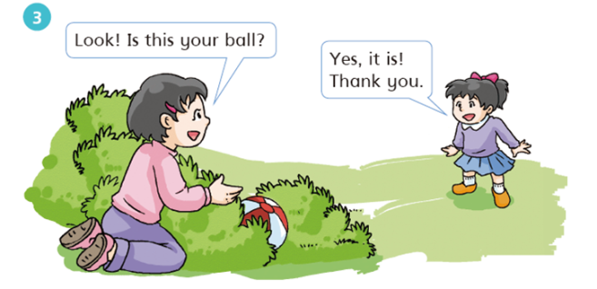

Slide 14
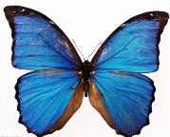
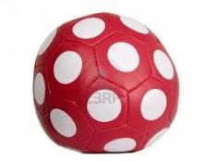
Ask and answer
What colour is the bag?
What colour is …?
It is ...
It is yellow, red and blue.

