Slide 1
UNIT 4 History and traditions
人教版高中英语必修二
Section A Listening and Speaking
WWW.PPT818.COM

Slide 2
人们常说,“历史是不能遗忘的”。但我们牢记历史并不仅仅是为了了解过去发生的事实,而是为了更好地把握今天,开创一个更美好的明天。
Yuanmingyuan
Yuanmingyuan,before its destruction,was referred to as the “Garden of Gardens”,since it was a combination^{①} of gardens of different styles,Chinese and Western.
Yuanmingyuan consisted of^{②} three gardens,Yuanmingyuan,Changchunyuan and Qichunyuan.They covered 350 hectares.

Slide 3
Plan of the three-in-one garden,with Qichunyuan in the front,Yuanmingyuan on the left,and Changchunyuan on the right.
The best-known Western structures were a fountain,a maze(迷宫) and European palaces,all of a Renaissance style.In a small lake was built a model of Venice.
The emperor’s apartments were adorned with art treasures of an astonishing richness.The garden was beautified by millions of foreign flowers and trees.
The Old Summer Palace yellow array,one of the scenes in the Garden of Perfect Splendour,has been reconstructed^{③}.It is a maze of winding paths between low walls in the eastern part of the garden.

Slide 4
Unfortunately,on 6 October 1860,the British and French troops attacked and looted^{④} Yuanmingyuan.About 2 weeks later on 18 October,the British set Yuanmingyuan on fire.The garden was in flames for three days destroying most of the Chinese-style buildings constructed with wood.
During the looting of Yuanmingyuan,many imperial treasures^{⑤} were stolen and taken out of China.Among the treasures stolen were sculptures of the 12 bronze zodiacs sculptures^{⑥} that graced Emperor Qianlong’s fountains.
Visitors today can see a few blocks of stone and broken marble that once belonged to the European palaces constructed under Emperor Qianlong between 1740 and 1747.

Slide 5
词海拾贝
①combination n.结合
②consist of由……组成
③reconstruct vt.重建
④loot v.抢劫
⑤treasure n.珍宝
⑥sculpture n.雕塑

Slide 6
典句欣赏
Visitors today can see a few blocks of stone and broken marble that once belonged to the European palaces constructed under Emperor Qianlong between 1740 and 1747.
翻译:今天的游客可以看到一些大块石头和破碎的大理石,它们曾经属于乾隆皇帝在1740年至1747年间建造的欧洲风格的宫殿。
分析:本句是个复合句。Visitors today can see...是主句,that once belonged...是定语从句,constructed under...是过去分词短语作定语。

Slide 7
理解诱思
1.Why were most of the Chinese-style buildings destroyed in the fire?
答案:Because they were mostly made of wood.
2.What do you think of the destruction of Yuanmingyuan?
答案:It is an inestimable loss not only in the history of Chinese culture,but also in the history of world culture!

Slide 8
Ⅰ
Ⅱ
Ⅲ
Ⅰ.知识体系图解
cemetery
philosophy
descendant
individual
heel

Slide 9
Ⅰ
Ⅱ
Ⅲ
导致;通向
做研究项目
家谱
与……相似
以……而著名
坚持;抓住
介绍
与……不同

Slide 10
Ⅰ
Ⅱ
Ⅲ
Ⅱ.释义匹配
1.cemetery A.the study of the nature and meaning of existence,truth,good and evil,etc.
2.philosophy B.considered separately from other people or things in the same group
3.descendant C.the curved back part of your foot
4.individual D.a person who is related to someone and who lives after them,such as their child or grandchild
5.heel E.an area of ground in which dead bodies are buried
答案:1.E 2.A 3.D 4.B 5.C

Slide 11
Ⅰ
Ⅱ
Ⅲ
Ⅲ.完成句子
1.Mr Brown (提出了一种想法)at yesterday’s meeting.
2.The author uses the story in the novel to_________________ (给出暗示) to the readers.
3.We would like you to (介绍) to the history of the tower.
4.He always tells me to (坚持下去) when I have difficulties.
5.Your good advice was still ringing in my ear__________________ (很久以后) you said it.
presented an idea
give a hint
give an introduction
hold on
long after

Slide 12
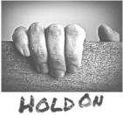
重点词汇
重点句式
随堂练习
1.hold on抓牢;坚持不懈;稍等一下
【课文原句】And so hold on when there is nothing in you
所以当你一无所有时要坚持
【词汇精讲】hold on是动词短语,意为“抓牢;坚持不懈;稍等一下”。
The boy held on to the rope until he was rescued.
男孩紧紧地抓住绳子,直到获救。
Though I met with a lot of difficulties,I held on.
尽管我遇到了很多困难,但我坚持不懈。
Hold on for a minute.I am getting changed.
等一会儿,我在换衣服。

Slide 13
重点词汇
重点句式
随堂练习
【词汇拓展】
She kept trying to hold back her tears.
她一直在试图抑制住眼泪。
With some hesitation and an uncertain smile,she held out her hand.
她犹豫了一下,带着迟疑的微笑把手伸了出去。

Slide 14
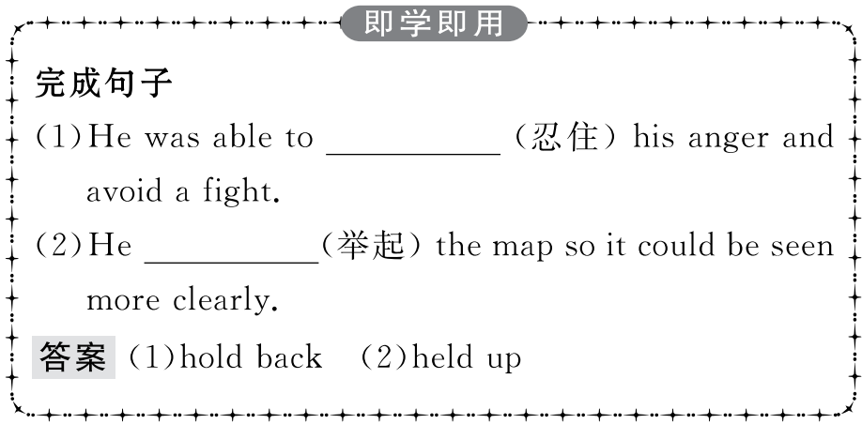
重点词汇
重点句式
随堂练习

Slide 15
重点词汇
重点句式
随堂练习
2.individual adj.单独的;个别的 n.个人
【课文原句】An idiom is an expression which means something different from the meaning of the individual words.
成语是一种表达方式,它的意思与单个词的意思不同。
【词汇精讲】individual作形容词,意为“单独的;个别的”,作名词,意为“个人”。
They wait for the group to decide instead of making individual decisions.
他们等待团体做决定而不是各自做出决定。
The competition is open to both teams and individuals.
团队和个人均可参加比赛。

Slide 16
重点词汇
重点句式
随堂练习
【词汇拓展】

Slide 17
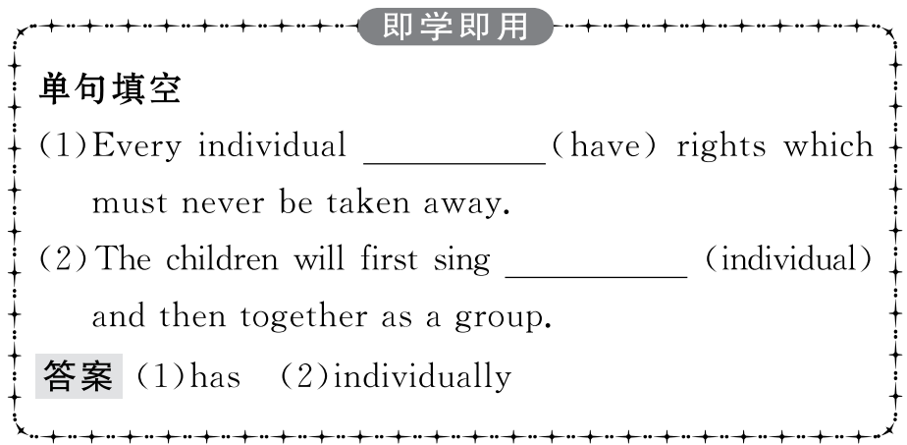
重点词汇
重点句式
随堂练习

Slide 18
重点词汇
重点句式
随堂练习
Why do you think William said his hometown was similar to Qufu?
你认为威廉为什么说他的家乡与曲阜相似?
【句式剖析】do you think是插入语,在句中不作成分,通常放在疑问词后。当句子中有此类插入语时,句子要用陈述语序。
What do you think is the writer’s point of view in this reading passage?
你认为在这篇阅读材料中作者的观点是什么?
Which part of this book do you think is the most interesting?
这本书中你认为哪一部分最有趣?

Slide 19
重点词汇
重点句式
随堂练习
【句式拓展】常用于这种形式的动词有:think,suggest,hope,believe,suppose,guess,consider,imagine等。
What do you believe the earth is made up of?
你觉得地球是由什么构成的?
What do you suppose he bought last week?
你认为他上周买了什么?

Slide 20
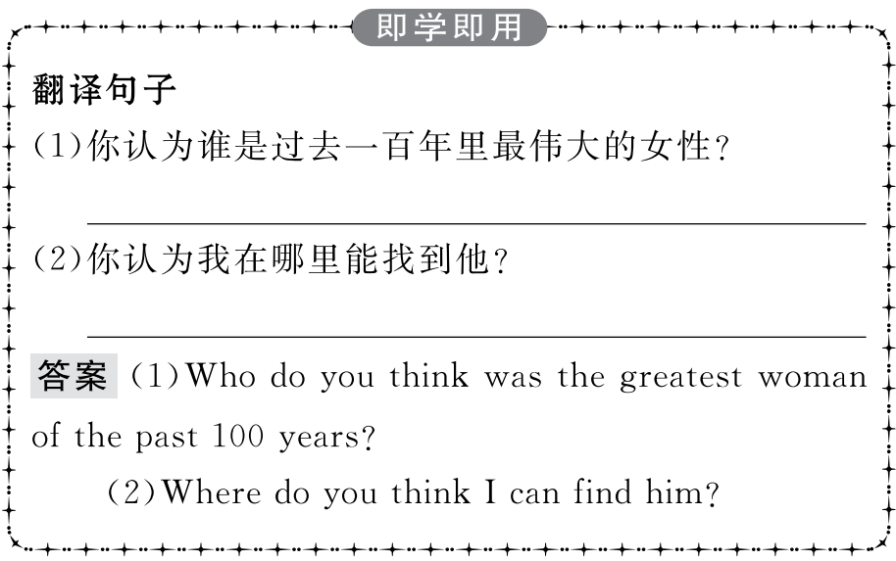
重点词汇
重点句式
随堂练习

Slide 21
重点词汇
重点句式
随堂练习
Ⅰ.单词拼写
1.The (公馆) was similar to a style popular at the time in Paris.
答案:mansion
2.After finishing middle school,he majored in (哲学) and psychology at college.
答案:philosophy
3.They are (后裔) of the original English and Scottish settlers.
答案:descendants

Slide 22
重点词汇
重点句式
随堂练习
4.A child’s awareness of being an (个人) grows in stages during the preschool years.
答案:individual
5.Every year they go to the (墓地) to pay their respect to those who died for the country.
答案:cemetery

Slide 23
重点词汇
重点句式
随堂练习
Ⅱ.介词填空
1.There is a path leading the top of the hill.
答案:to
2.My handbag is similar yours.
答案:to
3.They are doing a research project Confucius philosophy.
答案:on
4.London is different most European capitals.
答案:from
5.I feel like a fish out water at the party because I know no one.
答案:of

