Slide 1
Unit 2
I’ll help to clean up the city parks.
R 八年级下册
第3课时
WWW.PPT818.COM

Slide 2
Review
说出下列不定式的用法。
宾语
1. The girl wanted to take the joy home.
2. The teacher asked the students to be quiet.
宾语补足语
3. There are enough time to get to the airport.
定语

Slide 3
1a
Match the sentences with similar meanings.
___1. I’ve run out of it.
___2. I take after my mother.
___3. I fixed it up.
___4. I gave it away.
b
c
a
a. I repaired it.
b. I don’t have any more of it.
c. I am similar to her.
d. I didn’t keep it.
d

Slide 4
1b
Match the phrasal verbs with the nouns.
run out of
take after
fix up
give away
my bike
money
my father
old clothes

Slide 5
1b
Then make sentences with the phrases.
1. I gave away my bike to a children’s home.
2. _____________________________________
3. _____________________________________
4. _____________________________________
5. _____________________________________
I took after my father.
I gave away my old clothes to the poor kid.
I ran out of my money last weekend.
I fix up my bike and give it away.

Slide 6
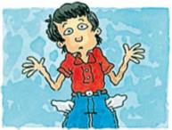
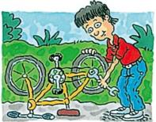
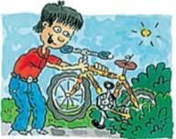
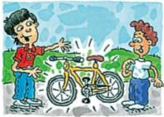
Listen and number the pictures [1- 4] in the correct order.
1c
a
b
c
d
2
1
3
4
_____
_____
_____
_____

Slide 7
1d
Listen again. Circle T for true or F for false.
1. Jimmy fixes up broken bicycle parts, T F
like wheels.
2. Jimmy sells bikes. T F
3. Jimmy takes after his mother. T F
4. Jimmy has run out of money. T F

Slide 8
Listen again and fill in the blanks.
Jimmy ____ or ____ old bikes ____ nobody wants. Then he _______ the bikes and _____them _____ to kids ____ don’t have enough money to buy their own bikes. That’s fantastic. What gave him the idea? He guess he _________ his father. But now he has _________ money to buy any more old bikes. he needs to ____________some way of getting money.
finds
buys
that
fixes up
gives
away
who
takes after
run out of
come up with

Slide 9
Role-play a conversation between Jimmy and the reporter. Use the information in 1c and 1d.
1e
What do you do, Jimmy?
I fix up...

Slide 10
Language points
1.I’ve run out of it.
run out of是“动词+副词+介词”的短语，of后接宾语，主语通常是表示“人”的名词，也可用于某种能消耗物品的机器等，意为“……用完了……”。
我的纸用完了。
I’ve run out of paper.

Slide 11
(1) run out of也可表示“从……跑出来”的意思。
这条狗从房间里跑了出来。
The dog ran out of the room.
(2)run out是“动词+副词”结构的不及物动词短语，
意为“用完，用尽”，主语通常是表示“时间、金钱”
等无生命的东西。
所有的钱都被我花光了。
All the money ran out by me.

Slide 12
(3)sth. run(s) out表示“某物用尽了、用完了”。
我们的食物快吃完了。
Our food will soon run out.

Slide 13
2. I take after my mother.
take after意为“像；与……相像”，指由于血缘关系而（在外貌、性格、行为等方面）与某个长辈相像。其中after是介词,后常接名词或代词。
玛丽真像她妈妈。
Mary really takes after her mother.

Slide 14
【拓展】look like指长相（外表上）“看起来像”。
这座山看起来像一只大象。
The mountain looks like an elephant.

Slide 15
Exercise
用run out或者run out of填空。
1. He ____________ the water.
2. The water _________.
3. — Peter, I think we need to buy a new car.
— Oh, no! We are _____________ money, you know?
ran out of
ran out
running out of

Slide 16
Mary ____ her mother. They both have big eyes.
A. looks after B. looks like
C. looks up D. looks at
B

Slide 17
My computer doesn’t work. Could you please help me ____?
A. fix up it B. fix it up
C. fix them up D. look it up
B

