Slide 1
人教精通版五年级下册
Unit 6 We’re watching the games.
WWW.PPT818.COM

Slide 2
>>Warm-up
Let’s sing

Slide 3
>>Lead-in
Review
basketball
football
volleyball

Slide 4
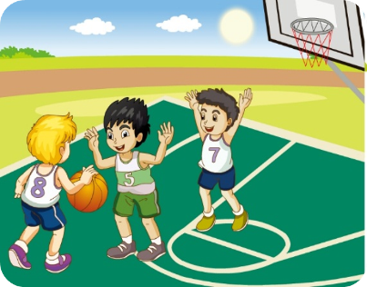
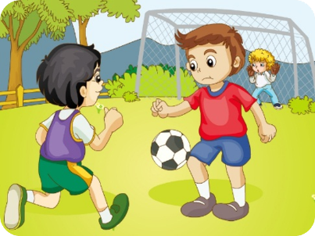
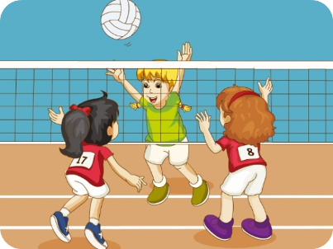
>>Lead-in
Review
---What are they doing?
---They’re_________________.
playing basketball
playing football
playing volleyball

Slide 5
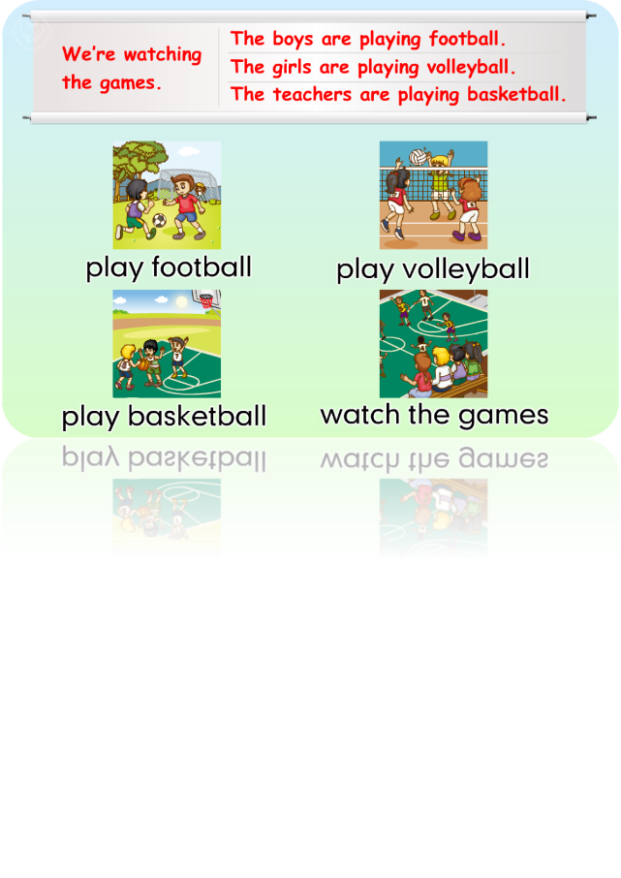
>>Presentation
Just practise

Slide 6
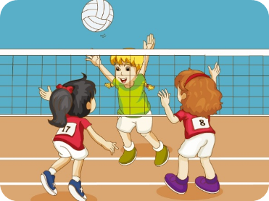
>>Presentation
The boys are playing football.
The girls are playing volleyball.

Slide 7
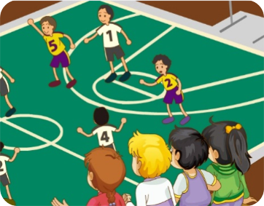
>>Presentation
The teachers are playing basketball.
We are watching the games.

Slide 8
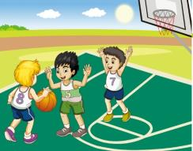
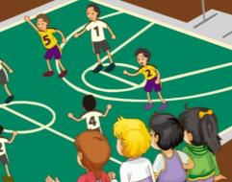
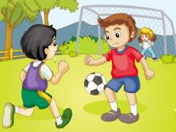
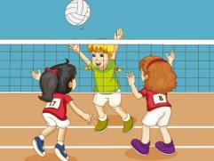
>>Practice
They are v-ing.

Slide 9
>>Practice
What are they doing?
They are v-ing.

Slide 10
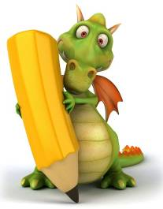
>>Presentation
Just write
watch
看
game
游戏
foot(feet)
脚（复数）
football
basketball
足球
篮球
playground
操场
We are watching the games.
我们正在看比赛。

Slide 11
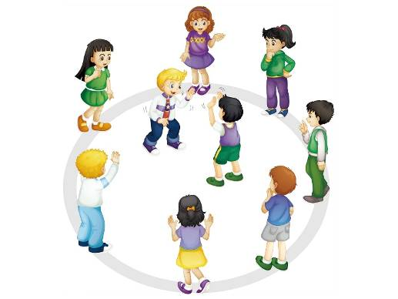
>>Practice
Let’s play
They’re playing football.
Look! What are
they doing?
No, I don’t think so.
They’re playing basketball.
Right!

Slide 12
>>Presentation
Let’s chant

Slide 13
>>Summary
四会词汇：
watch
game
foot(feet)
basketball
football
playground
如何询问和回答“他们正在做什么”？
---What are they doing?
---They are v-ing.
如何表达“我们正在看比赛” ？
We are watching the games.

Slide 14
>>Homework
1. 观看课文动画，按照正确的语音、语调朗读课文。
2. 熟练朗读Let’s chant部分。
3. 预习Lesson33。
close

