Slide 1
Unit 1 Li Ming Goes to Canada
Lesson 5 In the Living Room
WWW.PPT818.COM

Slide 2
Warming up
1. Let’s sing a song “In the Living Room”.
In the living room
there’s a sofa
There’s a sofa in the living room
Please sit down
Please sit down
in the living room
In the living room
there’s a window
There’s a window in the living room
Open the window
Close the window in
the living room
In the living room
there are curtains
There are curtains in the living room
Open the curtains
Close the curtains
in the living room
-
2. Free talk
In my living room, there is…

Slide 3
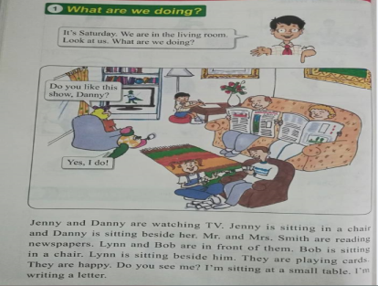
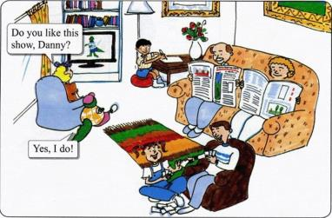
PRESENTATION
回答问题
Where are they?
How many people are there in
the picture?
Who are they?
They are in the living room.
There are 7 people.
They are Jenny, Danny, Mr. and Mr. Smith, Lynn, Bob and Li Ming.

Slide 4
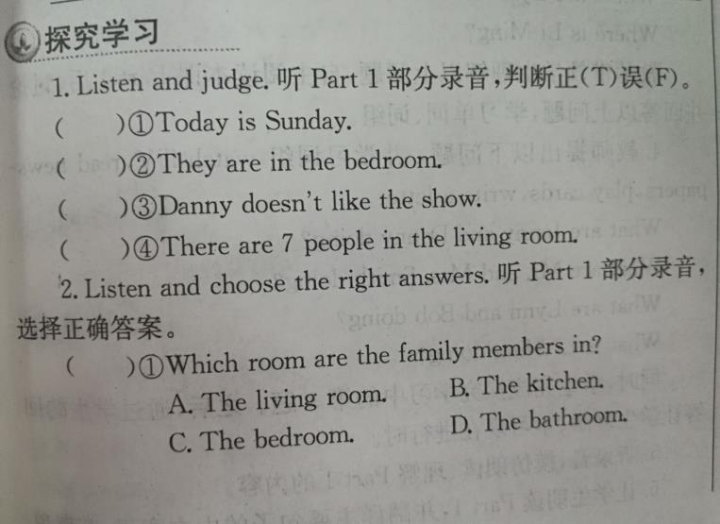
PRESENTATION
F
F
F
T
A
C

Slide 5
PRESENTATION
观察回答问题
Where is Jenny ?
Who is sitting beside
Jenny?
Where are Lynn and
Bob?
Where is Li Ming?
Jenny is sitting in a chair.
Danny is sitting beside
Her.
Lynn and Bob are in front
of Mr. and Mrs. Smith.
Li Ming is sitting at a small table.

Slide 6
PRESENTATION
观察回答问题
What are Jenny and Danny doing ?
What are Mr. and Mrs. Smith doing?
What are Lynn and
Bob doing ?
What is Li Ming doing?
They are watching TV.
They are reading
newspapers.
They are playing cards.
He is writing a letter.

Slide 7
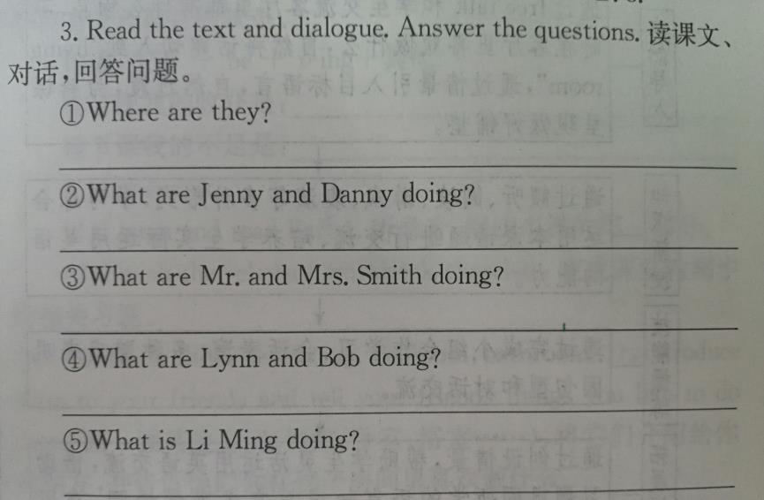
PRESENTATION
They are in the living room.
They are watching TV.
They are reading newspapers.
They are playing cards.
He is writing a letter.

Slide 8
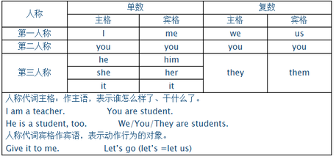
practice

Slide 9
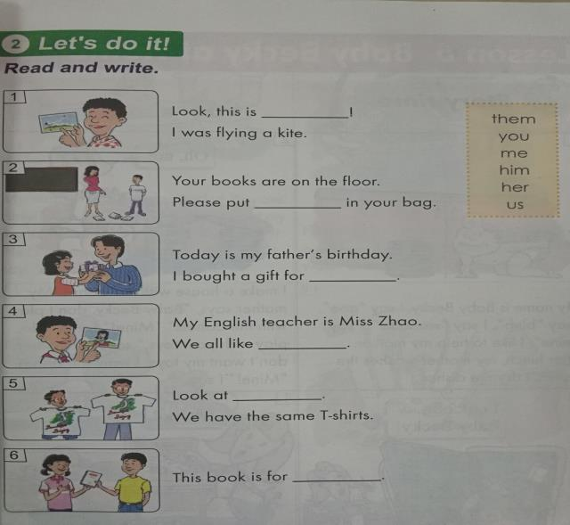
practice
me
them
him
her
us
you

Slide 10
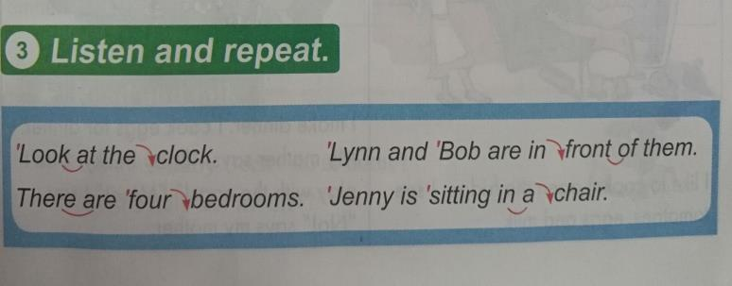
practice
Listen and repeat.

Slide 11
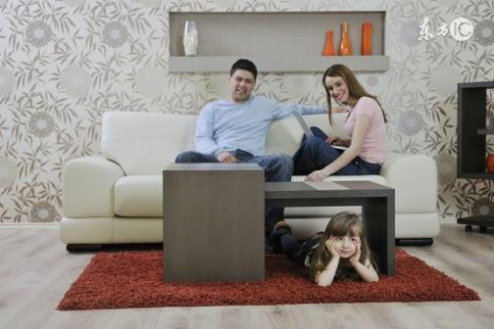
consolidation
What’s in my living room?
What do my family members like to do?

Slide 12
Summing up
1.Words:
table, chair, card, me, him, them, beside
2.Phrases:
in a chair, at a small table, in front of, watch TV, read newspapers, play cards, writer a letter
3.Grammar points:
现在进行时：表示现在或现阶段正在进行或发生的动作和存在的状态
构成：主语+be+动词ing+其他
这节课我的收获是：_____________
这节课我的不足是：_____________

Slide 13
homework
1.听录音，朗读本课的第一部分
2.完成相关习题
3.画一画其他房间，将它们介绍给你的朋友，并告诉他们你在这个房间里喜欢做什么。

