Slide 1
Unit3 How do you come to school?
陕旅版
三年级下册
第二课时
WWW.PPT818.COM

Slide 2
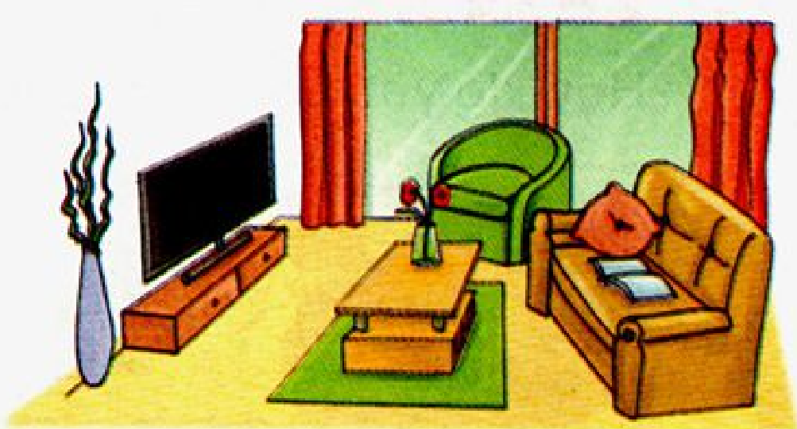
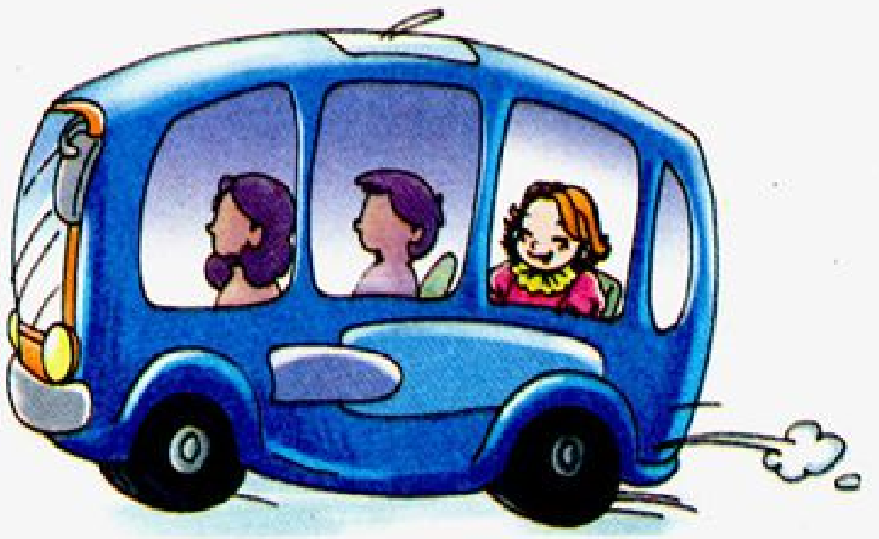
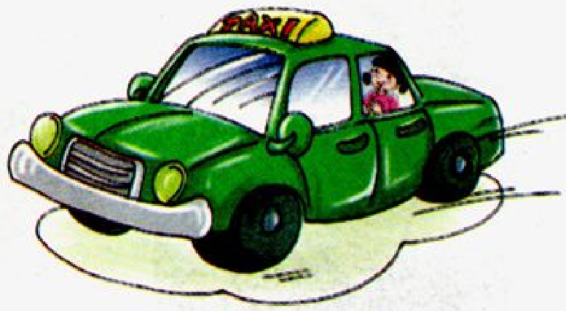
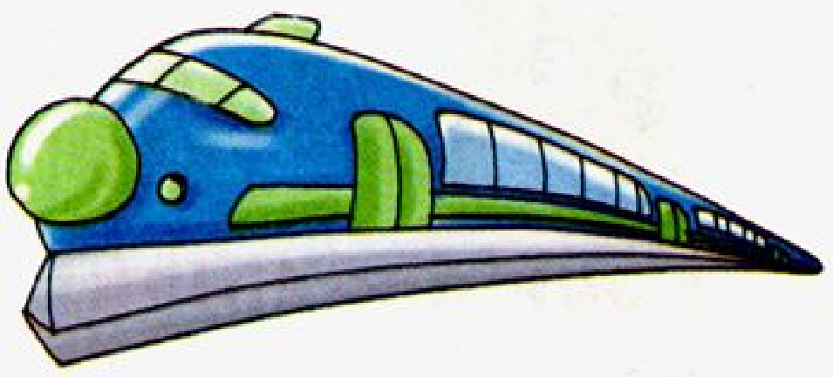
>>Review
Which is missing?

Slide 3
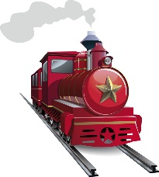
>>Review
句子接龙
How do you come to …?
I come to …
I come …

Slide 4
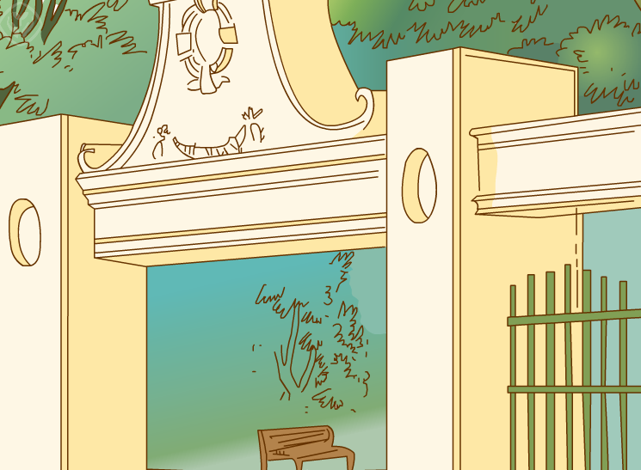
>>Warm-up
Let’s sing

Slide 5
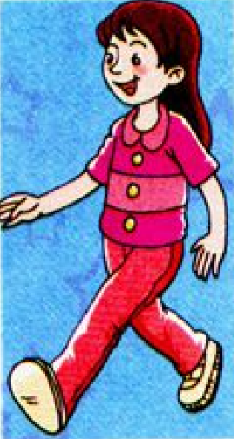
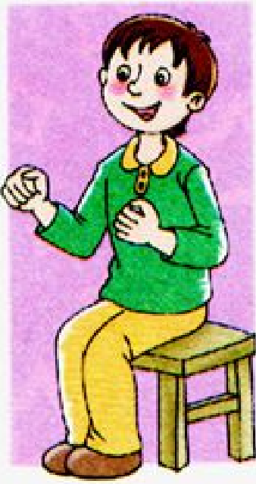
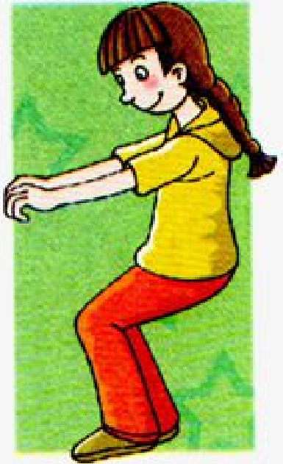
>>Lead-in
Listen and do
Ride a bike.
Take a bus.
Go on foot.
Drive a car.

Slide 6
>>Presentation
Make a survey
Come to school. Come to school.
I come to school on foot.

Slide 7
>>Presentation
Ask and answer
Do you come to school on foot?
Yes, I do.
No, I don’t.
Do you come to …?
Pair work
Yes, I do.
No, I don’t.

Slide 8
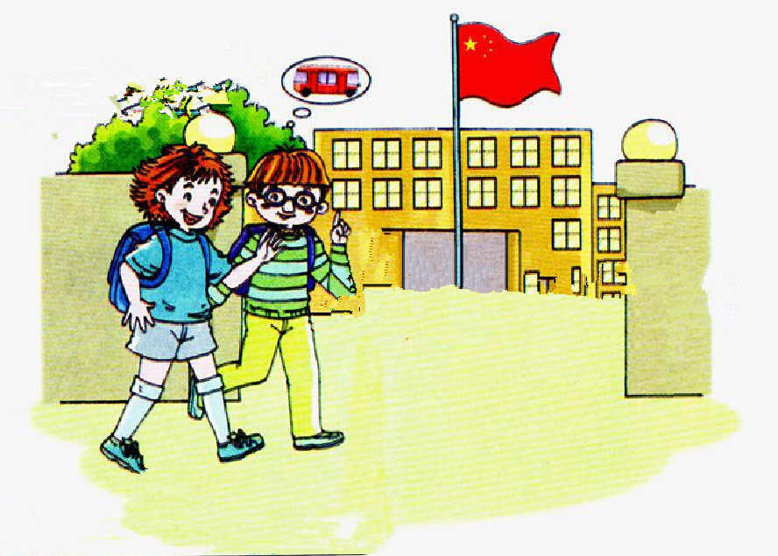
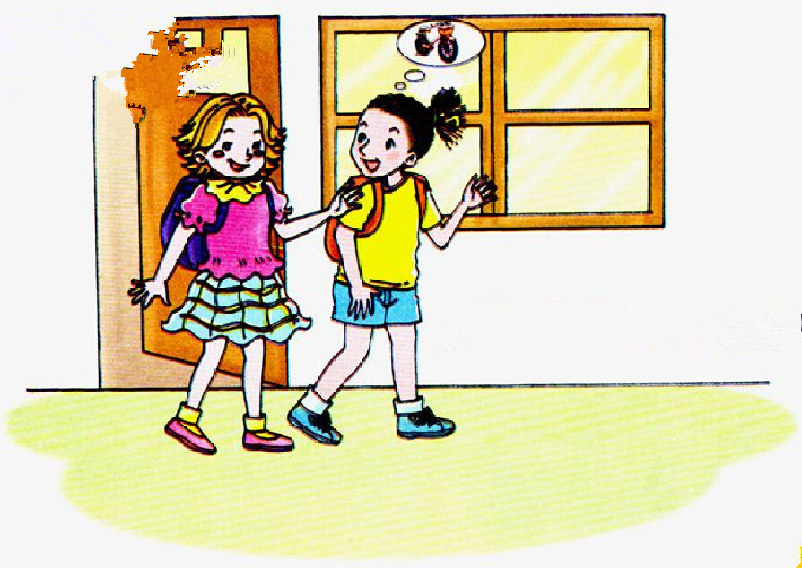
>>Presentation
Look and say

Slide 9
>>Presentation
Let’s talk
Morning, Kevin. How do you come to school?
I come to school by bus.
What about you?
I come to school on foot.

Slide 10
>>Presentation
Let’s talk
Do you go home on foot, Kitty?
No. I go home by bike.

Slide 11
>>Presentation
Let’s talk
Read and imitate
Colin: Morning, Kevin. How do you come to school?
Kevin: I come to school by bus. What about you?
Colin: I come to school on foot.
Alice: Do you go home on foot, Kitty?
Kitty: No. I go home by bike.

Slide 12
>>Practice
Read it by yourselves for one minute .
自读课文一分钟。
一分钟倒计时
60
Learning tip :
50
10
当你自己朗读时，遇到不会读或不明白意思的单词或句子，可以把它圈起来，请教同学或老师！
20
40
30
开始

Slide 13
>>Practice
Show time
小组合作，练习对话并表演，其他同学评价。
 | 模仿录音中的语音语调，有感情地朗读。
 | 可以脱离课本，适当改动其中部分，语音地道。
 | 适当添加内容，意思完整，有创新，表演生动。
Good
Great
Wonderful

Slide 14
>>Practice
活动
设计调查表
请设计一个调查表，调查五名学生日常出行所乘坐的交通工具。

Slide 15
>>Practice
Do a survey
A: How do you go to school?
B: I go to school …
Name By bus By bike By car By taxi On foot
Alice √

Slide 16
>>Summary
如何用特殊疑问句询问交通工具到某个地方去？
—How do you come to school/go home?
—I come to school/go home …
如何用一般疑问句询问乘坐哪种交通工具去某地？
—Do you come to school/go home …?
—Yes, I do./No, I don’t.

Slide 17
>>Homework
1.听课文录音并跟读，按照正确的语音、语调朗读并表演课文对话。 2.用本节课所学的疑问句型向自己的父母提问。
3.预习B Let’s learn more。
close

