Slide 1
Unit12
Fire
WWW.PPT818.COM

Slide 2
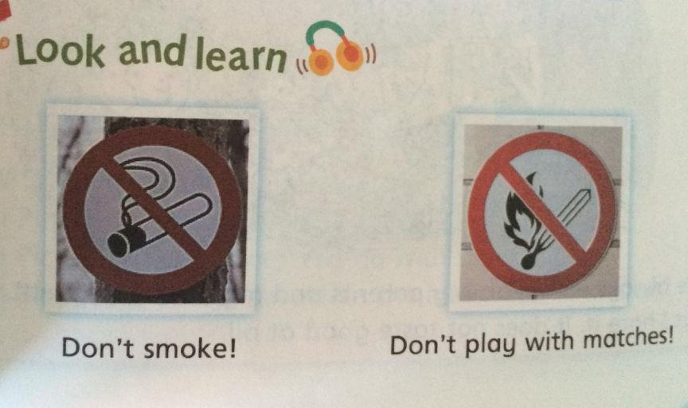
[‘mætʃɪz]
n.火柴

Slide 3
燃烧
[bɜ:rn]

Slide 4
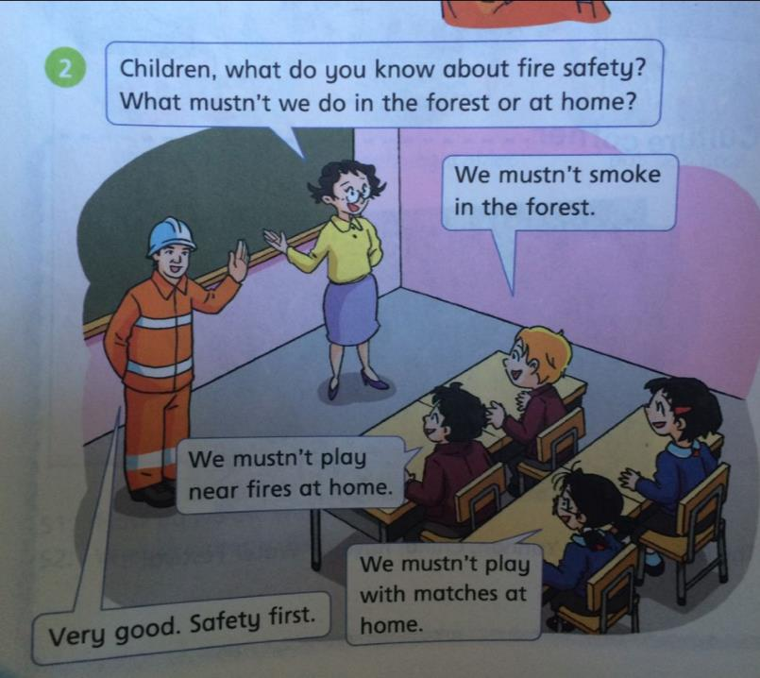
[seɪfli]
安全地

Slide 5
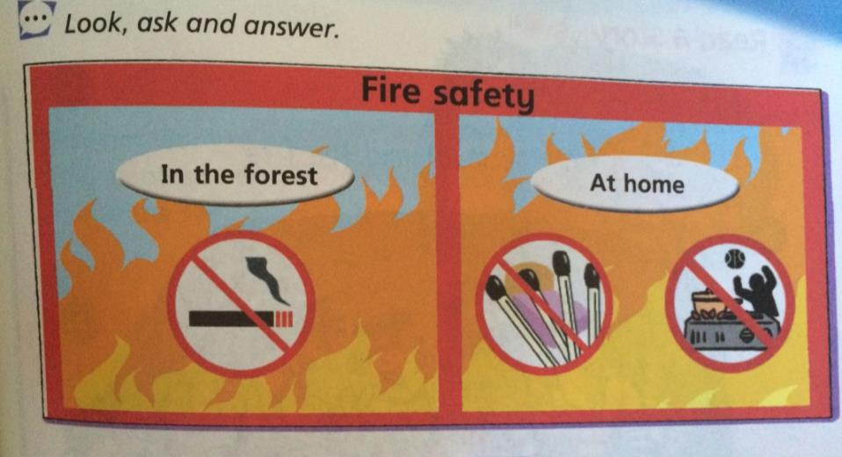

Slide 6
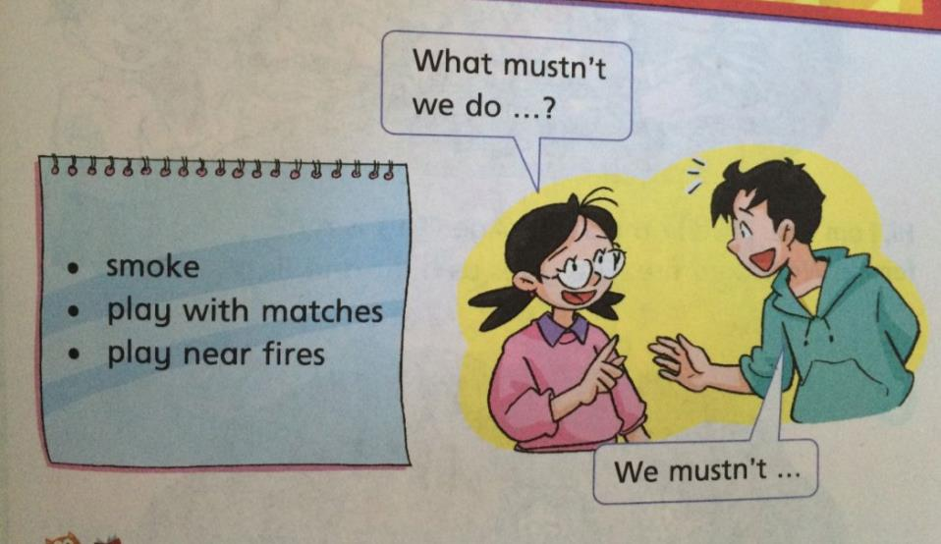

Slide 7
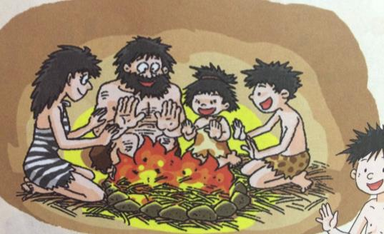
Yaz, the meat and the fire
[mi:t] n.肉;
Hi, I am Yaz. I live in the Stone Age. This is my family. We have a fire. Fire gives us heat and light.
[hi:t] 热
[laɪt] 光

Slide 8
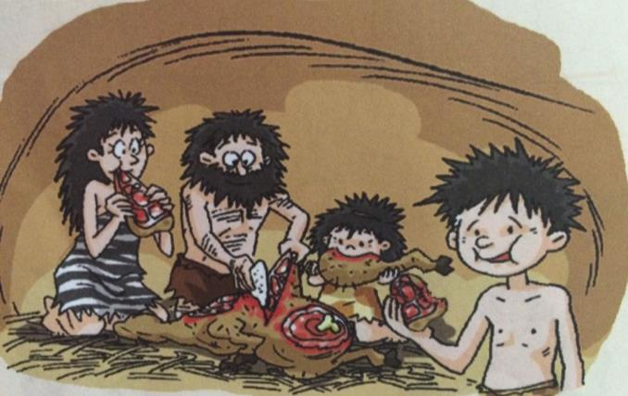
We always eat meat. My parents and my sister like meat, but I hate it. It does not taste good at all.
[heɪt] 厌恶
[teɪst]

Slide 9
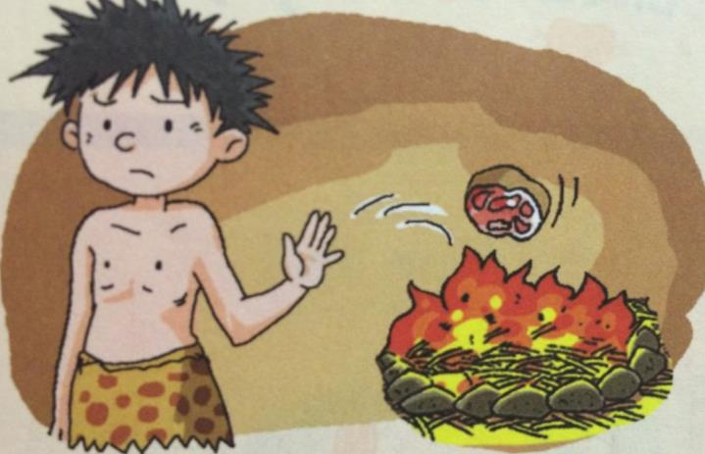
I do not want to eat any meat, so I throw it into the fire.
[θrəʊ].丢; 抛; 投掷

Slide 10
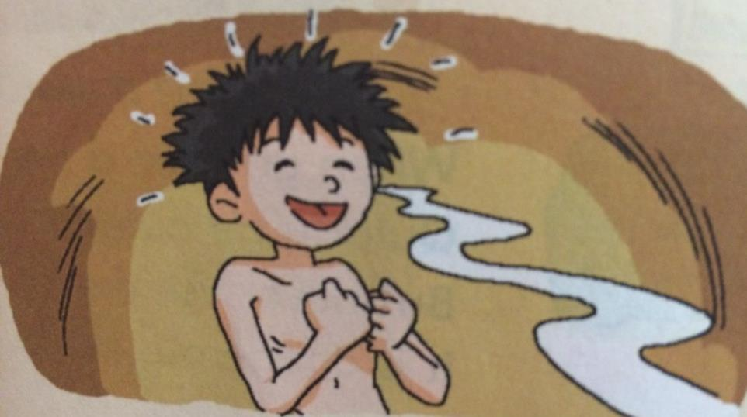
Now the meat smells very nice.
[smel] .嗅，闻;

Slide 11
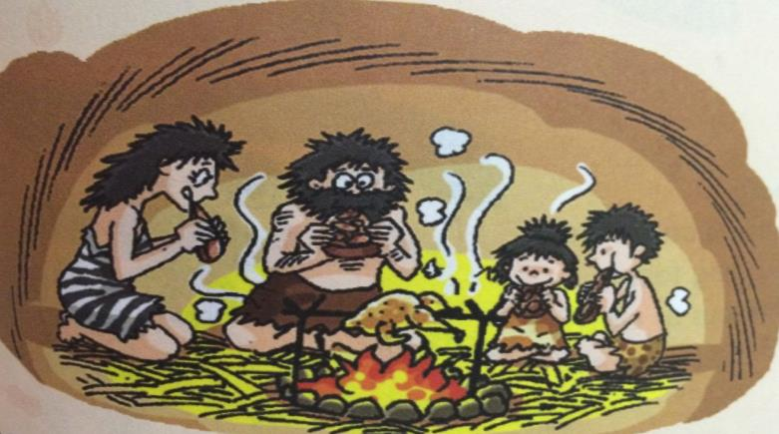
We eat the meat. It tastes great! After that, we cook all our meat on the fire.

Slide 12
1、Fire
2、No, he doesn’t.
3、He throws the meat into the fire.
4、It smells nice and tastes great.

Slide 13
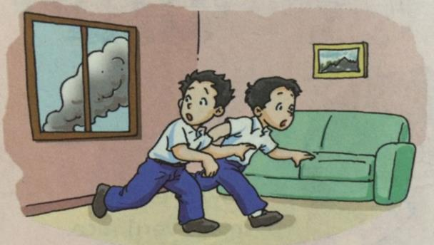
[kwɪklɪ]
adv.迅速地
When you see a fire, quickly go outside. But never use the lift. It is dangerous inside.
[lɪft] 电梯
[deɪndʒərəs] 危险的

Slide 14
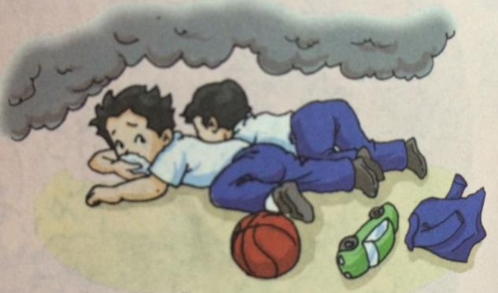
If it is all smoky, cover your mouth and nose and crawl out very fast. Never stop for toys or clothes.
[sməʊki]
[kʌvə(r)] 遮盖
[krɔ:l] 爬行

Slide 15
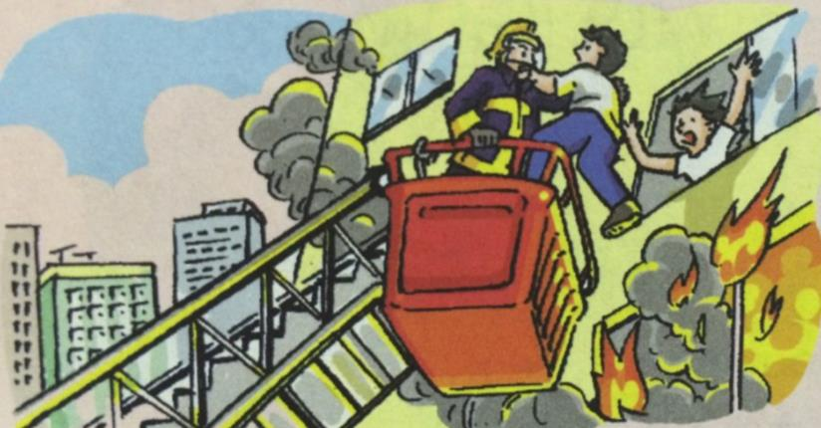
Now you are outside. You know what to do. Listen to the fireman. Here they are to help you!

Slide 16
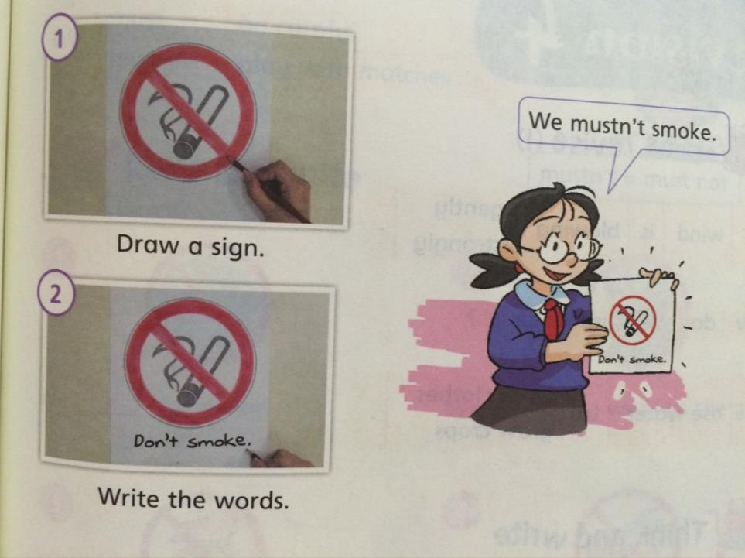

Slide 17
Sounds
th----- [θ]
A thin tiger goes north on the path.
He sees a fat rat.
He opens his mouth and thinks,
“I want to eat the rat!”
[nɔ:θ] 北方;
[pɑ:θ]
小路
[θɪn] 瘦的
[ræt] 大老鼠;
[maʊθ]
[θɪŋk]

Slide 18
Don’t smoke.别吸烟。
Don’t play with matches. 玩火柴。
must 必须
path 小路
north 北部

