Slide 1
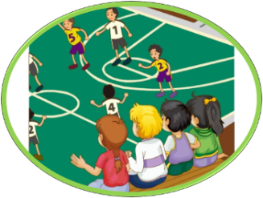
人教精通版五年级下册
Unit 6 We’re watching the games.
WWW.PPT818.COM

Slide 2
>>Warm-up
Let’s chant

Slide 3
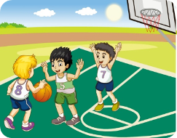
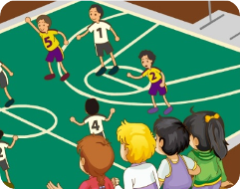
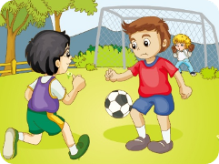
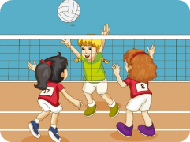
>>Lead-in
Review
They are v-ing.

Slide 4
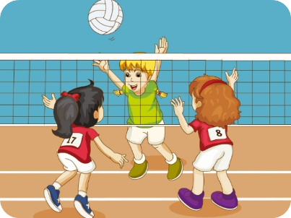
>>Lead-in
Review
---What are they doing?
---They’re_________________.
playing basketball
playing football
playing volleyball

Slide 5
>>Lead-in
Review
---What are you doing?
---________________________.
We are watching the games

Slide 6
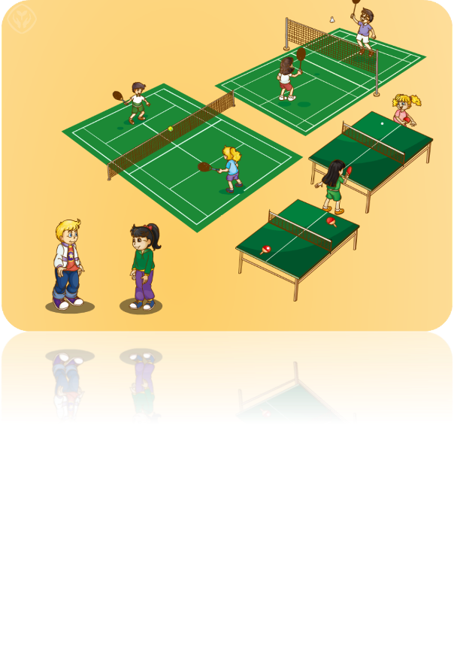
>>Presentation
Just talk
What are they doing?

Slide 7
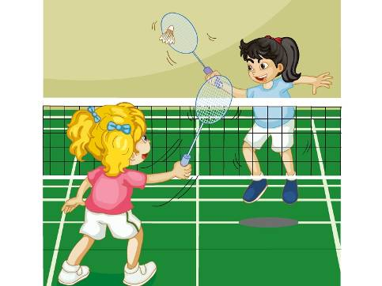
>>Presentation
play badminton

Slide 8
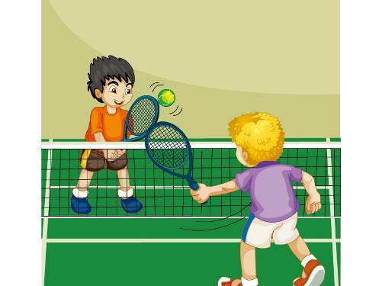
>>Presentation
play tennis

Slide 9
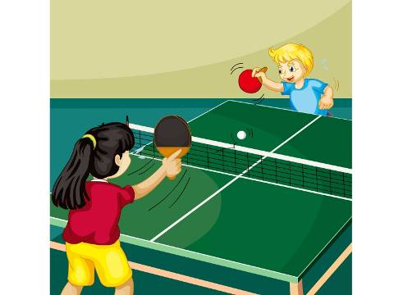
>>Presentation
play ping-pong

Slide 10
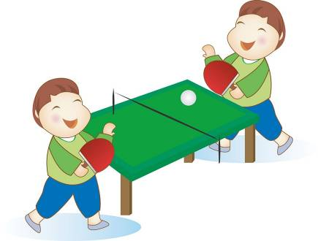
>>Presentation
They’re playing ping-pong.
That’s my favourite sport.
favourite

Slide 11
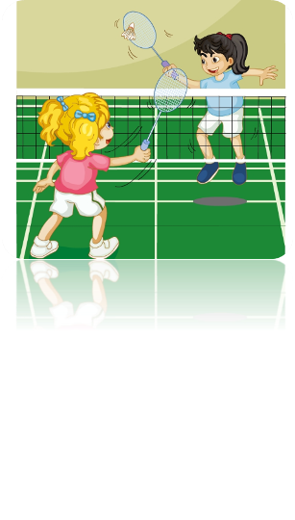
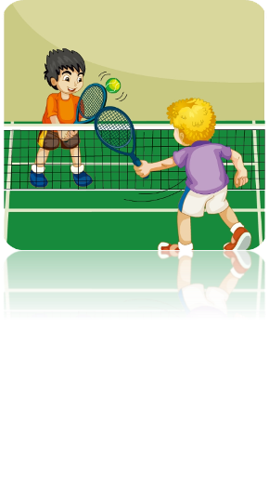
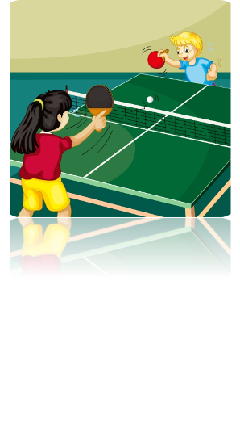
>>Practice
They’re___________________.
playing badminton
playing ping-pong
playing tennis

Slide 12
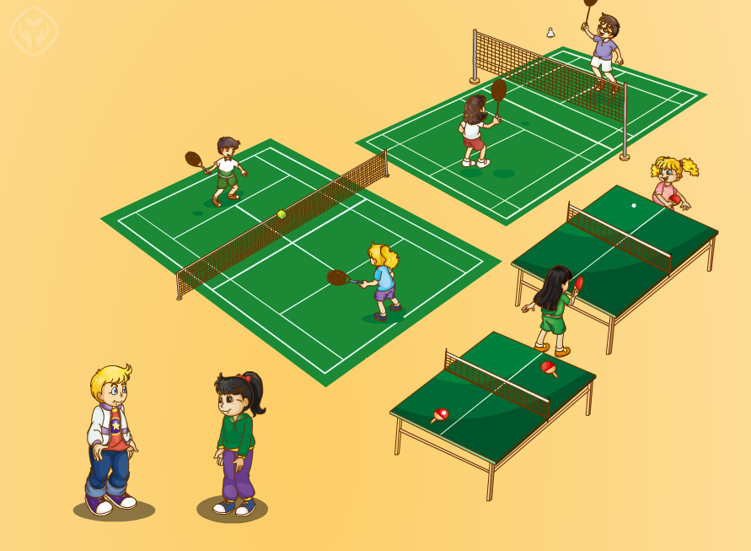
>>Practice
Just talk
1. Mr Zhang and Miss Liu are _________________.
playing badminton
2. Mr Liu and Miss Qi are ______________.
playing tennis
3. Zhou Pei and Kate are __________________.
playing ping-pong
4. Peter’s favourite sport is __________.
ping-pong

Slide 13
>>Practice
分角色朗读

Slide 14
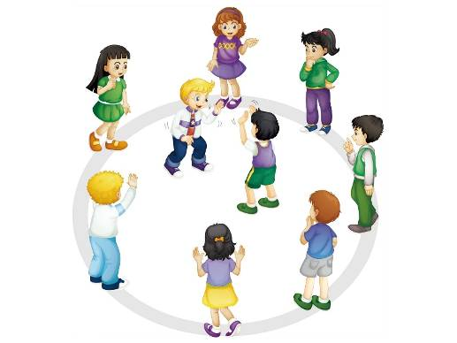
>>Practice
Let’s play
Look! What are
they doing?
They’re…
No, I don’t think so.
They’re...
Right!

Slide 15
>>Summary
重点词汇：
play badminton
play tennis
play ping-pong
favourite
如何询问“他们正在做什么”？
What are they doing?
如何表达“他们正在打羽毛球/网球/乒乓球”？
They are playing badminton/tennis/ping-pong.

Slide 16
>>Homework
1. 观看课文动画，按照正确的语音、语调朗读课文。
2. 我们总共学了几个运动类词组？请你列个单子吧！
3. 预习Lesson34。
close

