Slide 1
Unit 7 Numbers
How Many Colours
WWW.PPT818.COM

Slide 2
Numbers
New Words

Slide 3
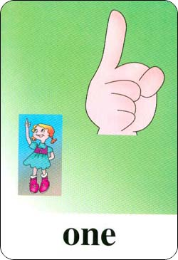
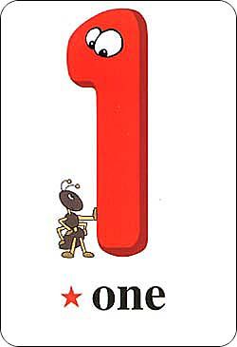
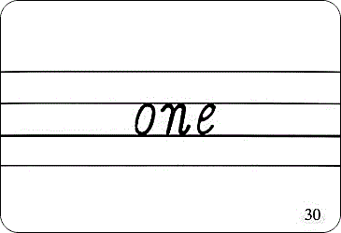

Slide 4
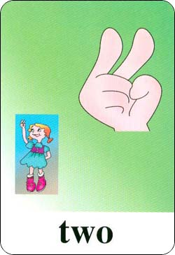
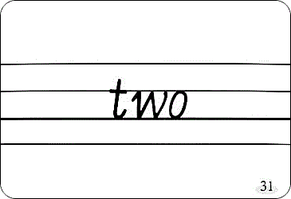

Slide 5
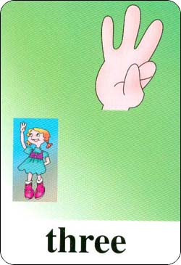
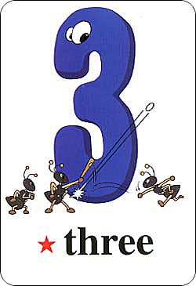
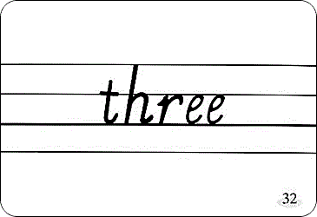

Slide 6
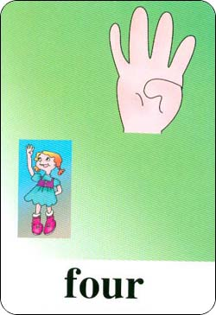
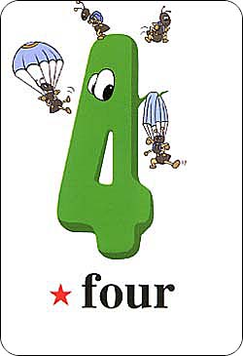
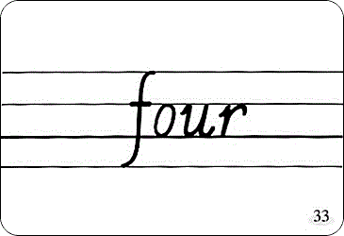

Slide 7
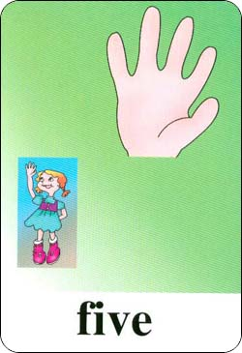
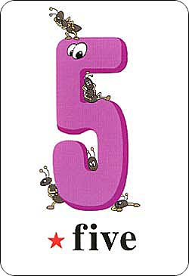
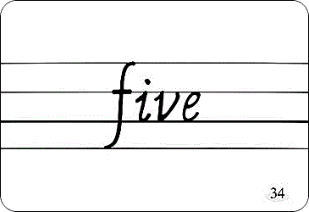

Slide 8
Count together:
one, two, three, four, five …

Slide 9
询问数字的时候，我们这样提问：
How many…?
回答：
数字

Slide 10
How many colors?
One.

Slide 11
How many colors?
Two.

Slide 12
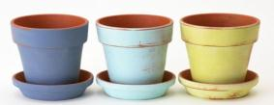
How many colors?
Three.

Slide 13
How many colors?
Four.

Slide 14
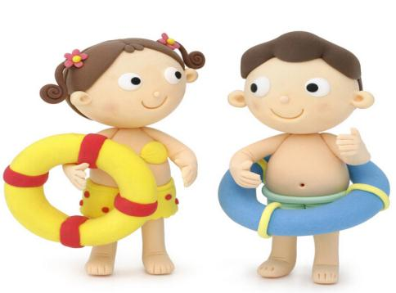
Five.
How many colors?

Slide 15
Let’s learn letters!
Ww
Vv
Uu

Slide 16
Homework
1.Copy the words and sentences.
one two three four
How many colors?
2.Make a mini dialogue.

Slide 17
Thank you.

