Slide 1
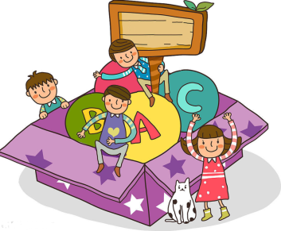
Toys
第三课时
WWW.PPT818.COM

Slide 2
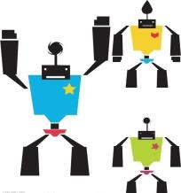
Ask and answer
What do you like?
I like … They are …

Slide 3
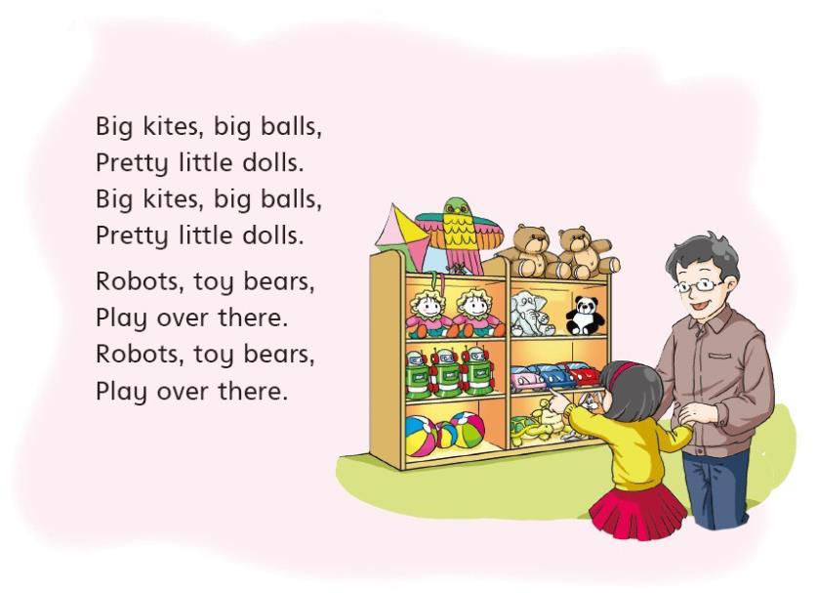

Slide 4
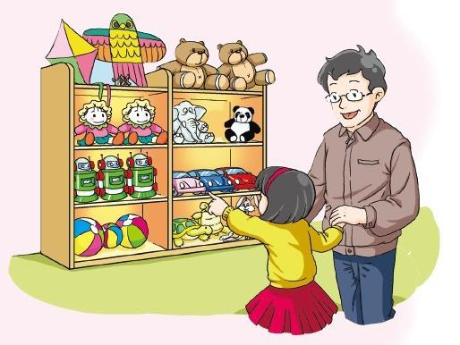
Think and say
What can you see in a toy shop?

Slide 5
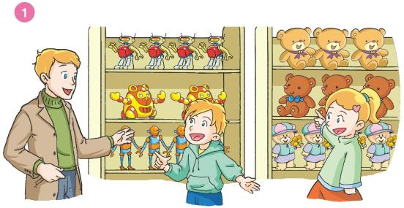
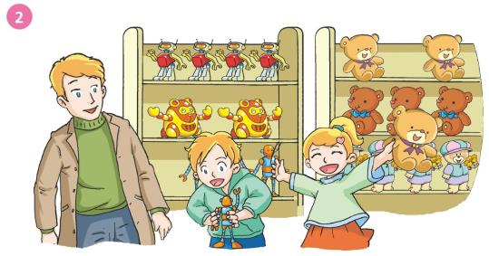

Slide 6
Read and choose
Where are they?
A. At a fruit shop. B. At a toy shop.
2. Sally likes _______.
A. toy bears. B. robots
3. Peter likes _______.
A. toy bears. B. robots

Slide 7
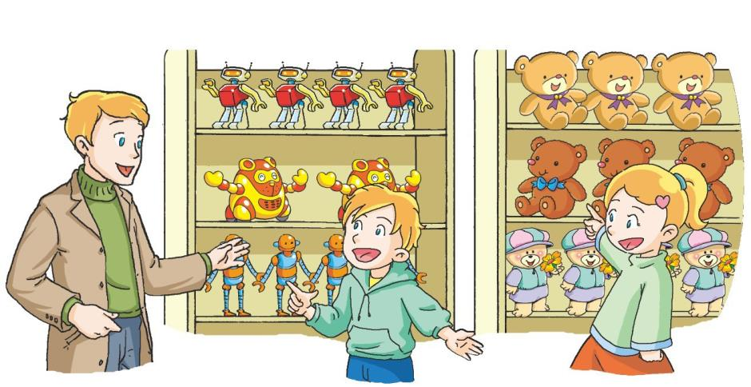
What do you like, Peter?
I like robots.
What do you
like, Sally?
I like toy bears.

Slide 8
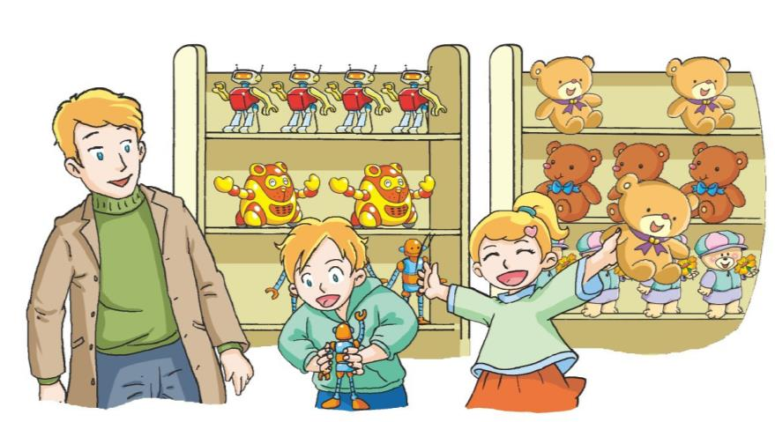
I like this robot.
It’s cool.
I like this toy bear.
It’s lovely.

Slide 9
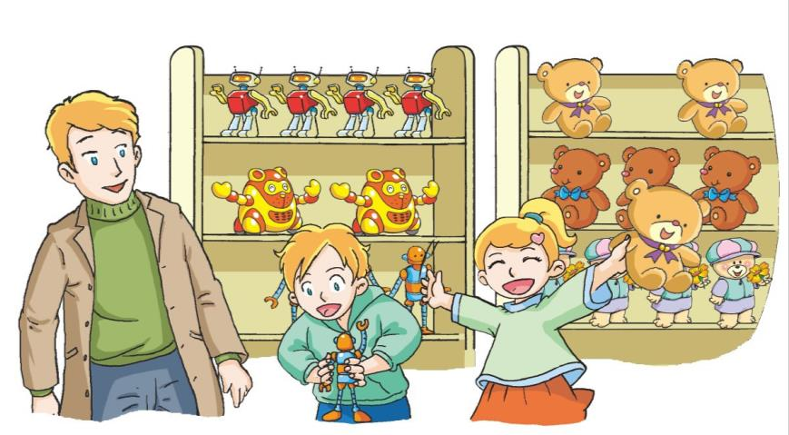
Act it out

Slide 10
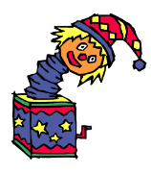
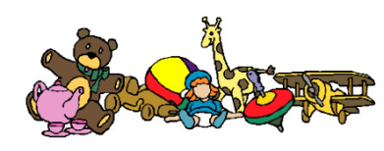
Look and say
A visit to a toy shop

Slide 11
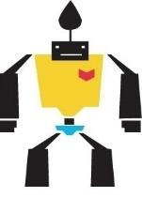
Look and read
I like robots.
I like this robot.
I like this blue robot.

Slide 12
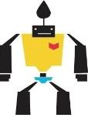
Choose and say
A toy shop

Slide 13
Choose and say
A toy shop
What do you like?
Which one do you like?
I like …
I like this …

Slide 14
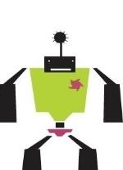
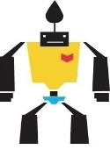
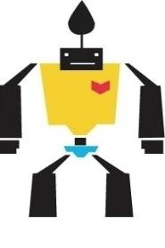
Say and read
A toy shop
What do you like?
I like robots.
Which one?
I like this yellow one.
It is lovely.
Here you are.
Thank you.

Slide 15
Look and say
Shopping list 1
Shopping list 2
Shopping list 3

Slide 16
Look and say
Shopping list 3
Shopping list 1
this green robot.
this orange kite.
this big ball.
this blue doll.
this red ball.
this big toy bear.
I like
I like
Shopping list 2
this pink doll.
this blue kite.
this small toy bear.
I like

Slide 17
Choose and say
A Toy Shop
What do you like ?
I like ...
Which one?
I like this … It is ...
Here you are.
Thank you.

Slide 18
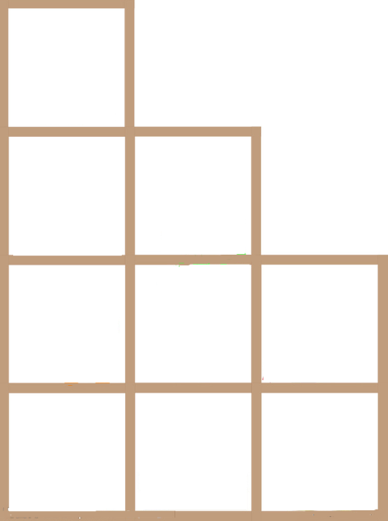
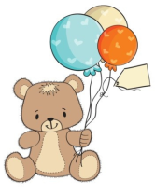
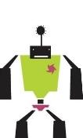
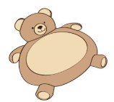
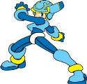
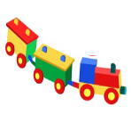
Look and say
5 yuan
10 yuan
15 yuan

Slide 19
Read and say
Shop assistant: Good morning. Can I help you?
What do you like?
Customer: I like ...
Shop assistant: Which one?
Customer: I like this … It is ... How much?
Shop assistant: … yuan.
Customer: Here you are.
Shop assistant: Thank you.

Slide 20
Look and say
5 yuan
10 yuan
15 yuan

Slide 21
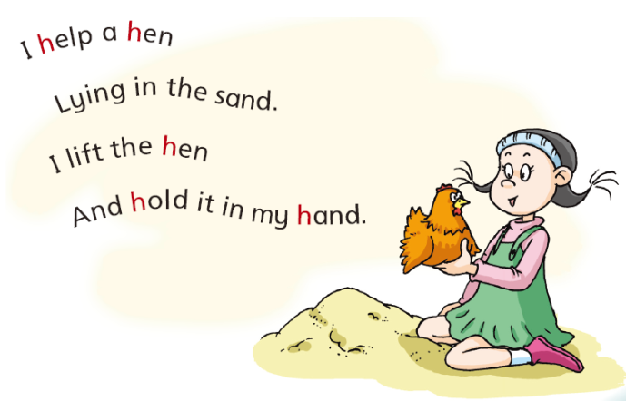
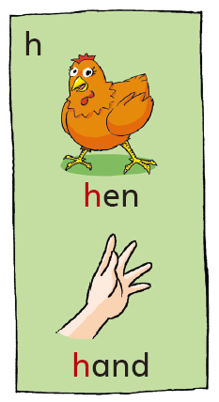

Slide 22
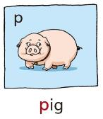
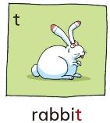
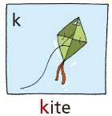
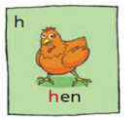
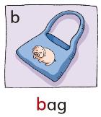
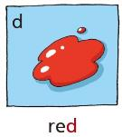
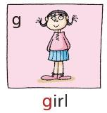
Listen and circle
pat bat 2. tip dip
Kate gate 4. pod pot
lake late 6. goat boat
7. hip hid 8. pop hop

Slide 23
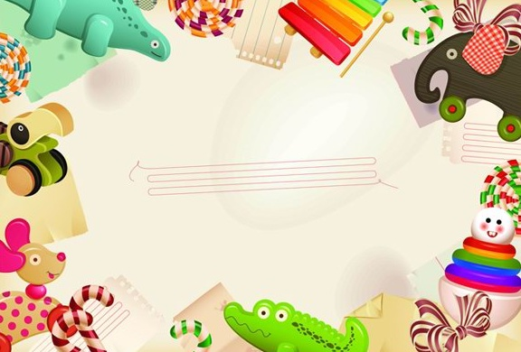
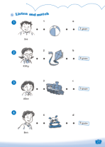
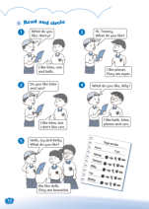
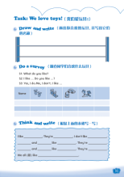
Homework
1 Read and act Listen and say.
2 Complete Workbook pages 27, 30 and 31.

