Slide 1
Unit 7
May I have some grapes?
WWW.PPT818.COM

Slide 2
let's sing

Slide 3
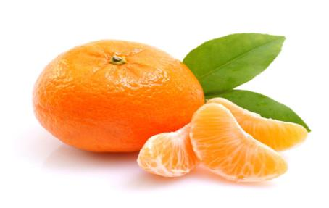
orange
an orange

Slide 4
purple
some
grapes

Slide 5
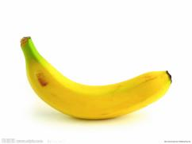
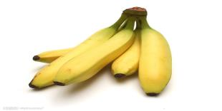
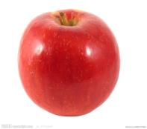
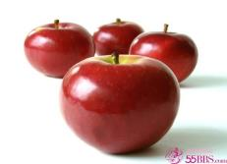
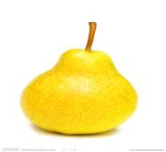
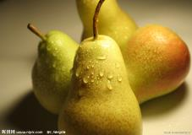
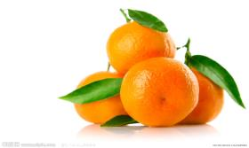
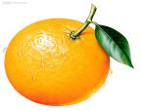
a banana
some bananas
an apple
some apples
a pear
some pears
some grapes
an orange
some oranges

Slide 6
A: I want a/an/some …
Do we have …?
B: No, we don’t.
But we have…
A:l like ….
May I have some…?
B: Yes. Here you are.
A: Thank you.

Slide 7
Let’s chant.
Yellow bananas,yellow bananas.
Do we have yellow bananas?
No, we don’t.No, we don’t.
Pear,where,pear,where?
It’s on the chair.
Apple green,apple red.
I want green apple,you want red.
Purple grapes,purple grapes.
May I have some purple grapes?
Yes,here you are.Here you are.

Slide 8
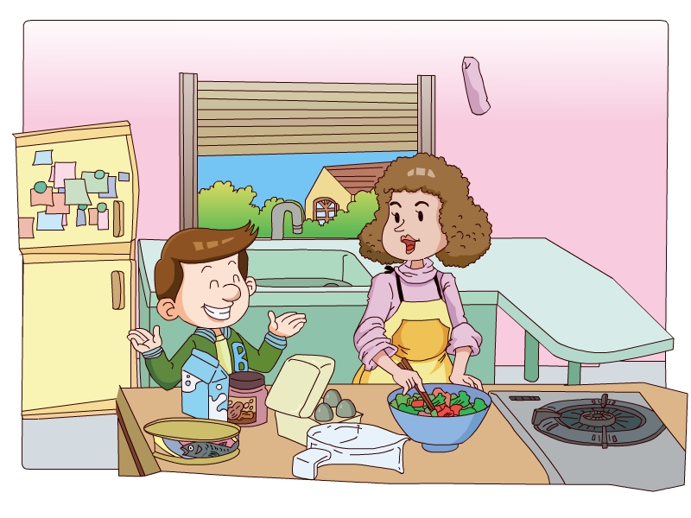
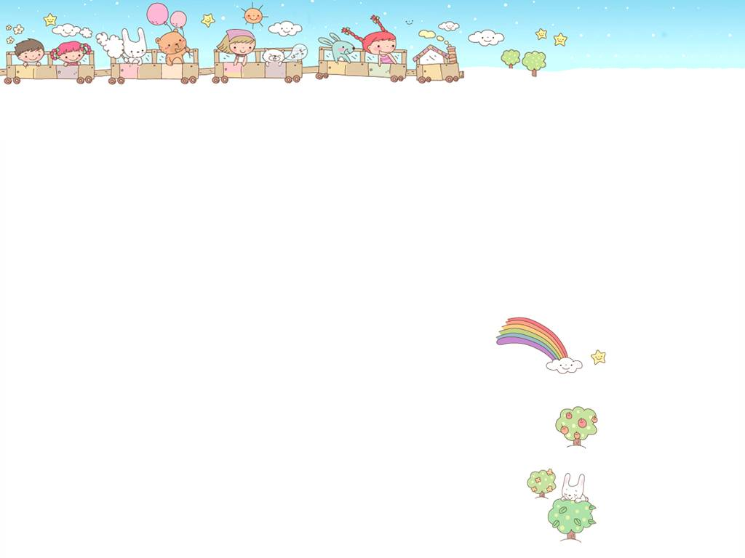
Who is the lady?
Who is the boy?

Slide 9
请你帮Ben回答问题：
1.Do we have bananas?
2. But we have…
3. May I have some grapes?
No, we don’t .
Some grapes.
Yes.Here you are.

Slide 10
根据课文内容，把下列对话补充完整.
a
A: I want ____ banana,mum.
___we have bananas?
B: ____, we don’t.But we have ____grapes.
A: I like grapes.____I have ____grapes,then?
B: Yes. _____ you are.
A: Thank you.
Do
No
some
May
some
Here

Slide 11
Homework:
1.听读Unit 7.
2.分角色表演课文。
3.用英语跟你的同学或家人说出本课的单词。

