Slide 1
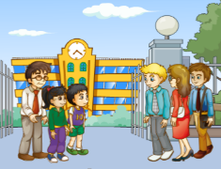
Unit1 Welcome to our school!
人教精通版五年级下册
Lesson 1
WWW.PPT818.COM

Slide 2
>>Warm-up
Sing a Song
（单击图片可播放动画）

Slide 3
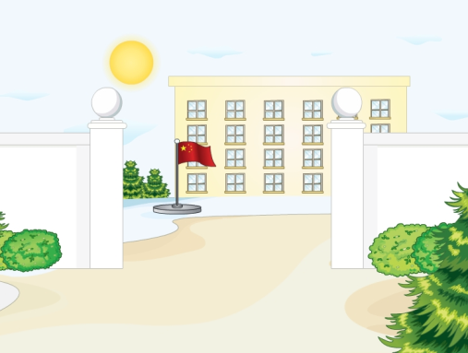
>>Lead-in
Guessing game
What place is it?
It’s a place.
We can see teachers and classmates there.
We often have classes, play games, and do many interesting activities there.

Slide 4
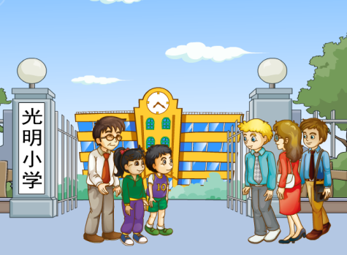
>>Presentation
Look and say
What place is it? Who are they?
headmaster
visitors
guides
（单击图片可播放动画）

Slide 5
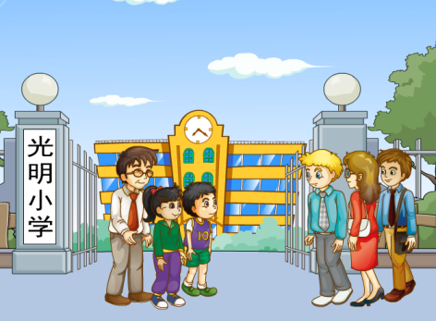
>>Presentation
Look and say
Welcome to our school!
Welcome
Welcome

Slide 6
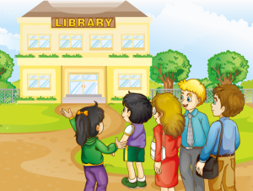
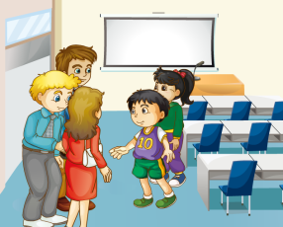
>>Presentation
Look and say
Li Yan and Gao Wei will show the visitors around their school.
Li Yan and Gao Wei will show the visitors around their school.
library
meeting room
show around

Slide 7
>>Presentation
Look and say
What places are they visiting?
They’re visiting the library.
Do you often come to the
library?
Yes, we do.
Do you often run in the library?
No, we don’t.

Slide 8
>>Presentation
Look and say
What places are they visiting?
They’re visiting the meeting room.
Do you often have meetings in the meeting room?
Yes, we do.
Do you often eat in the meeting room?
No, we don’t.

Slide 9
>>Presentation
Listen and say
Do they often come to the library?
Yes, they do. They often borrow books from it.
Yes, they do. They often borrow books from it.
Do they often have meetings in the meeting room?
Yes, they do. We often have a meeting in it.
Yes, they do. We often have a meeting in it.

Slide 10
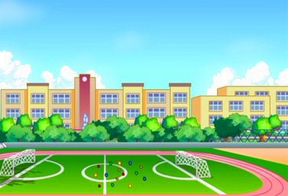
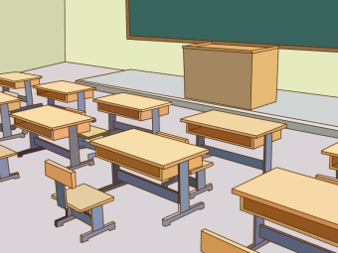
>>Practice
Ask and answer
Do you often … on/in the …?
Yes … / No …

Slide 11
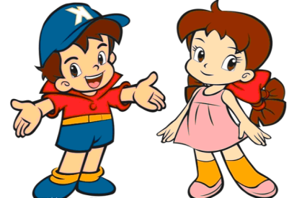
>>Practice
Role play
四人一组练习Just read and talk部分对话，随后表演出来吧！

Slide 12
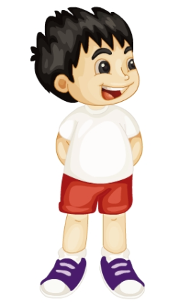
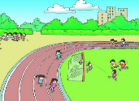
>>Practice
活动1
猜谜游戏
Is it big or small?
Do you often come to this place?
Do you often… here?
Is it our …?

Slide 13
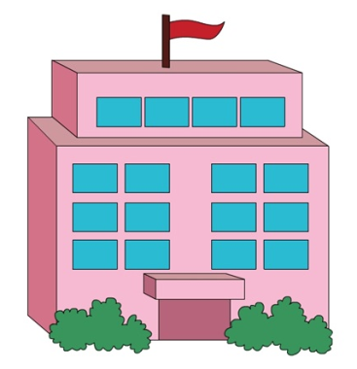
>>Practice
活动2
我是小导游
Hello! Welcome to our
School! Look! This is…

Slide 14
>>Summary
1.本课的重点词汇有哪些？
show around
library
meeting room
borrow books
have a meeting
2.本课的重点句型是什么？
Welcome to our school.
Do you often …?
Yes, we do. / No, we don’t.

Slide 15
>>Homework
1.观看课文动画，按照正确的语音、语调朗读课文对话。 2.运用句型“Welcome to… / This is… / Do you often…?和朋友相互介绍自己的学校，并写出你们之间的对话,不少于6句话。
3.预习 Lesson 2。

