Slide 1
Travelling Around
Section Ⅱ Reading and Thinking(1)
WWW.PPT818.COM

Slide 2
1.Discussing
(1)If you have a good chance to go travelling，where would you like to go? How will you go travelling?
①____________________________________________________
②___________________________________________________
Beidaihe，the West Lake, the Great Wall, Paris, London and so on.
We can travel by plane, by bus, by train, on foot, by bike, by ship and so on.

Slide 3
(2)What’s the meaning of travelling?
①____________________________________________________
②____________________________________________________
③____________________________________________________
④____________________________________________________
It can broaden our view.
We can experience different cultures and life.
We can enjoy the beautiful scenery.
We can relax ourselves and forget our sorrow for a while.

Slide 4
2.Predicting—Look at the pictures and the titles of the passage on Page 26 & Page 27 and predict what type of the passage is.
____________________________________________________
The practical writing(应用文).

Slide 5
1.First reading—Match the main idea with each paragraph.
Para.1 A.The four-day Machu Picchu Tour
Para.2 B.The four-day Lake Titicaca Tour
Para.3 C.Encourage people to travel to Peru
Para.4 D.The four-day Cusco Tour
Para.5 E.A brief introduction about Amazon Rainforest Tour
Para.6 F.How to get more brochures about other package tours around Peru
答案 Para.1 E Para.2 A Para.3 D Para.4 B Para.5 C Para.6 F

Slide 6
2.Second reading—Choose the best answer according to the text.
(1)What is the author’s intention of writing the text?
A.To recommend four tourist attractions of Peru.
B.To tell people to travel as often as possible.
C.To encourage people to do outdoor activities.
D.To help people learn more about Peru.
(2)If you are interested in biology，where would you like to travel?
A.Amazon Rainforest. B.Machu Picchu.
C.Cusco. D.Lake Titicaca.

Slide 7
(3)The word “fit” in Machu Picchu Tour probably means “________”.
A.a short period of time when someone stops being conscious
B.the way that something is suitable for a particular person，space etc.
C.a very strong emotion that you cannot control
D.to have enough space for people or things
(4)Which of the following is NOT true about Cusco Tour according to the text?
A.Cusco was the capital of the Inca Empire from the 13th until the 16th century.
B.At Cusco you will enjoy the unique American and local Indian culture.
C.You can pay a visit to the museums there.
D.It will take you four days to travel there.

Slide 8
(5)Where does this text probably come from?
A.An agricultural magazine. B.A medical journey.
C.An engineering textbook. D.A tourist brochure.
答案 (1)A (2)A (3)B (4)B (5)D

Slide 9
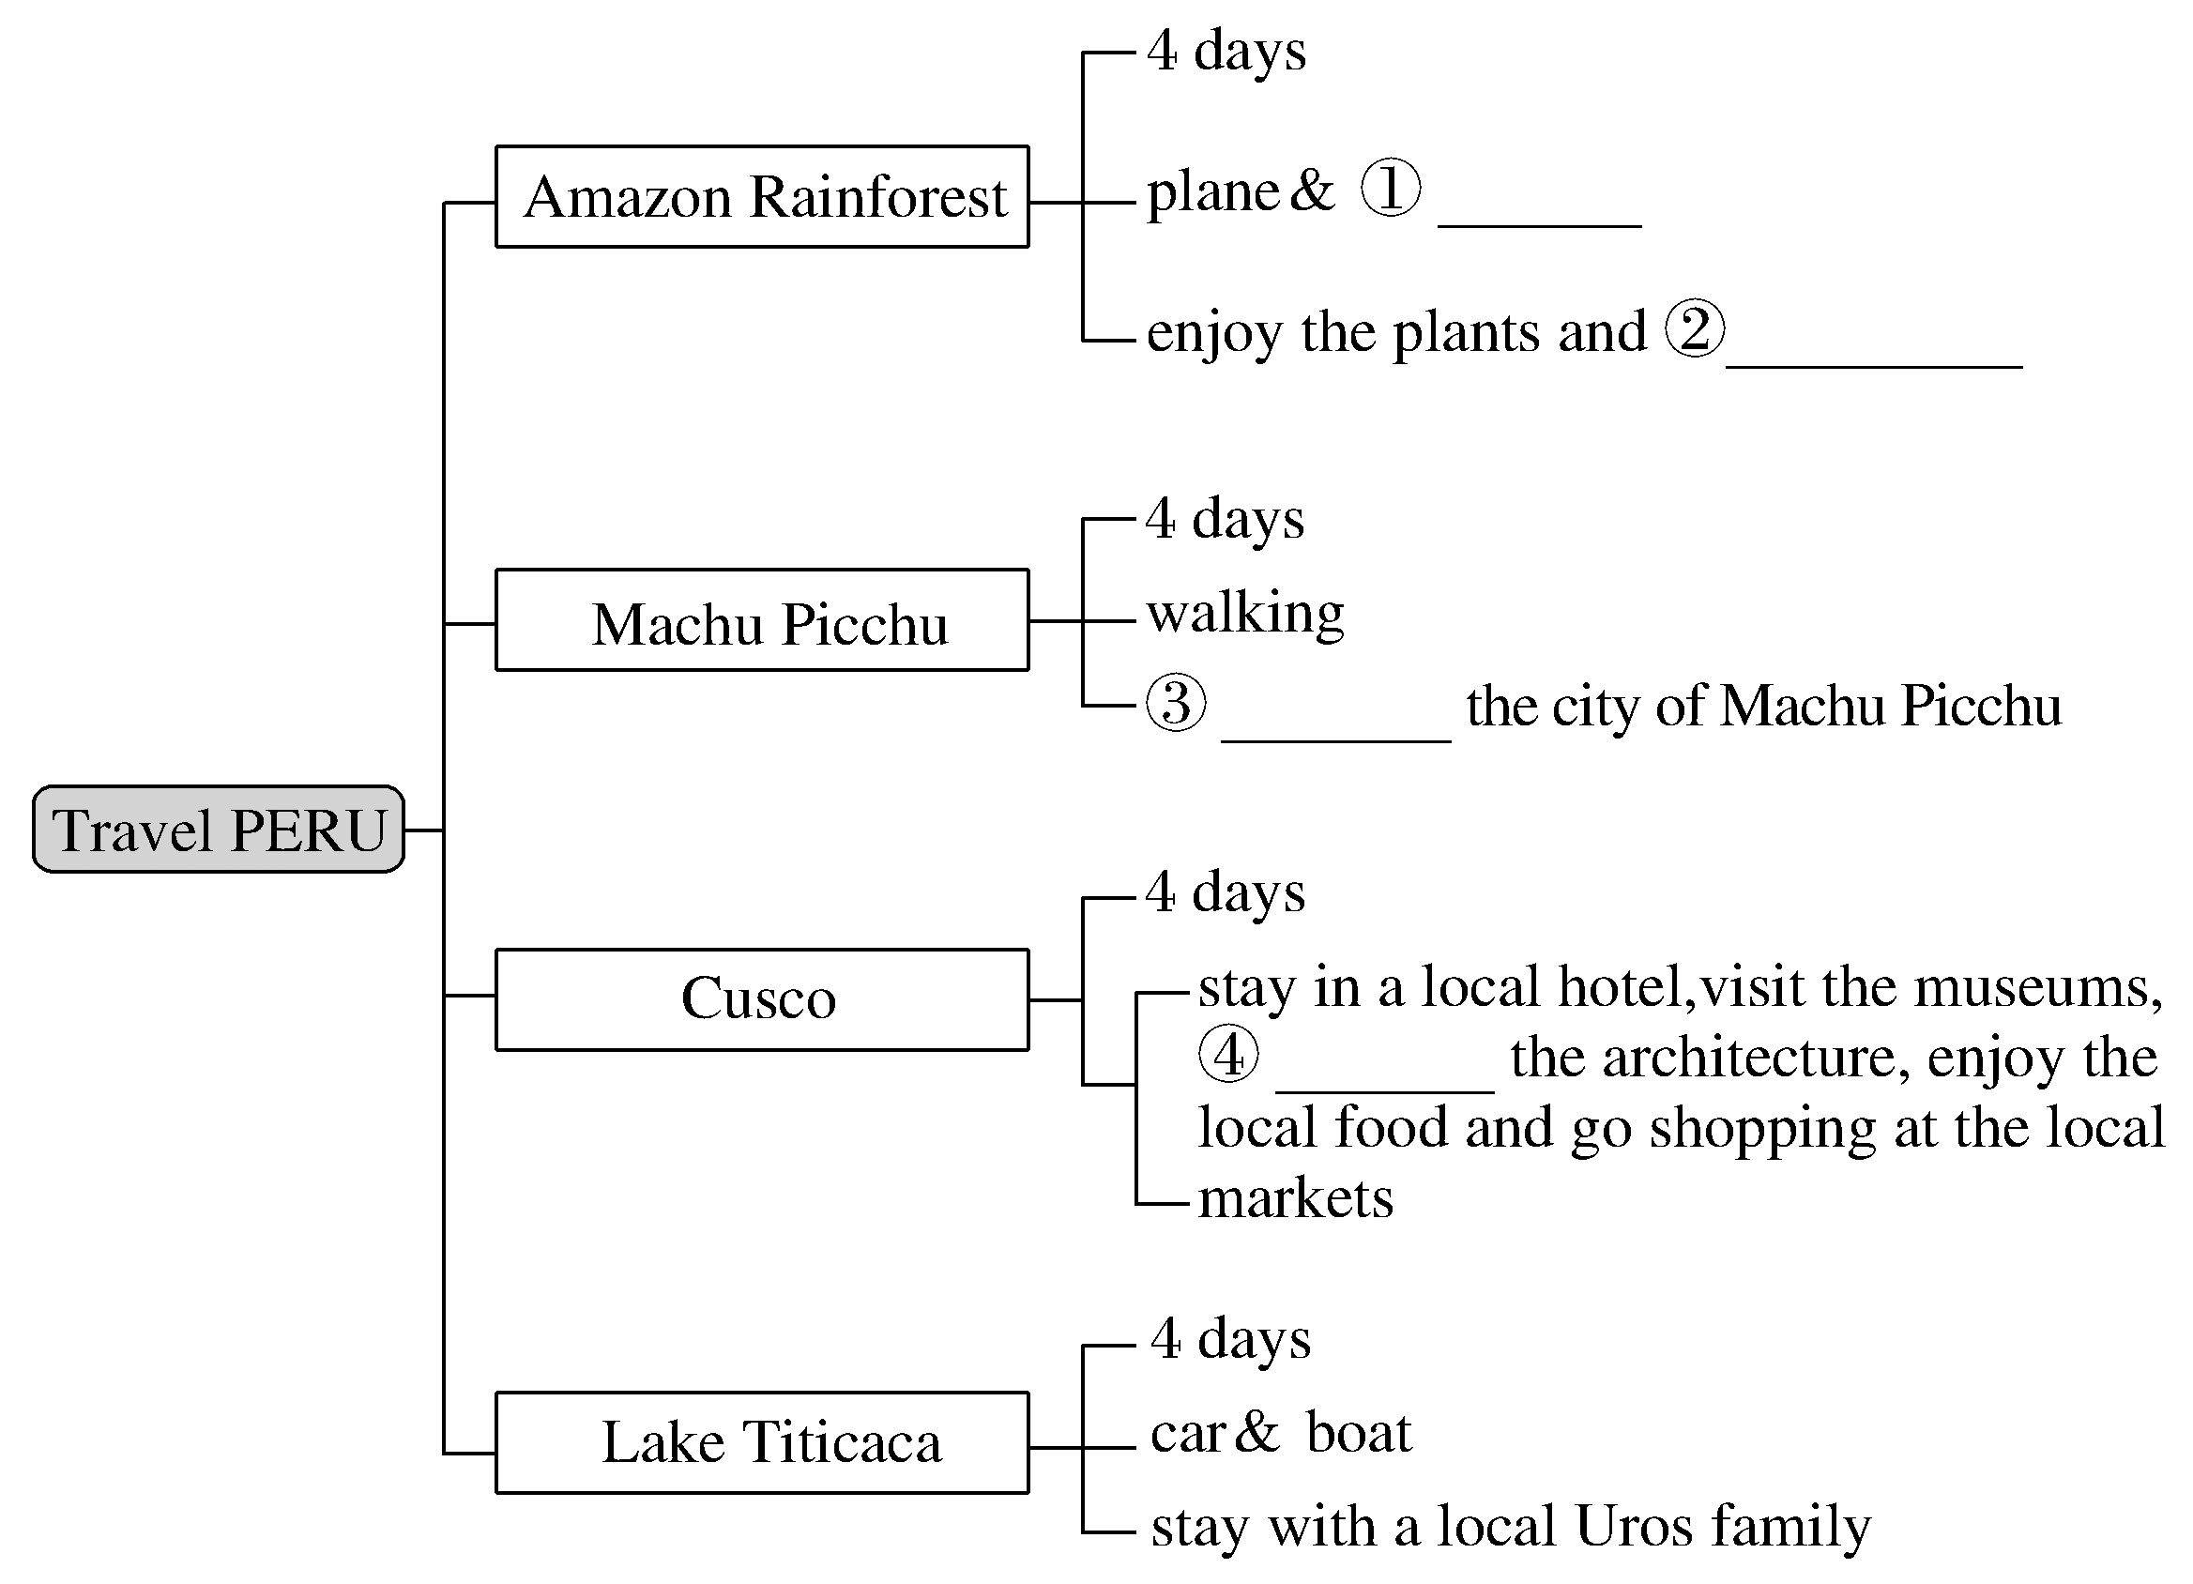
3.Third reading—Fill in the blanks according to the text.
boat
animals
explore
admire

Slide 10
1.If you are interested in culture，where would you like to travel? Why?
________________________________________________________________________
2.Which culture would you prefer？The Indian culture or the Chinese culture? Why?
_____________________________________________________
____________________________________________________
Cusco.Because at Cusco I can enjoy the unique Spanish and local Indian culture.
I prefer the Chinese culture.China is one of four major ancient civilized countries.It has a long history and broad culture，which has a profound effect on the world.

Slide 11
阅读技巧点拨
如何辨别文章的类型？
1.Look through titles and headings.
2.Don’t forget to look at pictures and charts.
3.Sometimes there is some other information that might tell you what type of text it is.

Slide 12
语言现象感知
Ⅰ.单词理解
体会句中加黑单词的词性和含义
1.Peru is a country on the Pacific coast of South America with three main areas：narrow，dry，flat land running along the coast，the Andes Mountains，and the Amazon rainforest.__________________
2.It is for this reason that Spanish is the main official language of Peru.____________
v.(使)朝某方向延伸
adj.官方的

Slide 13
Ⅱ.词块积累
写出下列词块的含义
1.on the Pacific coast_______________
2.in the 16th century____________
3.for this reason____________
4.package tour____________
5.in the middle of the forest____________
6.reach one’s destination____________
7.go shopping____________
在太平洋海岸上
在16世纪
因为这个原因
包价旅游
在森林中央
到达目的地
去购物

Slide 14
Ⅲ.句式欣赏
1.You can then spend three days exploring the rainforest with a local guide and enjoying the plants and animals unique to the rainforest.
分析：动名词短语exploring the rainforest和enjoying the plants and animals作宾语，构成spend time (in) doing sth结构。
2.Especially amazing is the Incas’ dry stone method of building.
分析：此处为倒装句，主语为the Incas’ dry stone method of building。
3.Enjoy the beautiful countryside as you spend a day driving along the new highway connecting Cusco to Lake Titicaca.
分析：as引导时间状语从句， connecting Cusco to Lake Titicaca为现在分词短语作后置定语。

