Slide 1
陕旅版英语五年级上册
Unit4 At Table
第3课时
WWW.PPT818.COM

Slide 2
教学目标：
1. 能正确使用句型Would you please pass me the …? Would you give me some...? 并能用Here you are. Of course.等对请求句做出相应的回答。
2. 能用之前学过的句型I want to ...来表达自己的想法，并寻求他人的帮助。
3. 能在教师的组织和带领下，完成Part C中的Read and tick部分及Look, write and talk部分的习作，通过这些练习对所学的知识进行有效的巩固。

Slide 3
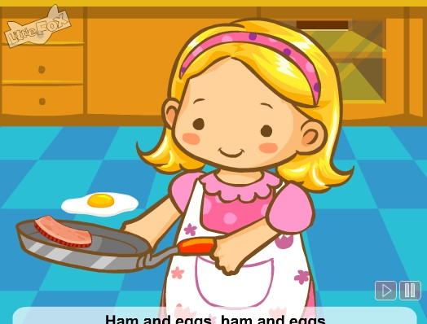
Let’s sing- Ham and eggs

Slide 4
Review
How to use the knife and fork?
How to use the chopsticks?

Slide 5
New class
听课文录音，回答下列问题：
Question 1: What are they doing?
Question 2: Who wants to have some soup?
Question 3: Who wants to cut the beef?
Question 4: Who would like some noodles?

Slide 6
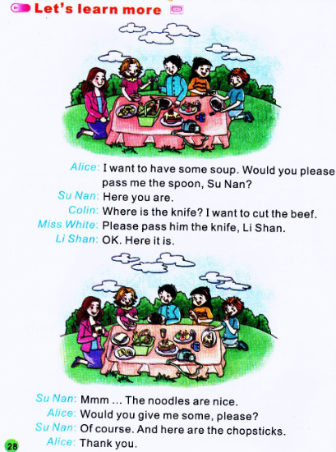

Slide 7
Answers：
Question 1: What are they doing?
Question 2: Who wants to have some soup?
Question 3: Who wants to cut the beef?
Question 4: Who would like some noodles?

Slide 8
Summary-请求与应答
---Would you please pass me the…?
---Here you are.
---Would you give me some…?
---Of course.

Slide 9
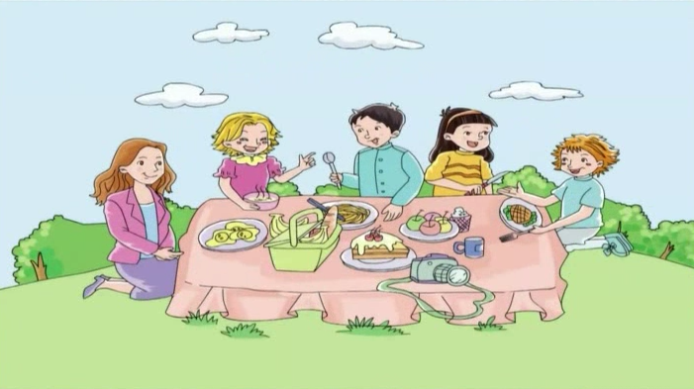
观看课文动画并跟读

Slide 10
Role play
同学们五人一组，分角色扮演课文中的人物。
同学们表演的时候要注意语音语调哦！

Slide 11
抽纸条比赛
全班同学分为两队，依次派一名同学抽取盒子里的纸条，如果读的正确，将为所在组得一分，读错不扣分。

Slide 12
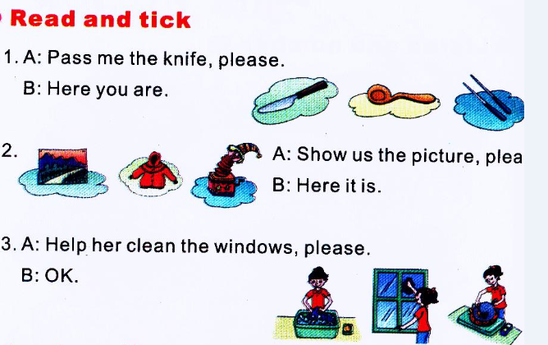

Slide 13
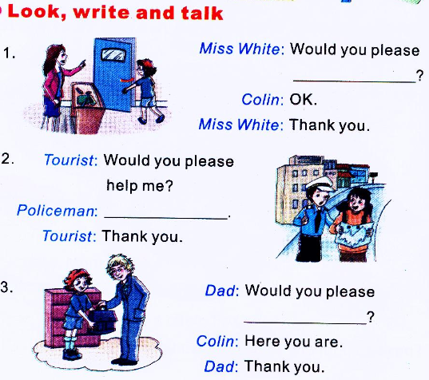
close the door
Of course
pass me the bag

