Slide 1
Unit1 Let’s go to school.
人教精通版三年级下册
Lesson 1
WWW.PPT818.COM

Slide 2
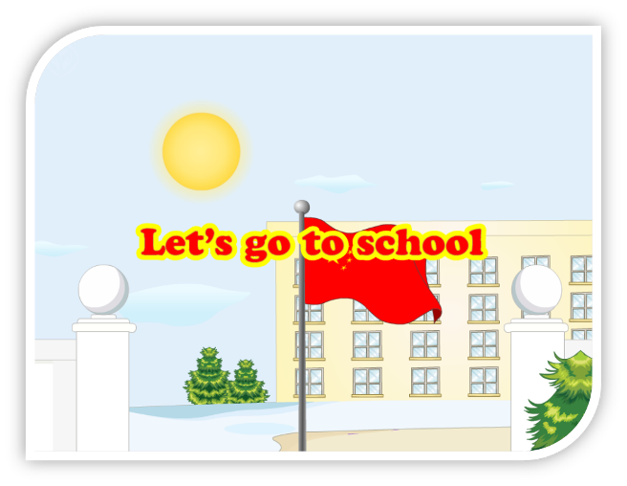
Let’s sing
Warm-up
（单击图片可播放动画）

Slide 3
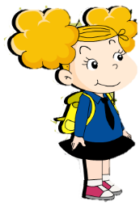
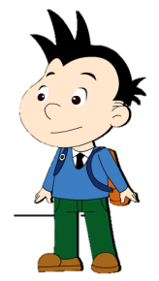
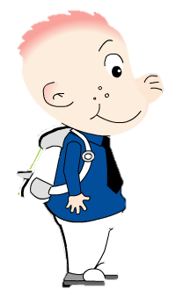
Lead-in
Free talk
新学期开始了，同学们会用英语相互问候吗？

Slide 4
Presentation
Hello, Dave!
Nice to meet you!
Nice to meet you, too!
Hello, Sam!

Slide 5
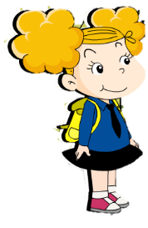
Presentation
How are you?
Hi, Lily!
Hi, Amy!
Fine, Thank you!

Slide 6
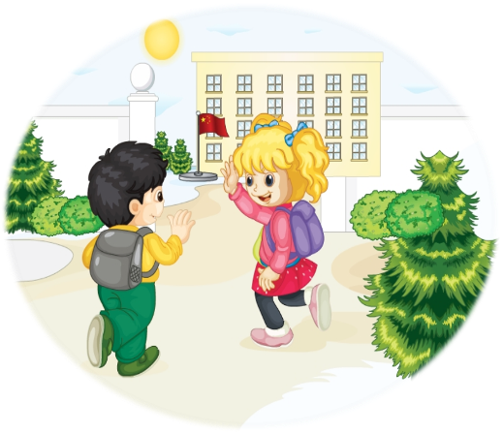
Presentation
猜一猜这是什么地方？他们说了什么？

Slide 7
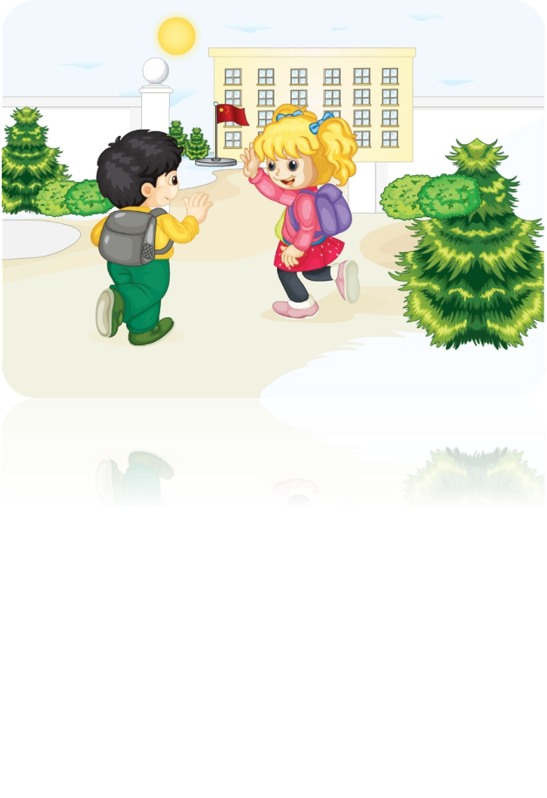
Let’s talk
Presentation
（单击图片可播放动画）

Slide 8
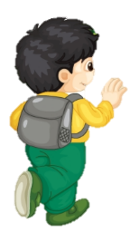
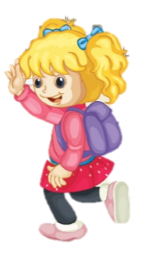
Let’s talk
Presentation
Hello, Gao Wei! Glad
to see you again.
Hello, Kate! Nice to
see you again.

Slide 9
Let’s talk
Presentation
Let’s go to school.
Ok. Let’s go!

Slide 10
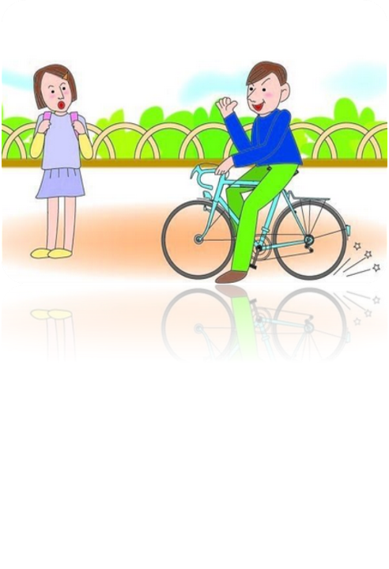
Presentation
老朋友在上学路上相遇，他们会说…
Nice to see you again.
Nice to see you again.

Slide 11
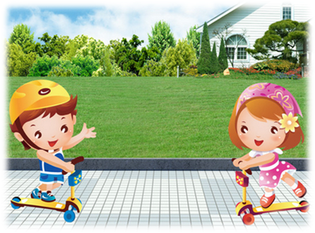
Presentation
老朋友玩耍时相遇，他们会说…
Nice to see you again.
Nice to see you again.

Slide 12
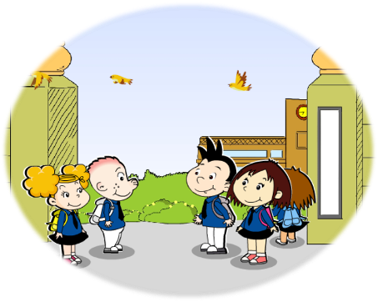
Presentation
同学们在校门口相遇，他们会说…
Hi! Let’s go to school.
OK, let’s go to school.

Slide 13
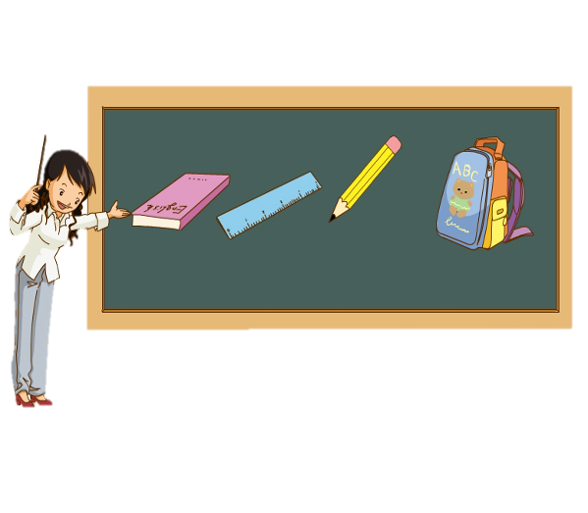
Presentation
老师在讲课时，会对同学们说…
Hi! Let’s look at the blackboard.

Slide 14
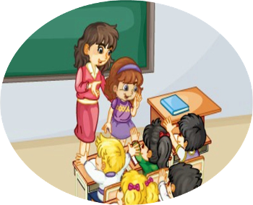
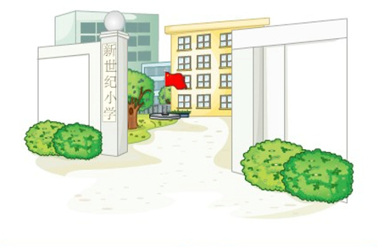
Presentation
Let’s learn
classroom
school
/u:/

Slide 15
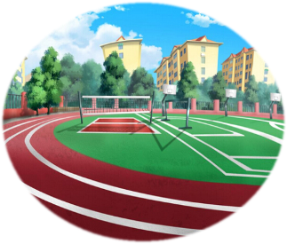
Practice
活动1
看图抢答单词

Slide 16
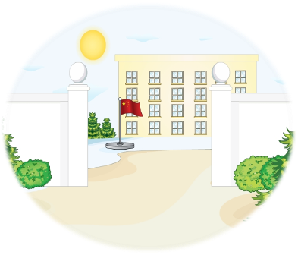
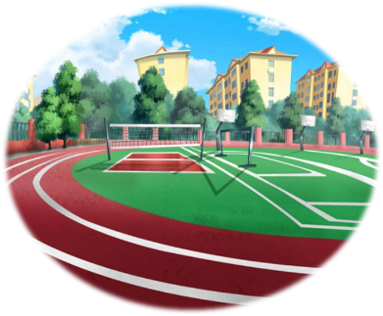
Practice
你会用Let’s…造句吗？
Let’s go to school.
Let’s go to classroom.
Let’s go to playground.

Slide 17
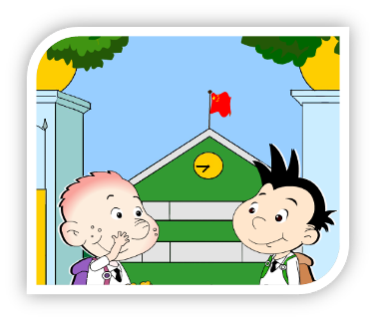
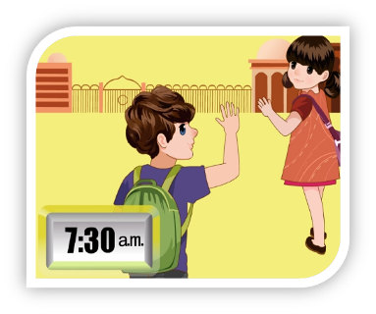
Practice
活动2
根据图片的场景两人一组编对话。

Slide 18
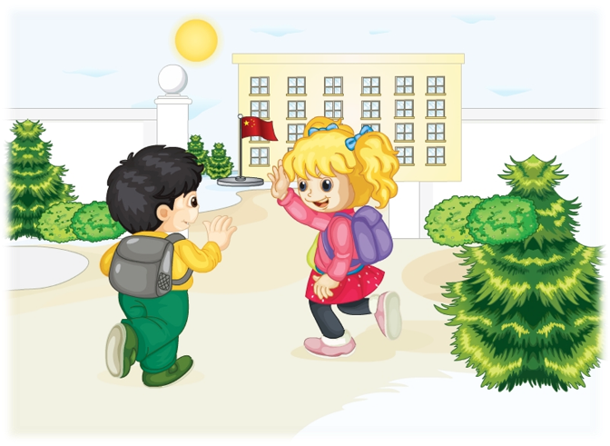
Consolidation
看图复述对话
Hello, Kate! Nice to
see you again.
Hello, Gao Wei! Glad
to see you again.
Let’s go to school.
Ok. Let’s go!

Slide 19
Summary
1. 老朋友重逢时，我们怎样和对方打
招呼呢？
Nice/Glad to see you again.
2. 在表达一起做某事的时候，我们
会说什么？
Let’s ...

Slide 20
Homework
1. 把本节课所学歌曲Let’s go to school. 唱给家人听。
2. 试用Nice/ Glad to see you again. 问候你身边好久不见的朋友。
Close

