Slide 1
Unit 7 Know Our World
Body Language
WWW.PPT818.COM

Slide 2
Learning Targets
Key words & phrases:
greet, European, kiss, cheek, nod, thumbs-up, polite, lip, rude, Italian, shake hands, refer to, communicate with sb.
Key sentences:
1. In China and abroad, people sometimes communicate without speaking.
2. But body language is not the same in all cultures.
3. In China and some other countries, friends shake

Slide 3
hands to greet each other.
4. In some European countries, people kiss each other on both cheeks.
5. In India, when people nod their heads, they mean “no”.
6. In Australia, however, it is not polite.
7. Culture refers to the beliefs, way of life, art and customs that are shared and accepted by people in a particular society.

Slide 4
Warming up
What is body language?
Body language is gestures (姿势；手势) or body movements (肢体动作) and facial expressions (面部表情) that show other people what we are thinking or feeling.

Slide 5
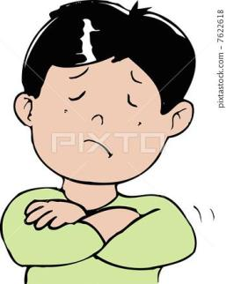
Let’s read body language from the
perspective of psychology.
refuse or self-protection

Slide 6
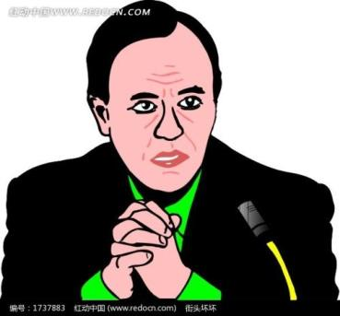
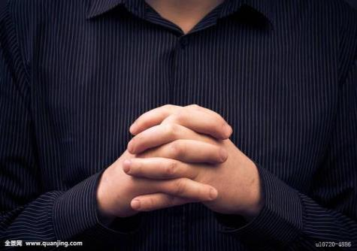
pay attention to

Slide 7
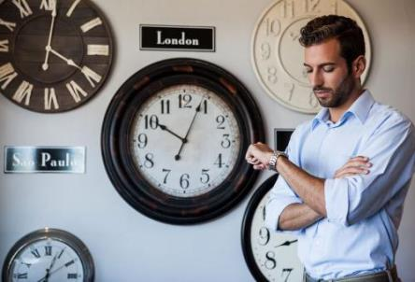
helpless
maybe anxious
or hurried

Slide 8
Play and Guess
One acts using body language, and the other guesses whether he or she is lying by observing his or her body language and words.

Slide 9
Words and expressions
greet
European
kiss
cheek
nod
thumbs-up
polite
v. 欢迎；迎接
n. 欧洲人 adj. 欧洲（人）的
v. & n. 吻
n. 脸颊；脸蛋
v. 点头
n. 翘拇指
adj. 有礼貌的

Slide 10
lip
rude
Italian
shake hands
refer to
communicate with sb.
n. 嘴唇
adj. 粗鲁的；粗野的
n. 意大利人；意大利语 adj. 意大利（人）的
握手
涉及；指的是；参考；提到
与某人交流

Slide 11
THINK ABOUT IT
What do you know about body language?
Do you use body language？When and where?

Slide 12
Presentation
Listen and read
In China and abroad, people sometimes communicate without speaking. How do they do this? They use body language. But body language is not the same in all cultures.
In China and some other countries, friends shake hands to greet each other. They may be new friends or old, but they shake hands to show friendship and trust. In some European countries, people kiss each other on both cheeks. It’s another way to show friendship and love.

Slide 13
In India, when people nod their heads, they mean “no”. And when people shake their heads, they mean “yes”. But in most other countries, these things mean the opposite.
A thumbs­up means “okay” or “well done” in most cultures. In Australia, however, it is not polite. In Japan, it means “five”, and in Germany, it means “one”.

Slide 14
In most places, people point to things with their fingers. But in some places, people point with their lips. They think it’s rude to point with a finger.
When Italians wave goodbye, it may look like “Come here!” to Americans. But the American goodbye wave looks like “no” in many parts of Europe and South America.
One body language is the same all around the world: a smile. Try it, and you’ll see!

Slide 15
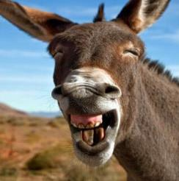
Culture Tip
Culture refers to the beliefs, way of life, art and customs that are shared and accepted by people in a particular society. The world has many different cultures. We should learn and respect different cultures.

Slide 16
Let’s Do It!
Read the lesson and write true (T) or
false (F)．
1
1. In some European countries, people like to kiss each other to show friendship and love. ( )
2. Nodding your head means “yes” and shaking your head means “no” everywhere in the world. ( )
3. A thumbs­up means “well done” in Germany.
( )
4. When Americans wave goodbye, it looks like “no” in some European countries. ( )
T
F
F
T

Slide 17
2
Read the lesson again and complete the table.
Gestures | Meanings | Countries
shake hands | greeting, friendship and trust | _________________
__________ | friendship and love | in some European countries
nod one’s head | yes | in most places
 | __________ | in India
shake one’s head | yes | ______________
 | no | in most places
thumbs-up | okay and well done | in many countries
 | not polite | __________
 | five | in Japan
 | one | __________
in China and some other countries
kiss
no
in most places
in Australia
in Germany

Slide 18
Fill in the blanks with the words in this lesson. The first letter is given.
3
1. His mother k________ him goodbye every morning when she leaves for work.
2. A: What do you do when you meet new friends？
B: I say hello and s________ hands with them.
3. If you agree, please n________ your head.
4. Italy is a E________ country. It has a long history.
5. It’s p________ to say “thank you” when someone helps you.
isses
hake
od
uropean
olite

Slide 19
Different cultures have different body language. Work in groups. One student acts out a kind of body language while the others guess the meaning.
4

Slide 20
Language points
1. In China and abroad, people sometimes communicate without speaking.
(1)辨析 sometimes、some times、sometime与
some time
①sometimes adv. 有时
例: Every man is a fool sometimes, but none at all times.每个人有时都会犯傻，但没有谁会一直都傻。

Slide 21
②some times 几次。此时time作可数名词，意为“次数”。 several times也可以表示 “几次”。
例: I am sure that we have met some times before.
我肯定我们之前见过几次了。
③sometime adv. 某个时候。它可指过去或将来的某个时候。
例: We'll take our holiday sometime in August.
我们会在八月找个时间度假。(将来)

Slide 22
I bought this sometime last summer.
这是我在去年夏天某个时候买的。(过去)
④some time 一段时间。它常与for连用。
例: We plan to stay in Hainan for some time.
我们打算在海南待上一段时间。
(2) communicate 交流；沟通（不及物动词）
常用短语：
communicate with sb. 与某人交流
communicate in 用……语言交流

Slide 23
例: Mary can communicate with strangers very well. 玛丽能和陌生人交流得很好。
They communicate in slogan.
他们用口号交流。
2. But body language is not the same in all cultures.
该句是一个不完全否定的句子。
“not the same in all cultures” 译为“并非在所有的

Slide 24
文化中都是一样的”，而不能翻译成 “在所有的文化中都是不一样的”。
例: Not all students are here today.
今天并非所有的学生都到了。
3. In China and some other countries, friends shake hands to greet each other.
shake hands 握手。
【拓展】shake hands with sb.和某人握手。

Slide 25
例: Shaking hands is very common in China.
在中国握手很常见。
注意：握手的动作要两只手才能进行，所以hand一定要用复数。
4. In some European countries, people kiss each other on both cheeks.
kiss v．亲吻
常用搭配：kiss sb. on＋身体部位, 类似的动词还有hit等。

Slide 26
例: The children like kissing their mothers on the cheeks.孩子们喜欢亲吻妈妈的脸颊。
5. In India, when people nod their heads, they mean “no”.
nod v．点头
它多用于表示同意或打招呼等。
它用作及物动词时，可接名词或代词作宾语，也可接双宾语；

Slide 27
它作不及物动词时，其后常接介词to或at，也可接动词不定式作目的状语。
例: He nodded his head sympathetically.
他同情地点点头。
She nodded when she passed me in the street. 她在街上走过我身旁时向我点了点头。
6. In Australia, however, it is not polite.
(1)however adv. 然而

Slide 28
however多位于句中，有时也放在句首或句尾，但都应紧跟在进行对比的词、短语或句子之后，其后用逗号将其与后面的句子隔开。
例: His first response was to say no. Later, however, he changed his mind.
他最初的反应是不同意。可是后来他改变了主意。
(2)polite adj. 有礼貌的。其反义词为impolite，意思是“没有礼貌的”。

Slide 29
例: Being polite in public is necessary.
在公共场所有礼貌是很有必要的。
7. Culture refers to the beliefs, way of life, art and customs that are shared and accepted by people in a particular society.
refer to 涉及；指的是；参考；提到。

Slide 30
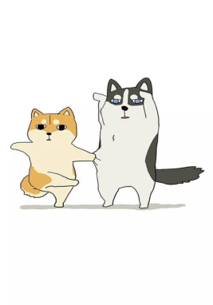
例: The latter meaning may refer to Hawaii’s volcanoes.
后一则意思也许是指夏威夷的火山。
His letter didn’t refer to you.
他的信中没有提到你。
Can't you refer to the dictionary？
你就不能查查字典吗？

Slide 31
Exercises
一、根据汉语意思完成句子，每空一词。
1. 在中国，初次见面的人互相握手是有礼貌的。
It's polite to ________ ________ ________ each other when people meet for the first time in China.
2. 年轻的妈妈亲吻了儿子的面颊然后去上班了。
The young mother ______ her son ________ the cheek and went to work.
3. 在学校我们应该对老师有礼貌。
We should be ______ to our teachers at school.
shake hands with
kissed
on
polite

Slide 32
二、用方框中所给单词或短语的正确形式完成句子
polite; nod; European; shake hands; culture
1. The lady __________ with my mother just now.
2. In the distance, my teacher is _________ her head to show her agreement.
3. ___________like eating beef.
4. There are many different __________ around the world.
5. After getting the prize, the girl said “Thank you!”, _________ with smile.
shook hands
nodding
Europeans
cultures
politely

Slide 33
三、连词成句
speak, languages, in, what, people, Asia, do
______________________________________?
2. England, is, the, London, city, of, capital
______________________________________.
3. world’s, the, continent, is, Asia, largest
______________________________________.
What languages do people speak in Asia
London is the capital city of England
Asia is the world’s largest continent

Slide 34
Summary
1. Learn some new words and expressions.
2. Get to know the importance of body language, and understand how to communicate with people properly by using body language.

Slide 35
Homework
1. Recite the words and phrases in this lesson.
2. Introduce other body languages
3. Preview next lesson

